Slide 1

Usefulness of 64 –detector-row scanner peripheral angiography in patients with skeletal tumors of lower extremities
Bozinovska B., Veljanovska L., Atanasov Z.,
Dimova.A . Zafirovski . G , Mitrev Z
Special Hospital for surgical diseases
“Filip II”Skopje - Macedonia
May 2009

Slide 2
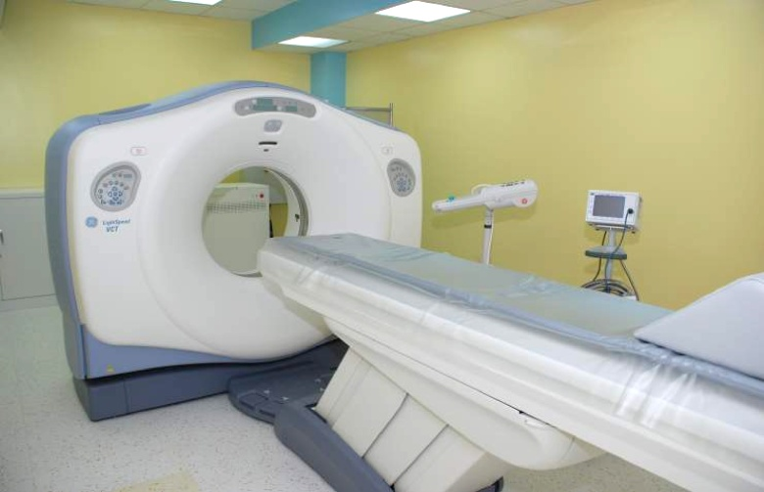
Technical principals of CT scanning
-multiple detector array
simultaneously obtains
tomography data at different
slice locations.
- detailed analysis of anatomy and pathology.
-capability of rapidly scanning
large longitudinal volume of
patient (torax-abdomen-both legs 20 sec.)

Slide 3
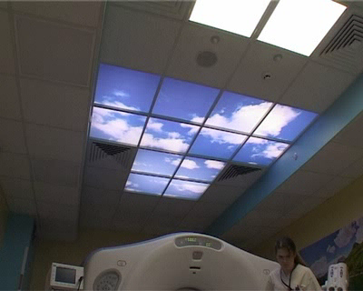
CT Angiography
3D Imaging and analysis of adjacent structures (bones, muscles) and blood vessels
Use of Ultravist 370 100mm with automatic injector . Scanning time 28 s.

Slide 4
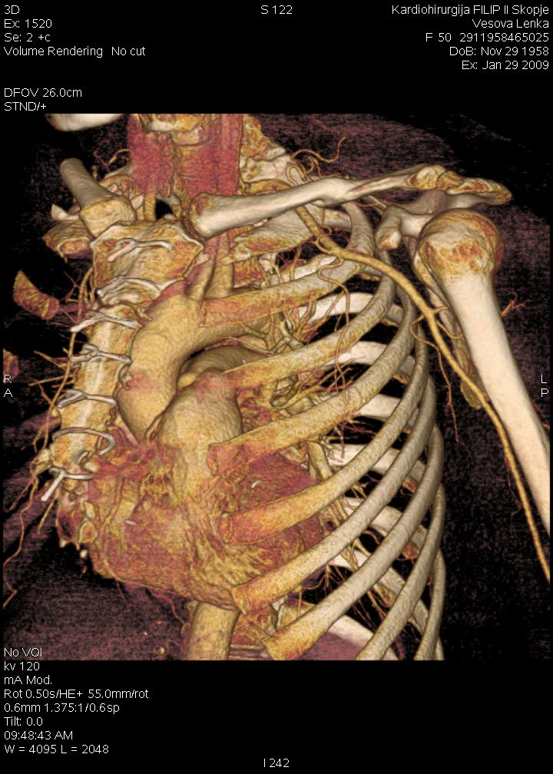
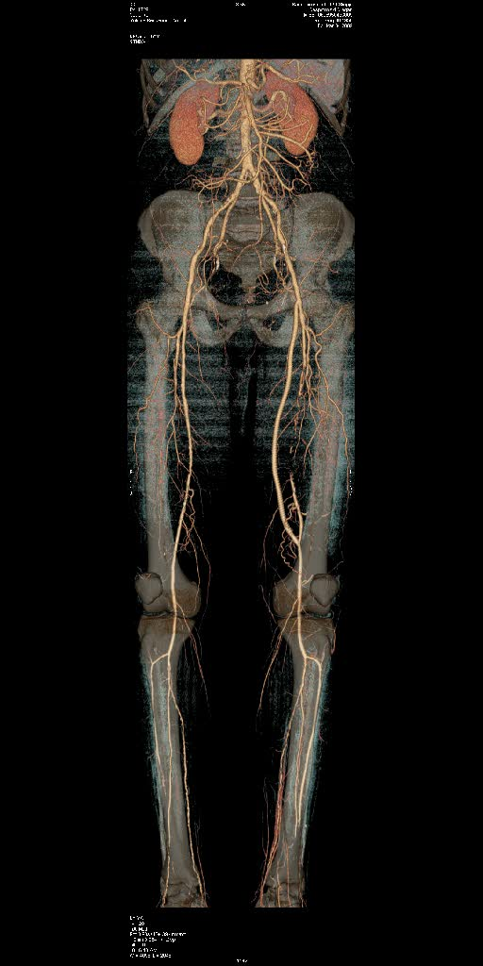
64 CT ANGIOGRAPHY
Non invasive procedure, comfortable for the patient
Great spatial and temporal resolution, slice thickness - 0,625 mm (provide excellent details that allow identification of vascular anomalies and different pathological entities)
3D post-processing
Method of choice for emergency cases
(dissection,trauma)

Slide 5
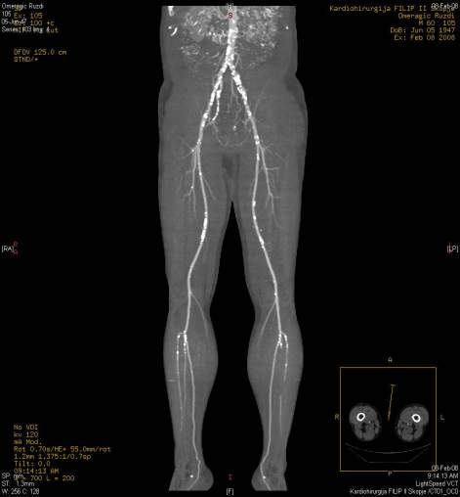
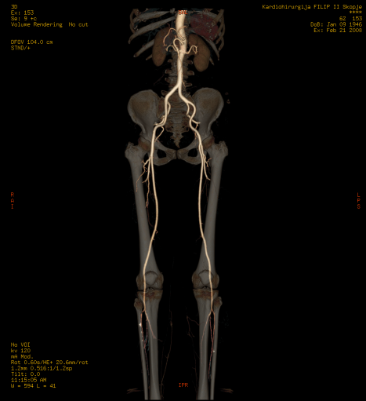
CT ANGIOGRAPHY- INDICATIONS
Vascular anomalies
Trauma-rupture, stenosis, occlusion
Pathological vascularisation of the tumors
Aneurysmatic disease and dissection of the aorta
Aneurysmatical disease of intracranial vessels
Planning - interventions, stenting or vascular surgery
Post-interventional follow up (grafts, stents)

Slide 6
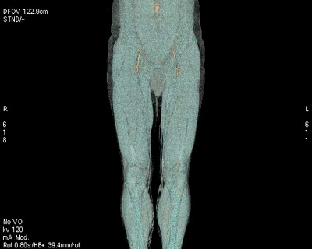
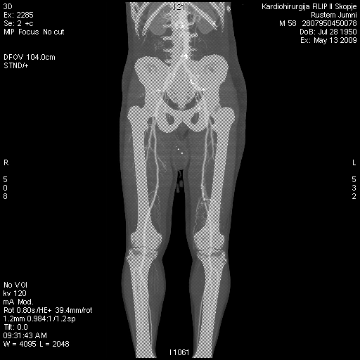
CT Angiography
64 detector-row scanners has brought major advantages in bone and joint imaging emphasizing its efficiency due to fast scanning and presentation of blood vessels and bone structures in assessment of skeletal malignant tumors.

Slide 7
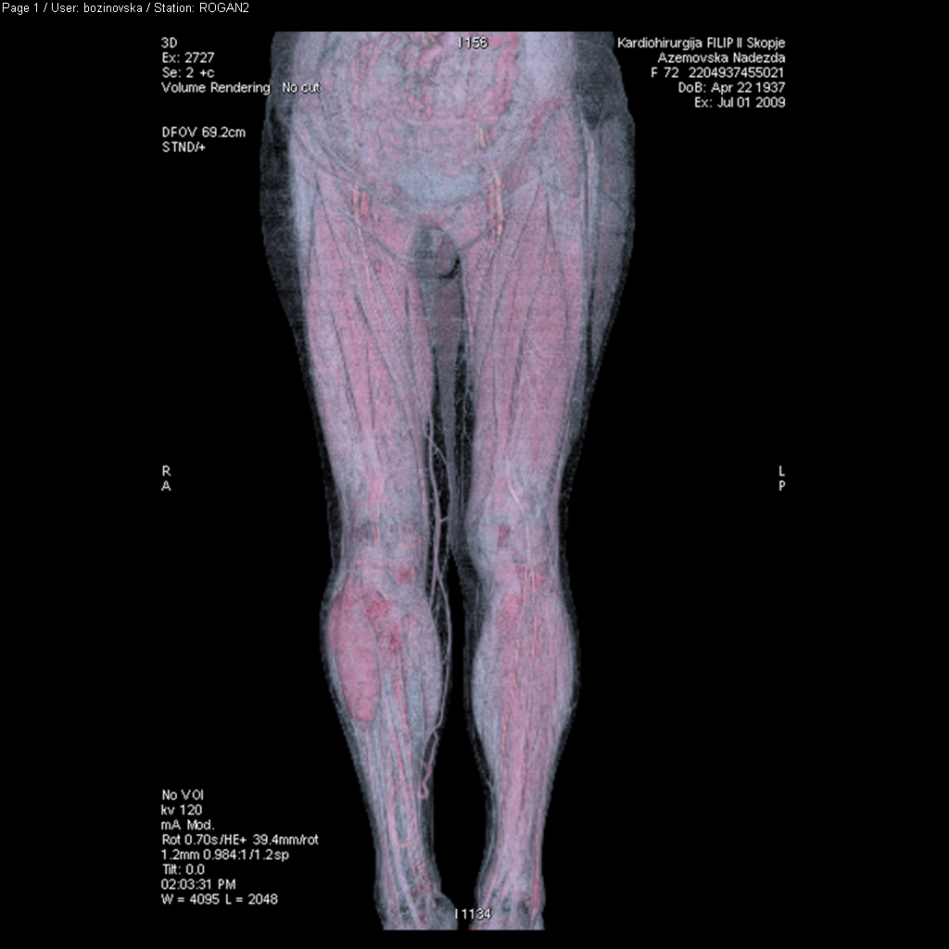
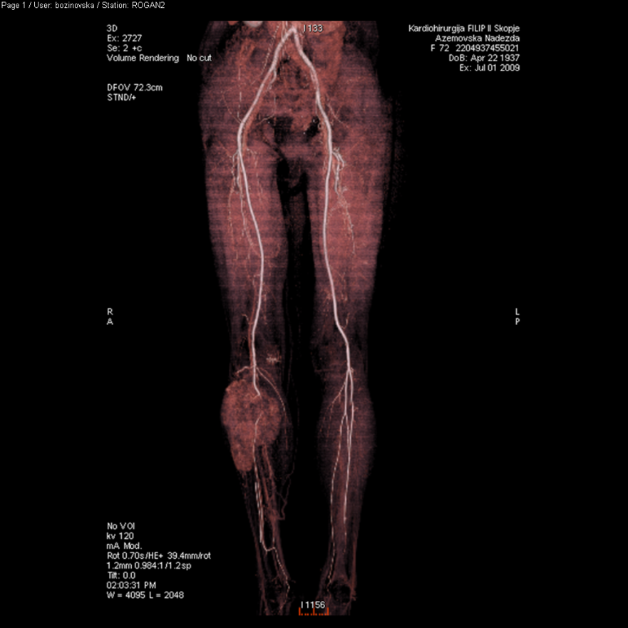
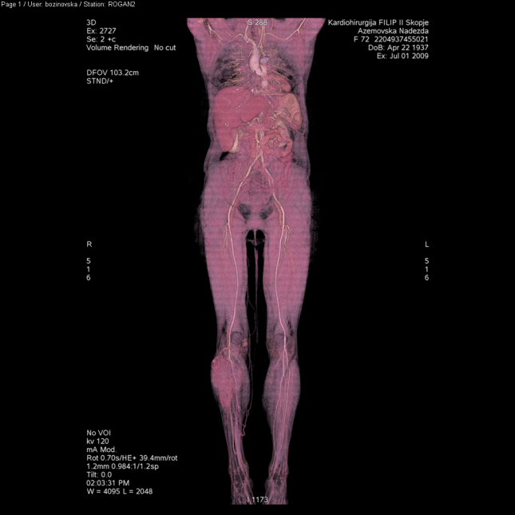
Goal of the study is to demonstrate usefulness of the method in diagnosis of soft tissue tumors considering location, orientation with great vessels, pathologic vascularisation and relation with the adjacent structures in order to develop further treatment. s

Slide 8
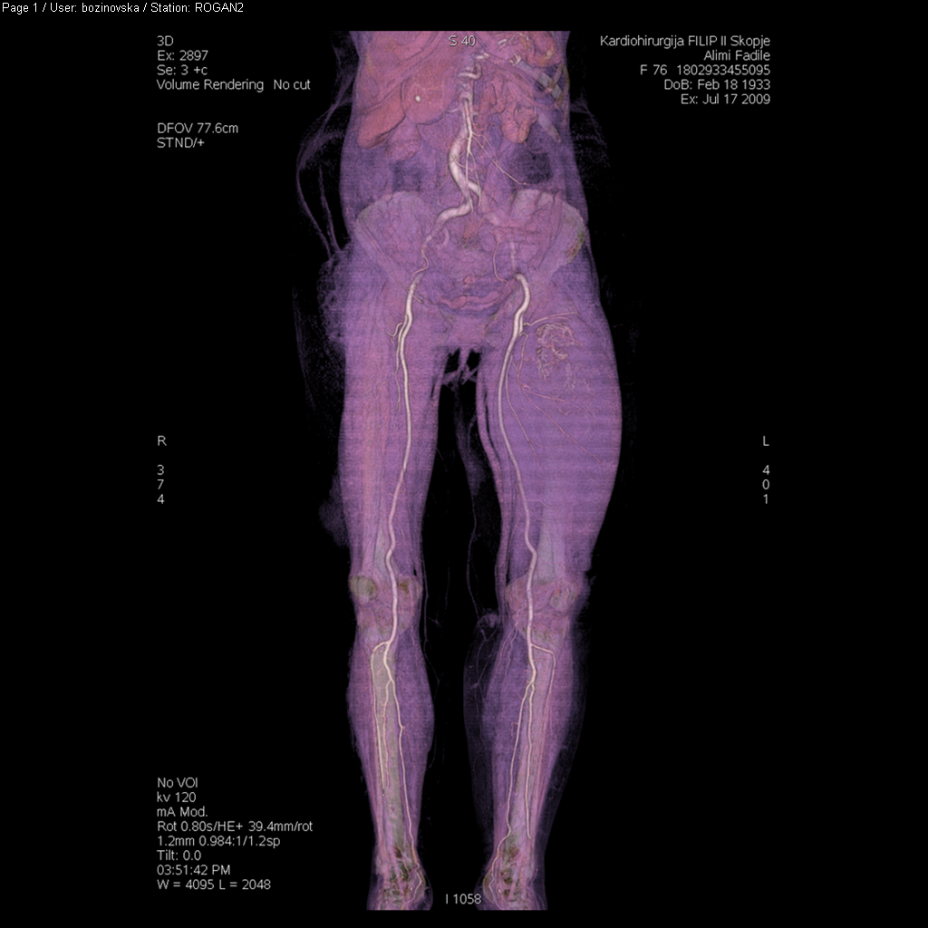
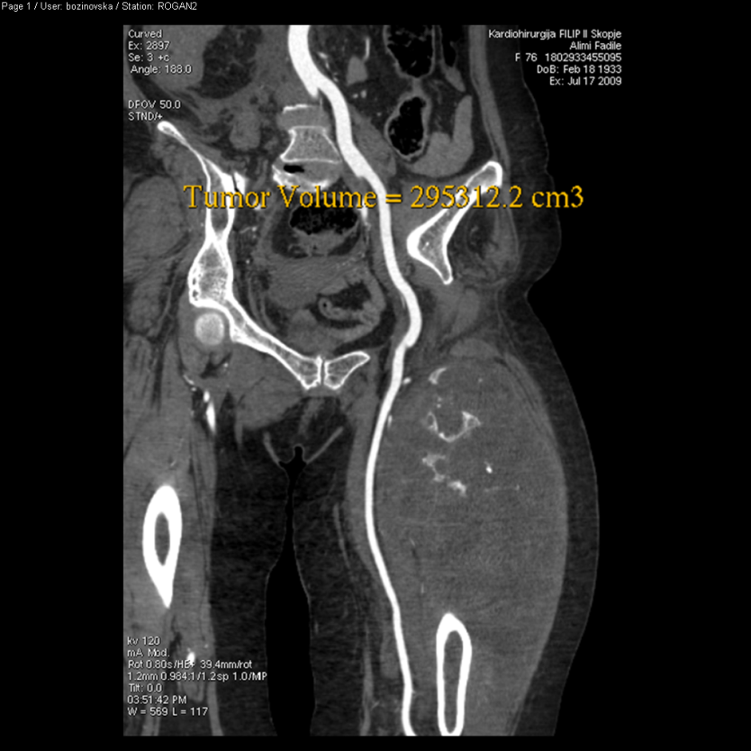
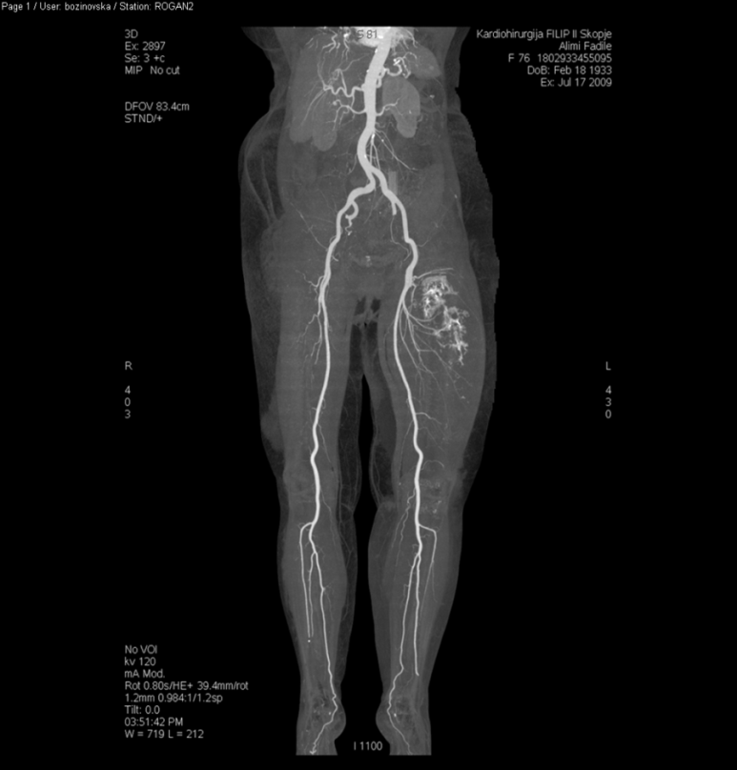
We evaluated 12 patients, 5 female and 7 male age 32 to 74 years old , with skeletal malignant tumors localized in lower extremities.

Slide 9
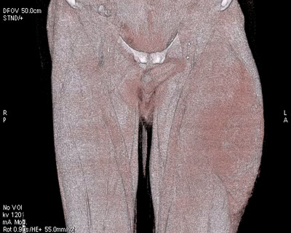
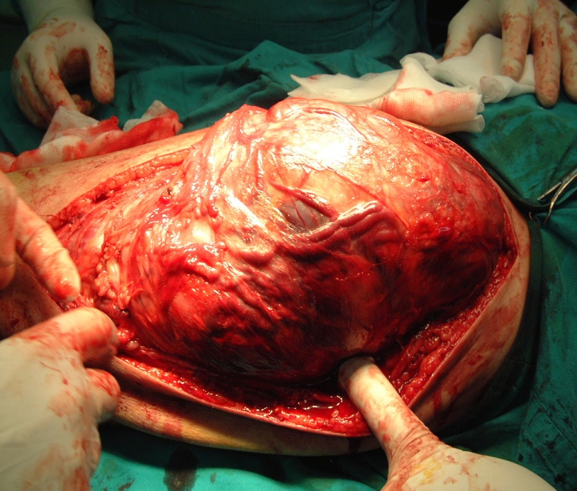
In patients with liposarcomas localized in postero-lateral femoral regions 64 MDCT has shown size and localization of the tumor with capsule, surface vessels and close relation of the tumor with superficial femoral artery. The main supply artery of tumors arises from profound femoral artery.

Slide 10
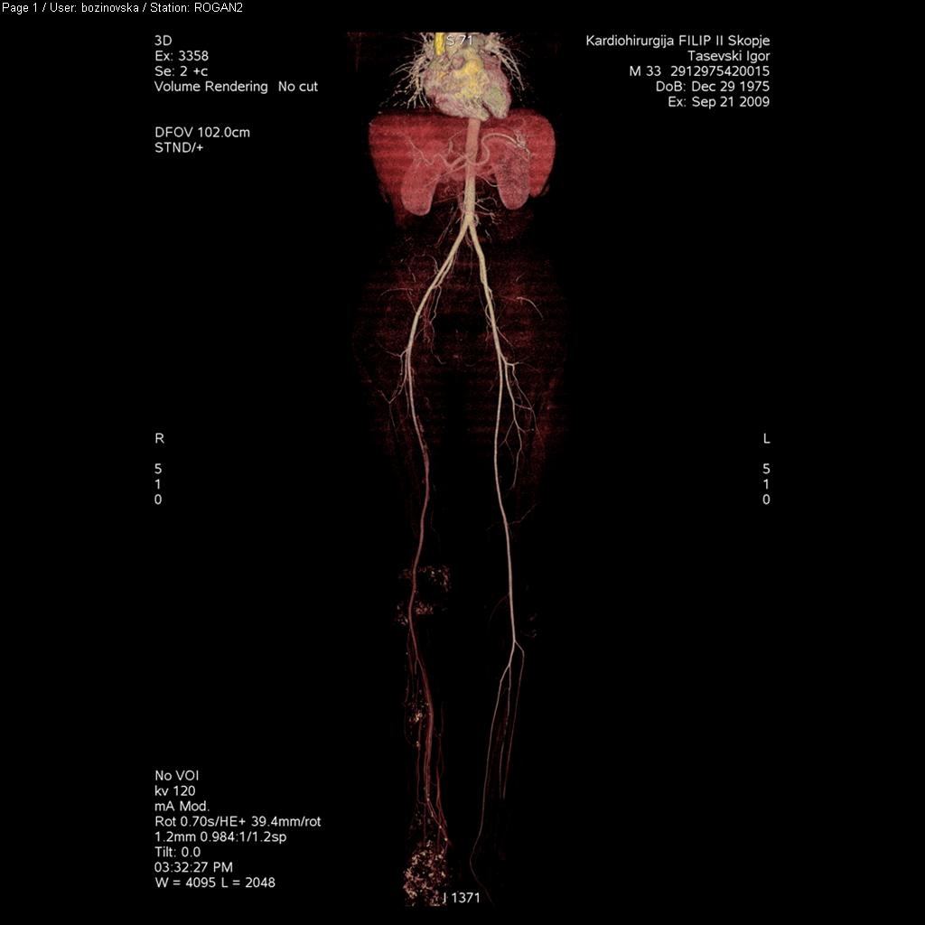
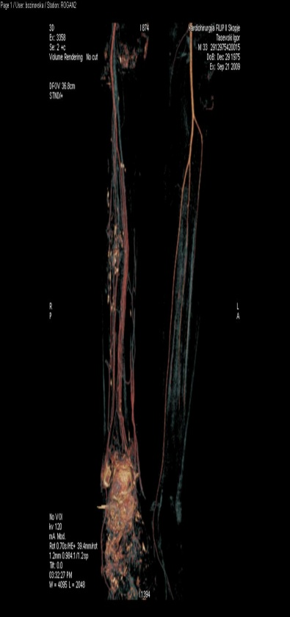
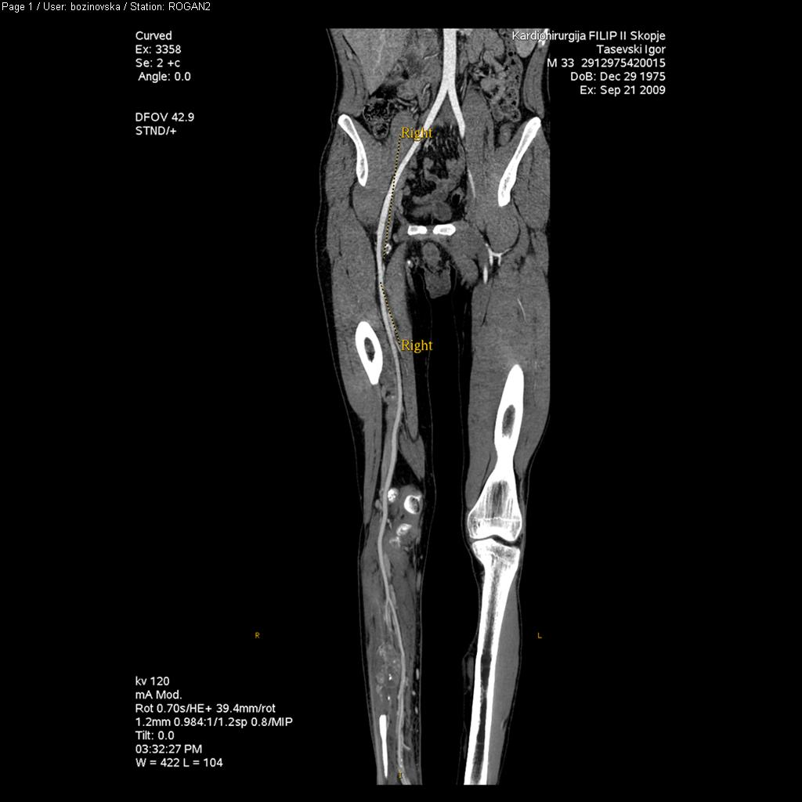
In patients with malignant giant cell tumors localized in the feed, destruction of the bone was detected with infiltration of soft tissue and vessels – a.tibialis anterior , a.fibularis and a.tibialis posterior.
Relation with the great vessels was very clear presented especially if the artery is compressed or infiltrated.

Slide 11
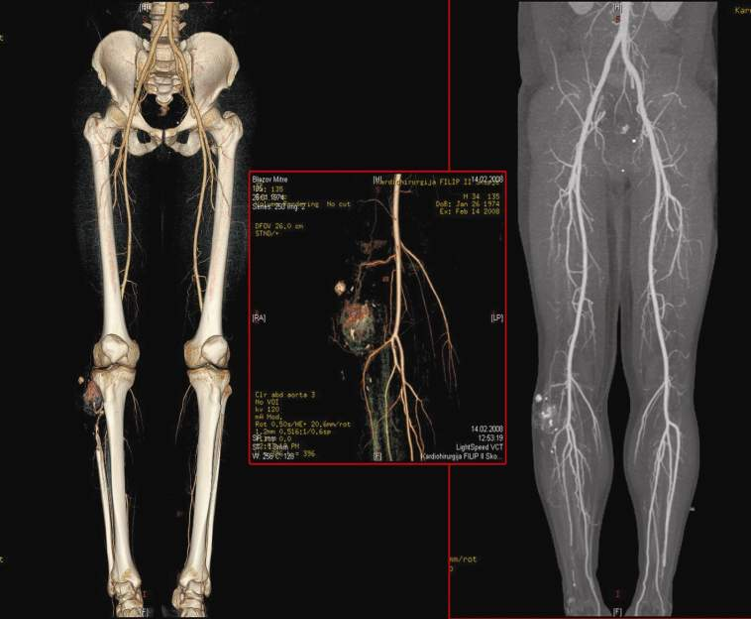
Paraoseal osteosarcoma
Pathologic vascularization
Relation of tumor with the bone
Affection of the bone
Soft tissue spreading
MDCT findings present affection of bone structures in patients with paraoseal osteosarcoma localized in proximal-lateral tibia region and pathologic vascularization of the tumor with main supply artery of the tumor arising from popliteal artery.

Slide 12
Conclusion:
According to histopathology results 5 of the patients were with diagnosed liposarcoma, 3 malignant giant cell tumors and 4 with paraosseal osteosarcoma.
64 slice MDCT peripheral angiography has high diagnostic accuracy in presentation of skeletal tumors and relation, localization toward great vessels .It gives opportunity for embolization of the main feeding artery of the tumor and less bleeding operative treatment.

