Slide 1

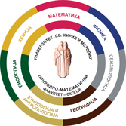


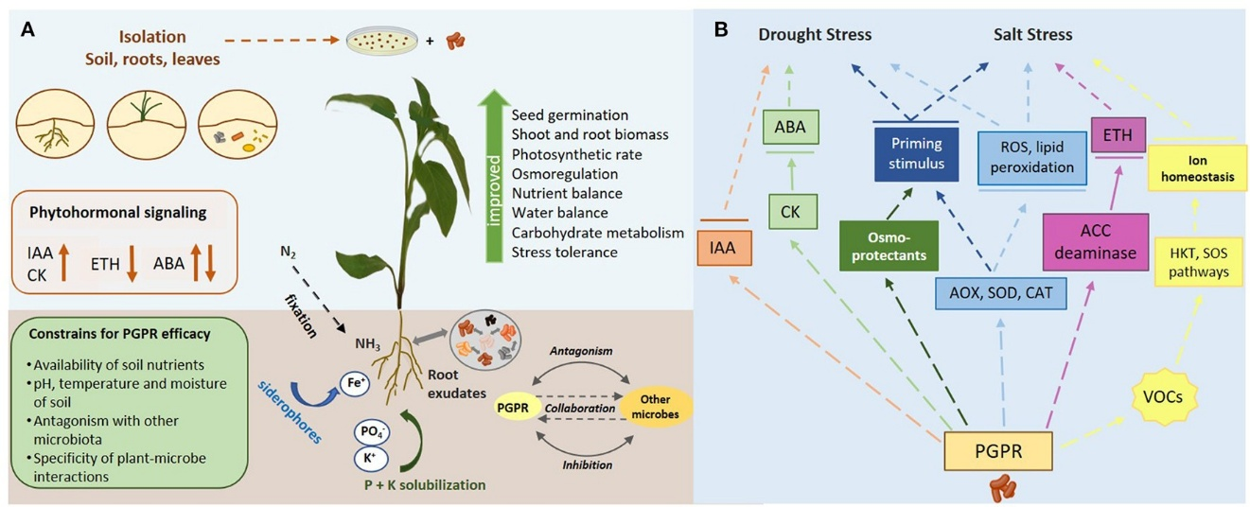
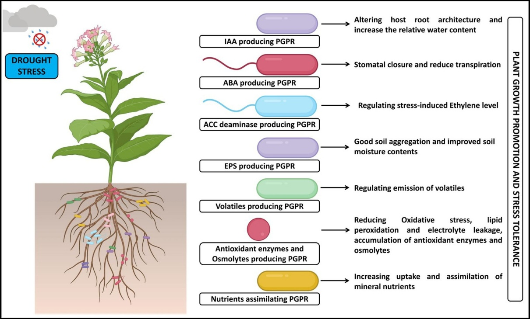
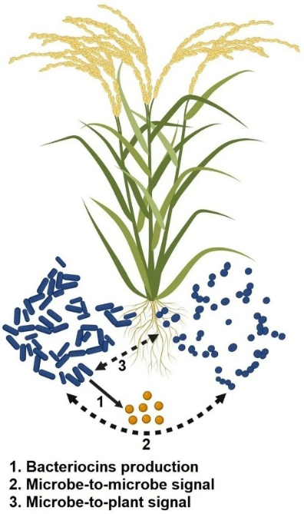
XXII European Rural Development Network Conference
“Resilient rural areas and sustainable food systems: governance, policy frameworks and structural challenges”
29 September – 1 October 2026, Mitrovica, Republic of Kosovo
PLANT GROWTH-PROMOTING RHIZOBACTERIA (PGPR) AS DRIVERS OF RURAL RESILIENCE AND SUSTAINABLE FOOD SYSTEMS
*corresponding author: natalijaap@gmail.com
Natalija Atanasova-Pancevska¹, Daniela Todevska², Sofija Kostadinovska¹
¹ Ss. Cyril and Methodius University in Skopje, Faculty of Natural Sciences and Mathematics – Skopje, Institute of Biology, Department of Microbiology and Microbial Biotechnology, Skopje, North Macedonia
² Faculty of Agriculture, Goce Delcev University, Stip, North Macedonia
INTRODUCTION
• The sustainability of rural areas and food systems has become one of the most pressing challenges of the 21st century. Increasing global population, climate variability, soil degradation, and the overuse of chemical inputs have created structural vulnerabilities that threaten both agricultural productivity and ecological balance. Since the mid-20th century, the “Green Revolution” introduced high-yielding crop varieties and synthetic fertilizers, which dramatically increased food production but also led to unintended consequences such as soil salinization, water contamination, and biodiversity loss (Dhiman et al., 2025; Orozco-Mosqueda et al., 2021). Today, the demand for sustainable alternatives is urgent, particularly in rural regions where livelihoods depend directly on soil fertility and crop resilience.
Plant growth-promoting rhizobacteria (PGPR) have emerged as one of the most promising biological solutions to these challenges. PGPR are beneficial bacteria that colonize the rhizosphere—the soil surrounding plant roots—and exert positive effects on plant growth and health through a variety of direct and indirect mechanisms. Direct mechanisms include nitrogen fixation, phosphorus and potassium solubilization, siderophore production, and phytohormone regulation. Indirect mechanisms involve pathogen suppression, stress tolerance, and induced systemic resistance (Khoso et al., 2024; Biswas et al., 2024). By reducing reliance on chemical fertilizers and pesticides, PGPR contribute to both environmental sustainability and economic resilience in rural communities.
Figure 1. A) An overview of diverse PGP traits affecting plant growth and stress tolerance. (B) A diagrammatic representation of the mechanisms underlying PGPR-mediated stress tolerance against drought and salt stress. (from Mellidou and Karamanoli, 2022)
Figure 2. A pictorial overview of the functioning of PGPR in support of plant growth and stress tolerance against salt stress. (from Al-Turki et al., 2023.
PGPR strains demonstrated significant effects on nutrient acquisition and plant growth. Laboratory and field trials consistently reported enhanced nitrogen fixation, phosphorus solubilization, and siderophore production. For example, Azospirillum and Rhizobium strains increased nitrogen assimilation in cereals and legumes, while Bacillus and Pseudomonas species improved phosphorus and iron uptake .
PGPR also contributed to pathogen suppression and stress tolerance. Pseudomonas fluorescens produced antifungal compounds that reduced Fusarium infections in chickpea, while Bacillus amyloliquefaciens enhanced salt tolerance in maize by regulating ion transporters (Dhiman et al., 2025; Biswas et al., 2024).
The results confirm that PGPR exert multifaceted benefits on plant growth and resilience. Direct mechanisms such as nutrient solubilization and phytohormone regulation improve crop productivity, while indirect mechanisms enhance stress tolerance and pathogen resistance. These findings align with previous reviews emphasizing PGPR as eco-friendly biofertilizers (Orozco-Mosqueda et al., 2021; Dhiman et al., 2025).
METHODOLOGY
RESULT
The methodological framework of this study is based on a systematic literature review and comparative synthesis of recent scientific contributions on plant growth-promoting rhizobacteria (PGPR).
This paper uses a qualitative research design that integrates peer-reviewed articles, meta-analyses, and experimental reports. The design was chosen to capture the diversity of PGPR mechanisms, applications, and policy implications. The methodology follows the principles of evidence-based synthesis, combining descriptive analysis with thematic categorization (Tranfield et al., 2003).
Studies were included if they:
• Were published between 2020 and 2025.
• Focused on PGPR mechanisms, biofertilizer applications, or rural sustainability.
• Provided empirical data, experimental results, or systematic reviews.
Exclusion criteria included:
• Studies outside the agricultural context.
• Papers lacking peer review or methodological transparency.
• Publications focusing solely on non-bacterial biofertilizers (e.g., mycorrhizal fungi).
This filtering process resulted in a corpus of 65 primary articles and 12 meta-analyses, which formed the basis of the synthesis.
The analytical framework was structured around two dimensions:
1. Mechanistic categorization – Direct mechanisms (nutrient acquisition, phytohormone regulation) and indirect mechanisms (biocontrol, stress tolerance).
2. Application pathways – Laboratory experiments, greenhouse trials, and field applications.
This dual categorization allowed for a systematic comparison across studies, highlighting both biological processes and practical outcomes (Khoso et al., 2024; Orozco-Mosqueda et al., 2021).
Data extraction involved coding each study for:
• PGPR strain(s) investigated.
• Plant species tested.
• Mechanisms identified (e.g., nitrogen fixation, phosphorus solubilization).
• Outcomes measured (e.g., yield increase, stress tolerance).
The synthesis was conducted using thematic analysis, grouping findings into categories such as nutrient solubilization, phytohormone production, and induced systemic resistance. Comparative tables were created to visualize strain-specific effects (Alzate Zuluaga et al., 2024).
The methodology acknowledges certain limitations.
The review also considered ethical and policy dimensions. PGPR-based biofertilizers align with sustainable development goals (SDGs) and One Health principles, but their adoption requires supportive governance frameworks. Policy documents and reports from FAO and EU rural development programs were consulted to contextualize scientific findings within broader socio-economic strategies (FAO, 2022).
Figure3. Mechanism of action of bacteriocins excreted by PGPR in abiotic stress resilience. (from Al-Turki et al., 2023)
CONCLUSION
The results highlight that PGPR-based biofertilizers can transform structural challenges in rural areas into opportunities for innovation. By lowering production costs, enhancing soil biodiversity, and mitigating abiotic and biotic stresses, PGPR contribute to the economic viability of smallholder farming and the ecological sustainability of food systems. Importantly, their integration into governance frameworks, farmer-led cooperatives, and smart agriculture strategies can ensure consistent application and maximize benefits.
In conclusion, PGPR represent a cornerstone of resilient rural areas and sustainable food systems. Their adoption offers a pathway to reduce dependency on synthetic agrochemicals, enhance food security, and promote environmental stewardship. Future research should focus on optimizing PGPR consortia, improving field consistency, and embedding biofertilizers into rural development policies. By doing so, PGPR can serve as strategic tools for transforming agriculture into a more sustainable, innovative, and resilient sector.

