Slide 1
COMPARATIVE ANALYSIS OF SPECTROPHOTOMETRIC VS VISUAL TOOTH COLOR DETERMINATION
Asst. Prof. Julija Zarkova Atanasaova

Slide 2
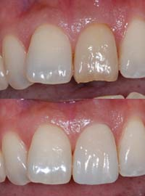
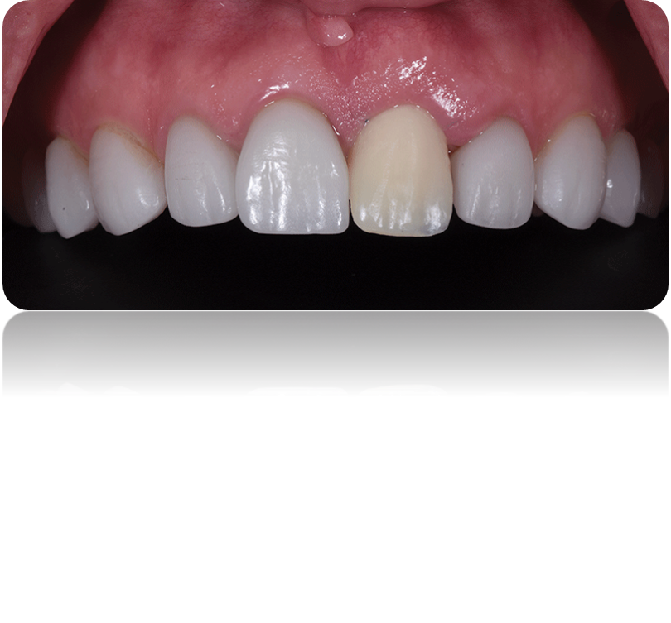
INTRODUCTION
Accurate tooth color determination is crucial in producing esthetically pleasing restorations.

Slide 3
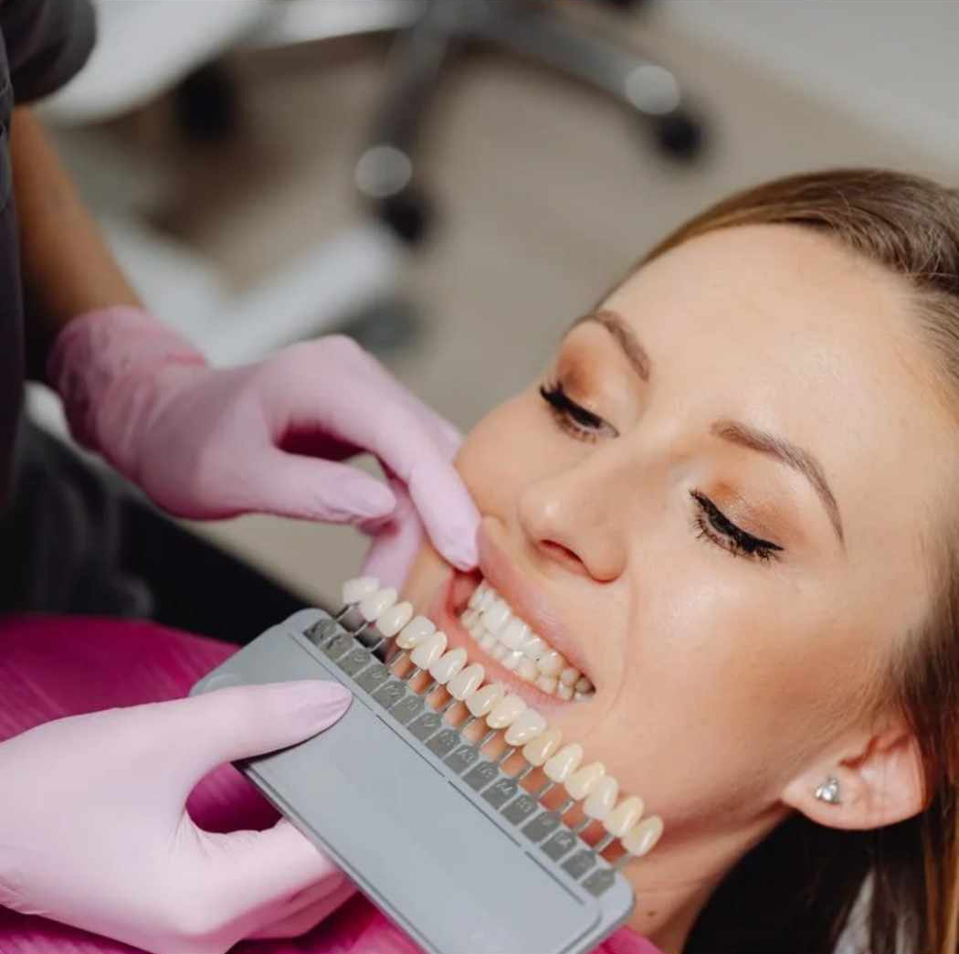
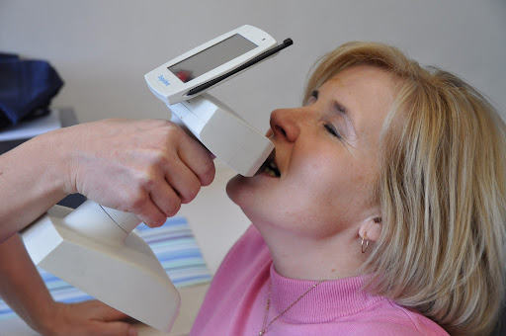
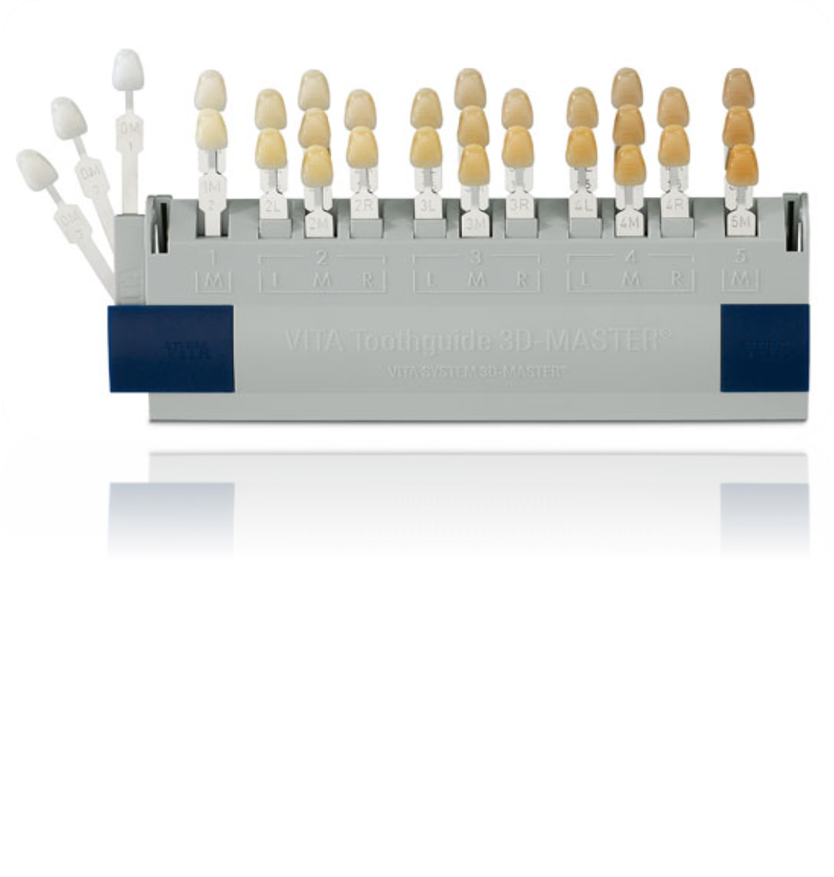
Visual tooth color determination 3D Masted Shade Guide
Spectrophotometry- Shade Pilot
VS.

Slide 4
METHODOLOGY:
100 patients age 18-60,
Inclusion and exclusion criteria
The color difference (ΔE) between the two methods was calculated using the CIEDE2000 formula

Slide 5
RESULTS AND CONSLUSION:
 | Mean Color Difference (ΔE) Standard Deviation | Correlation Coefficient | p-value
Spectrophotometric ShadePilot VS VITA 3D Master Shade Guide | 2.6(1.1) | 0.87 | 0.03
The notable difference in ΔE values and the high level of significance support the superiority of Spectrophotometer ShadePilot over the VITA 3D Master Shade Guide. Moreover, conducting visual color assessment under standardized conditions provides a consistent and controlled environment for accurate comparison. Dental professionals are encouraged to use spectrophotometers into their practice to enhance the reliability and precision of tooth color evaluations

Slide 6
Thank you for your attention!!!

