Slide 1
Human security of migrants in the on-line world
Olga koshevaliska
University of goce Delcev, stip, north macedonia

Slide 2
“Social media, mobile apps, online maps, instant messaging, translation websites, wire money transfers, cell phone charging stations, and WiFi hotspots have created a new infrastructure for movement as critical as roads or railways.”
Online vulnerability of migrants:
malware attacks, phishing, ransomware, identity thefts, spam, xenophobia, hate speech and hate crimes, data breach, unlawful use of personal data…

Slide 3
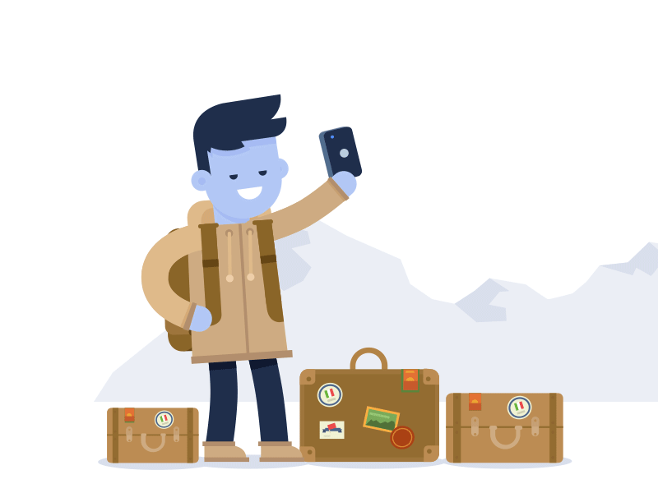
The online – life in COVID-19
Migration and IT – technology
“digitalizing” migrants' lives

Slide 4
Migrants and biometric data
The use of Ethereum is a relatively novel idea (2017) that was tested by the United Nations on Syrian refugee camps in Jordan. In Jordanian refugee camps, Syrian refugees receive Ether (Ethereum’s digital currency, similar to Bitcoin) in the form of Jordanian dinars through biometric technology.

Slide 5
Conclusion
Regardless if a person is a migrant, refugee or an asylum seeker, when individuals reveal their personal data for a particular purpose, it should be handled with due care to protect their best interests and to ensure that they are fully aware of any implication on their human rights and human security

Slide 6
Contact info Olga Koshevaliska, Department of Criminal Law, UGD, North Macedonia email> olga.gurkova@ugd.edu.mk

