Slide 1
СРЕДНОВЕКОВНА ЦРКВА ВО ПОДНОЖЈЕТО НА ЛОКАЛИТЕТОТ ,,ЦАРЕВИ КУЛИ“ - СТРУМИЦА THE MEDIEVAL CHURCH AT THE FOOT OF THE ,,TZAR‘S TOWER“ SITE – STRUMICA
ПЕТНАДЕСЕТИ ЦАР-ШИШМАНОВИ ДНИ В САМОКОВ
PhD Dusko Cvetanov -
NI Institute for protection of cultural monuments and Museum -Strumica
Prof. PhD Trajce Nacev -
University Goce Delcev - Stip

Slide 2
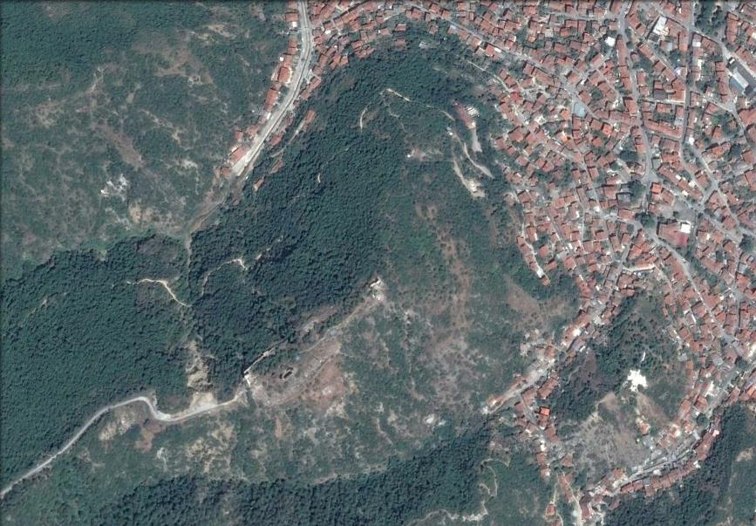
medieval church
Tzar's Tower
Archaeological site ,,Tzar's Tower“ (Strumica)

Slide 3
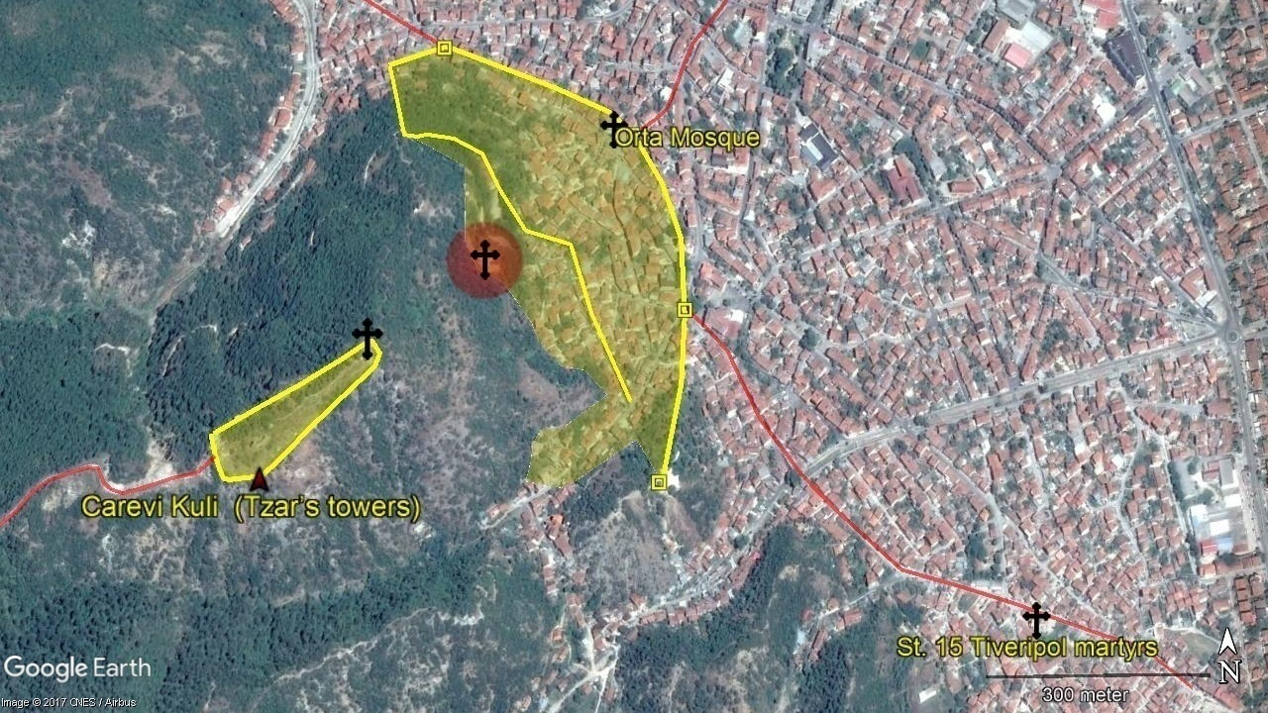
Fortress and civilian part of the medieval Strumica

Slide 4
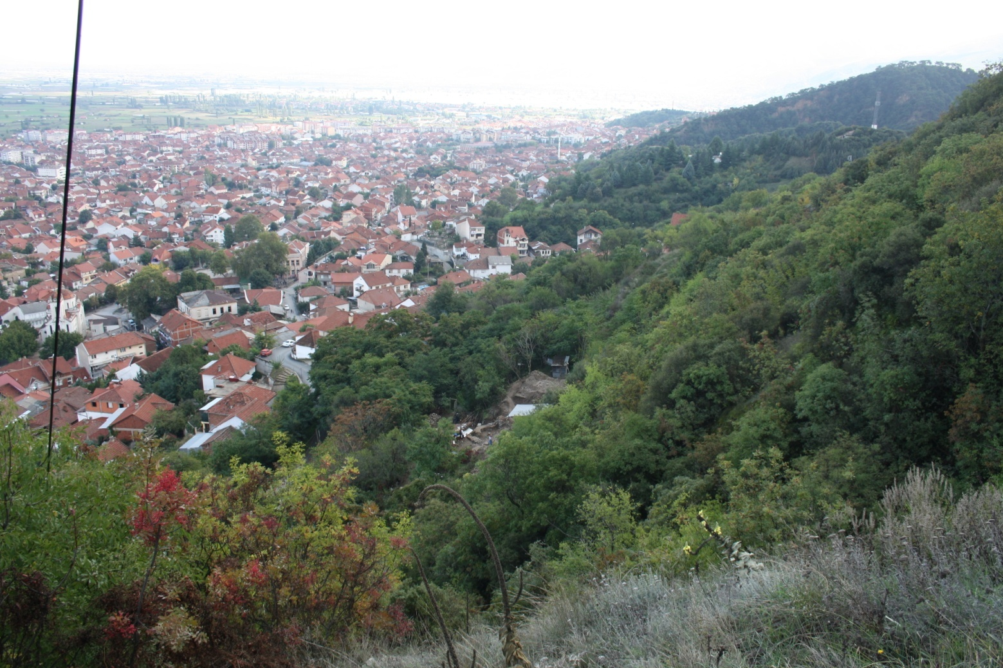
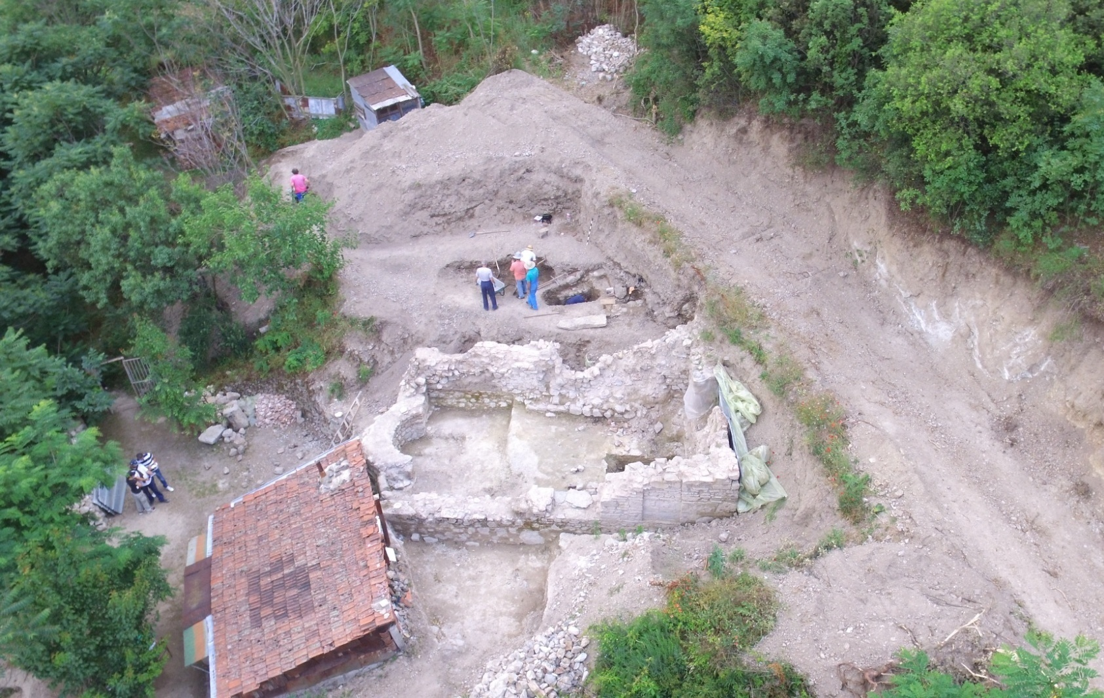
The medieval church

Slide 5
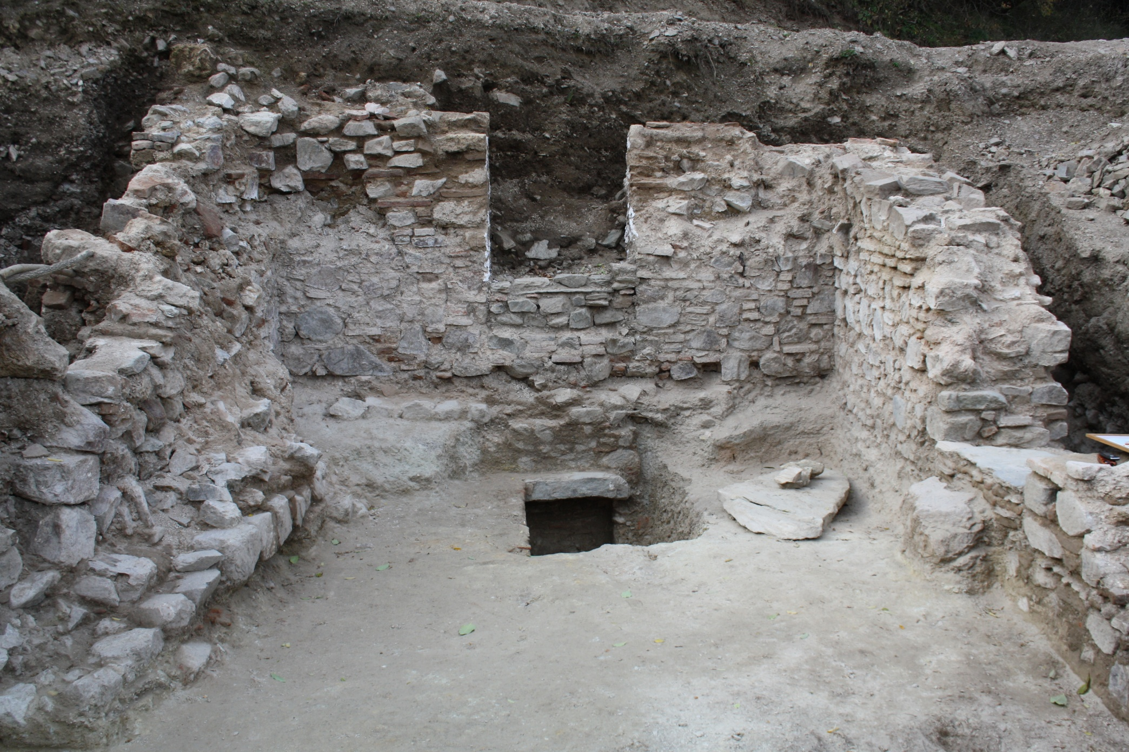
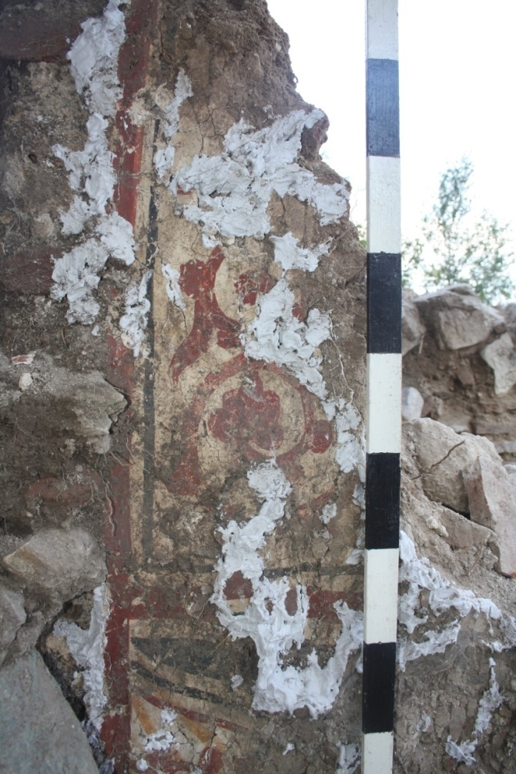
Inside in the church (western entrance and the tomb)

Slide 6
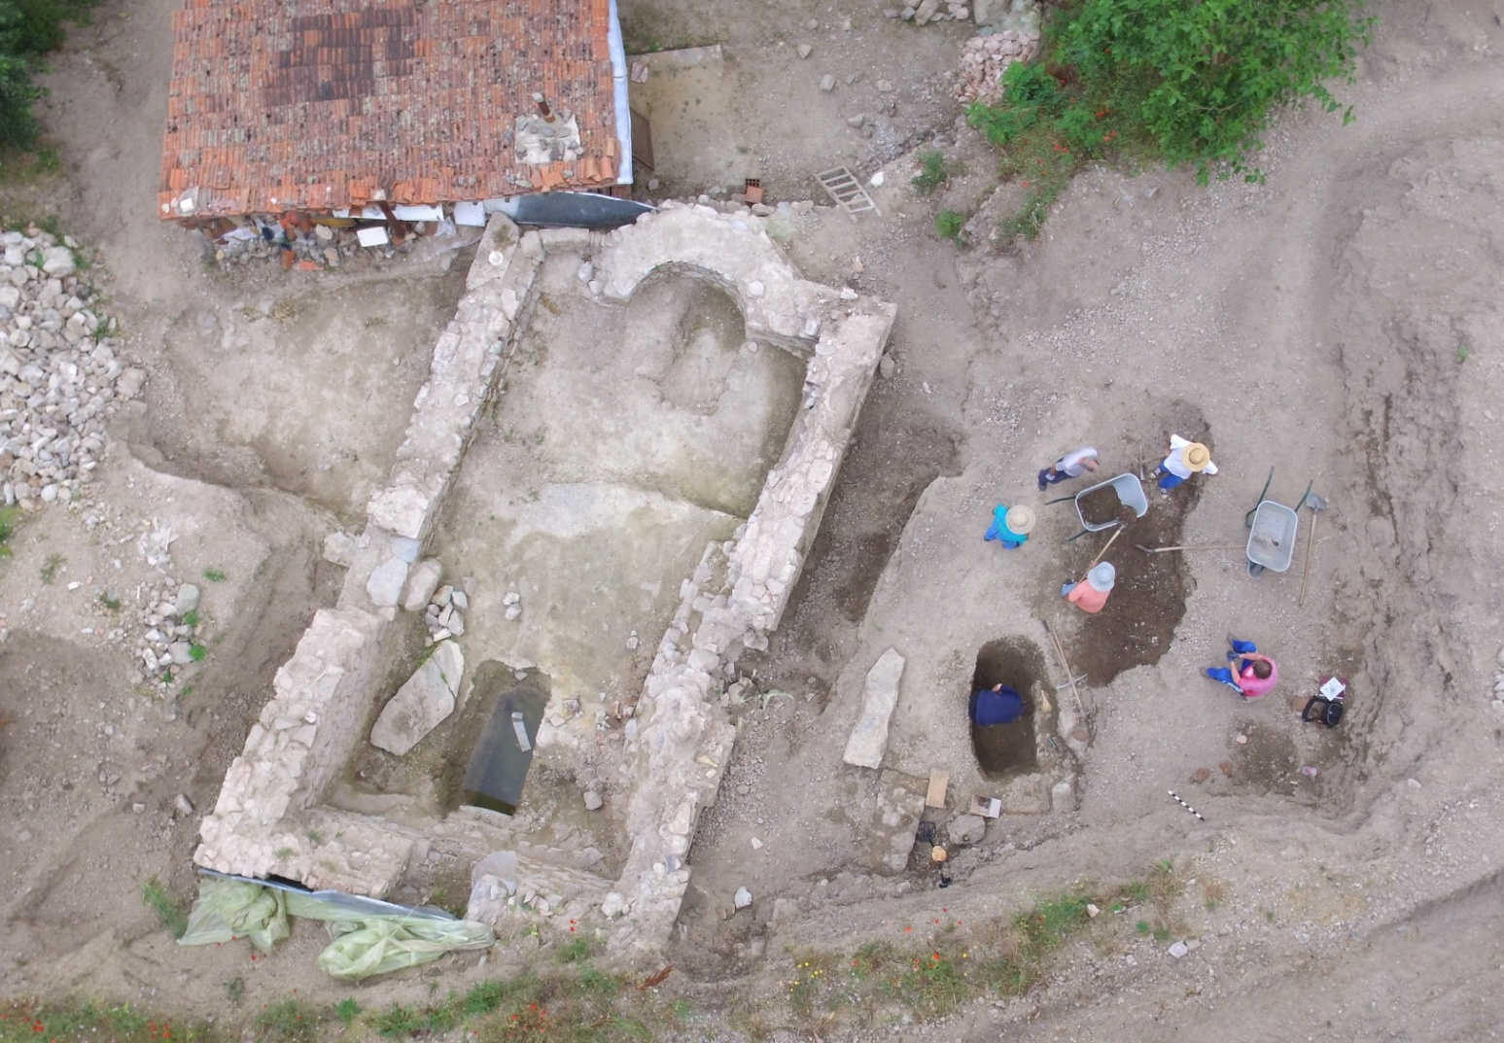
Archaeological research of the medieval church (2016)

Slide 7
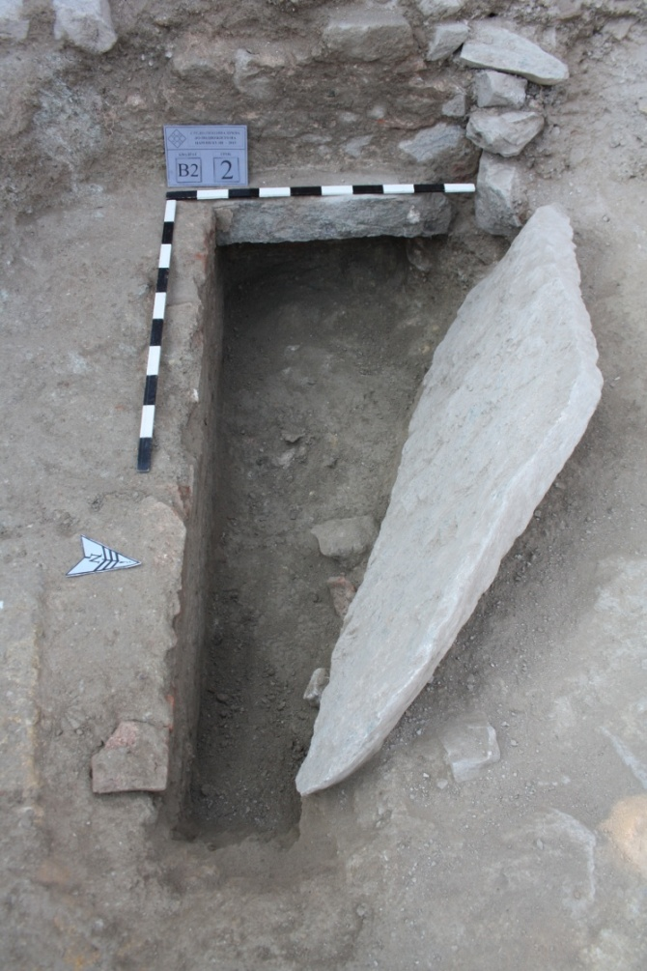
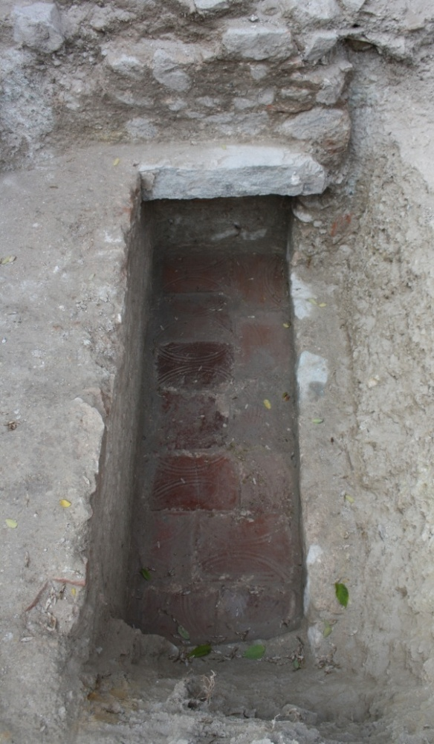
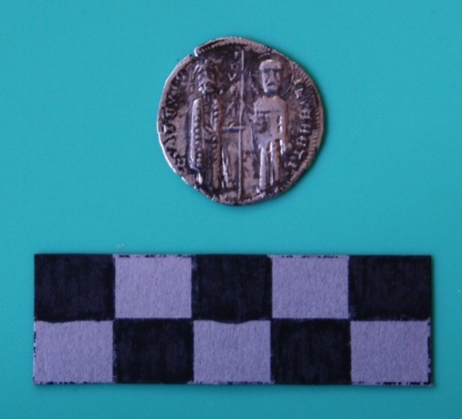
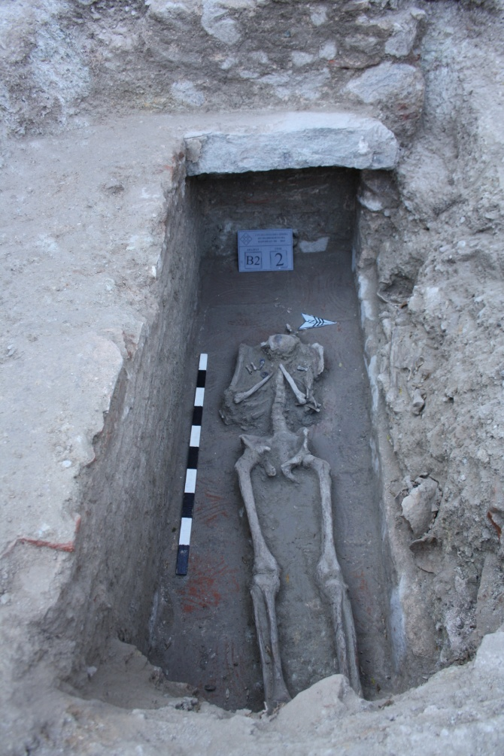
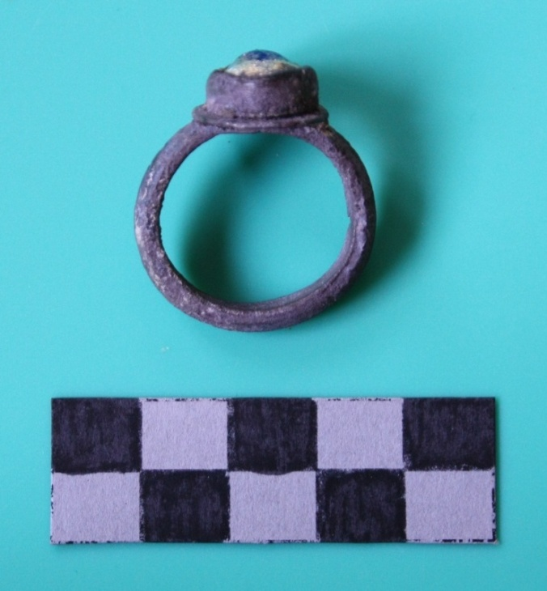
Burial findings from the tomb
Tomb inside the church
Lorenzo Tiepolo (1268-1275)

Slide 8
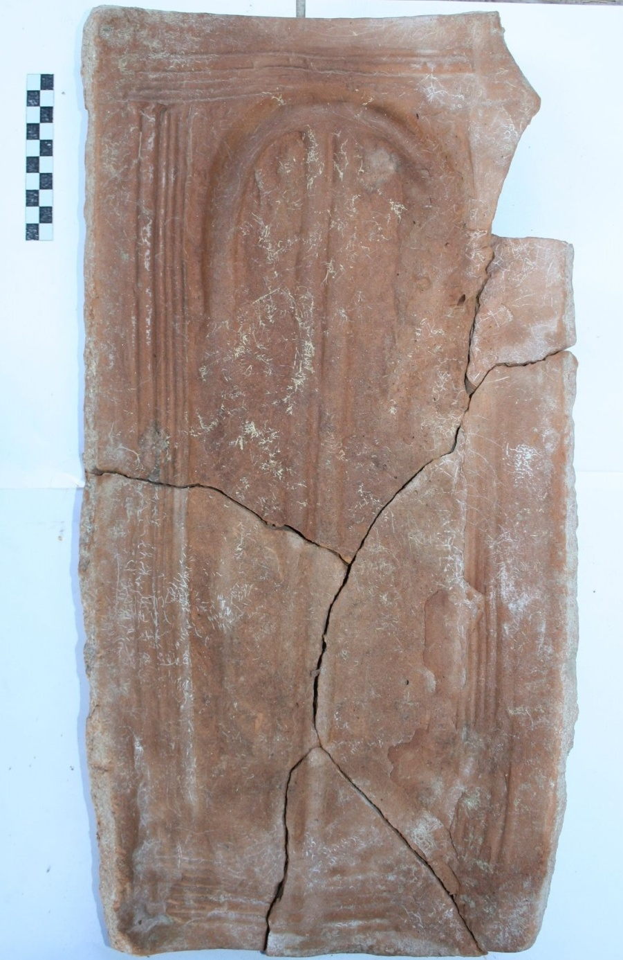
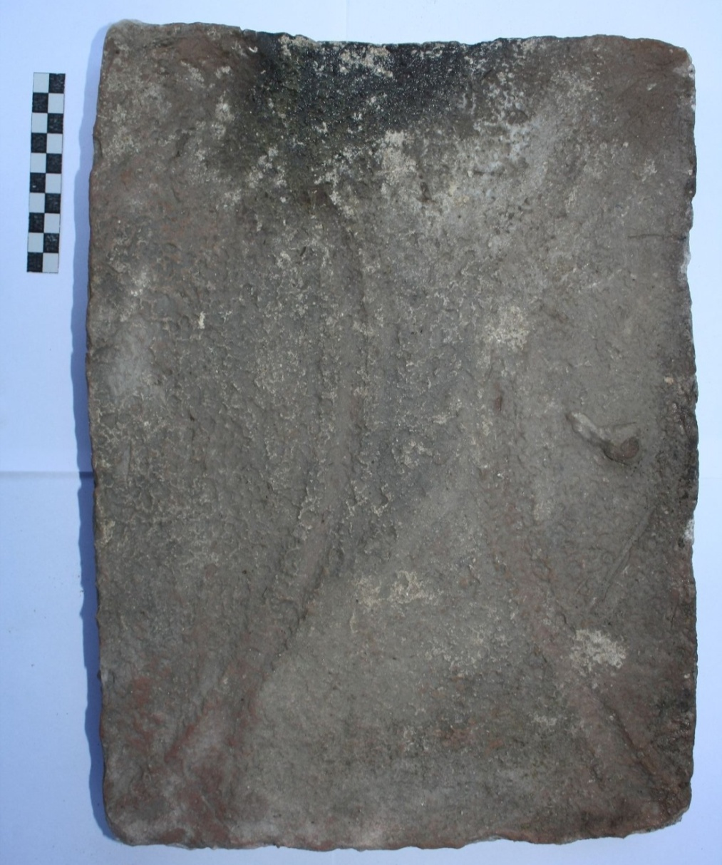
Brick 30/40 cm
roofing tile 29/56 cm

Slide 9
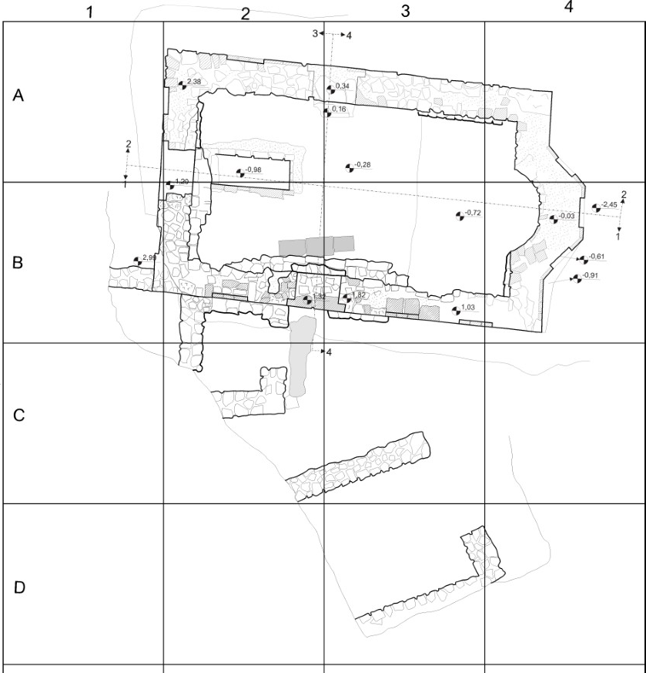
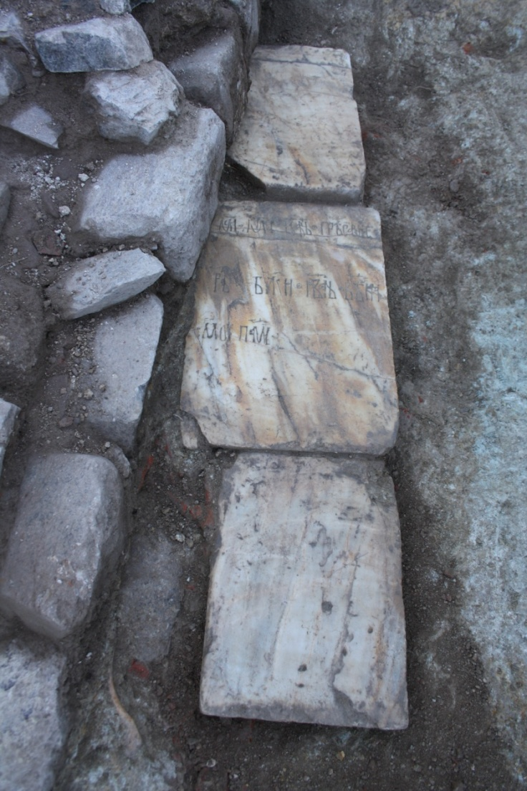
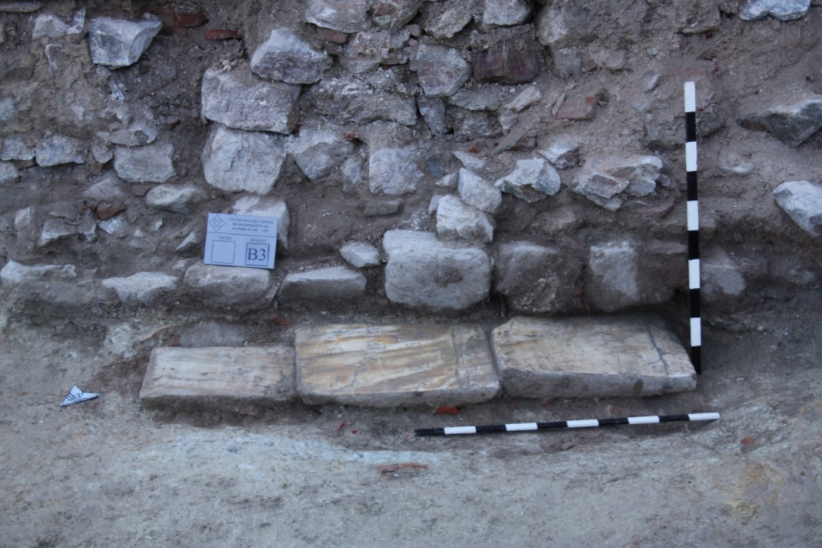
The gravestones (discovered inside the church)

Slide 10
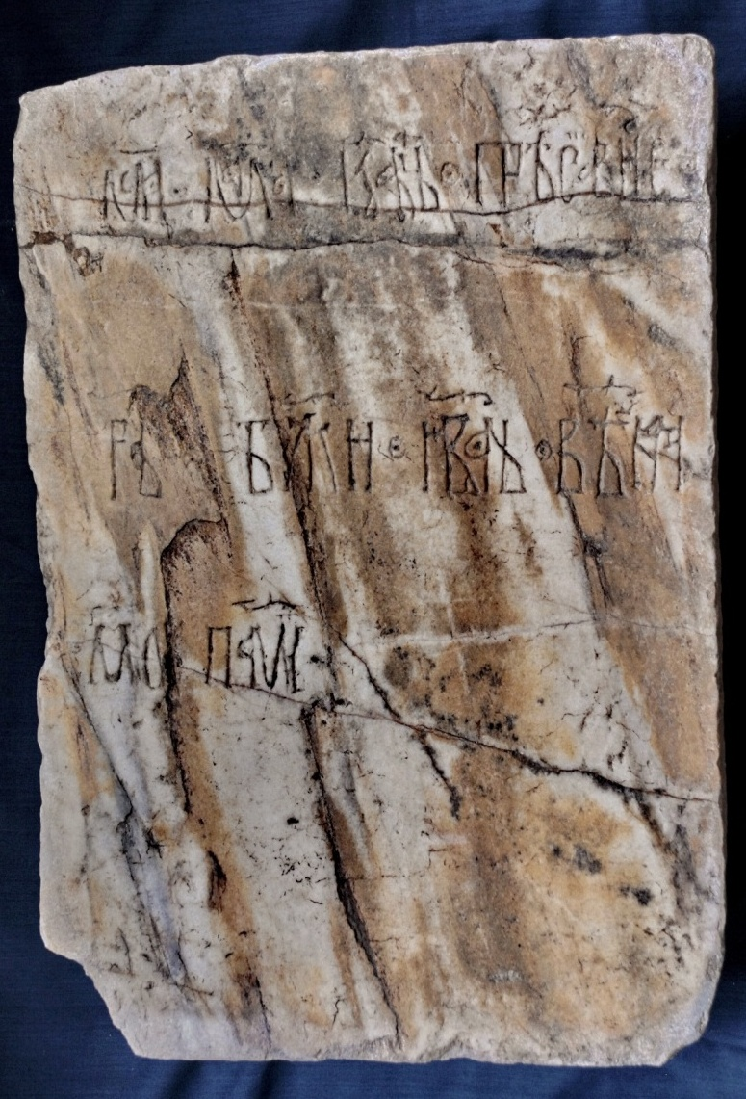
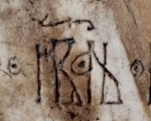
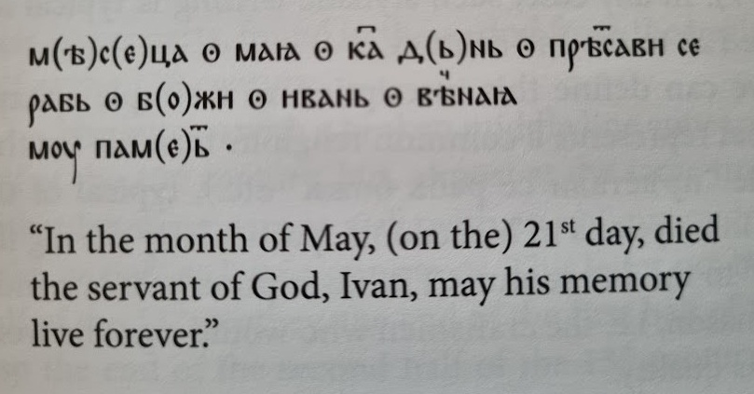
The tombstone epitaph
with Old slavonic Cyrilic letter

Slide 11
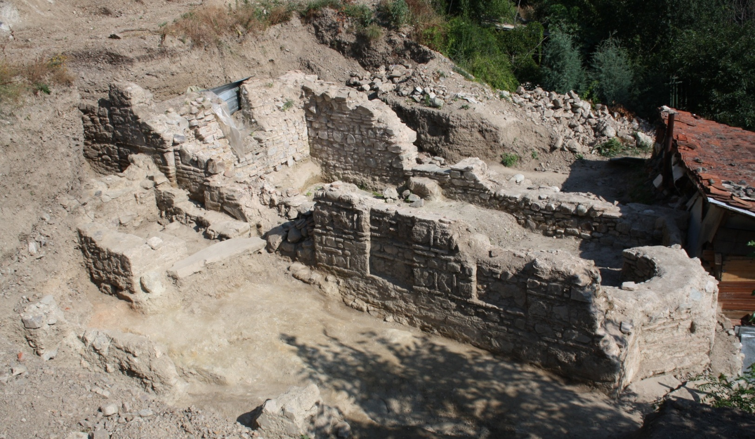

Slide 12
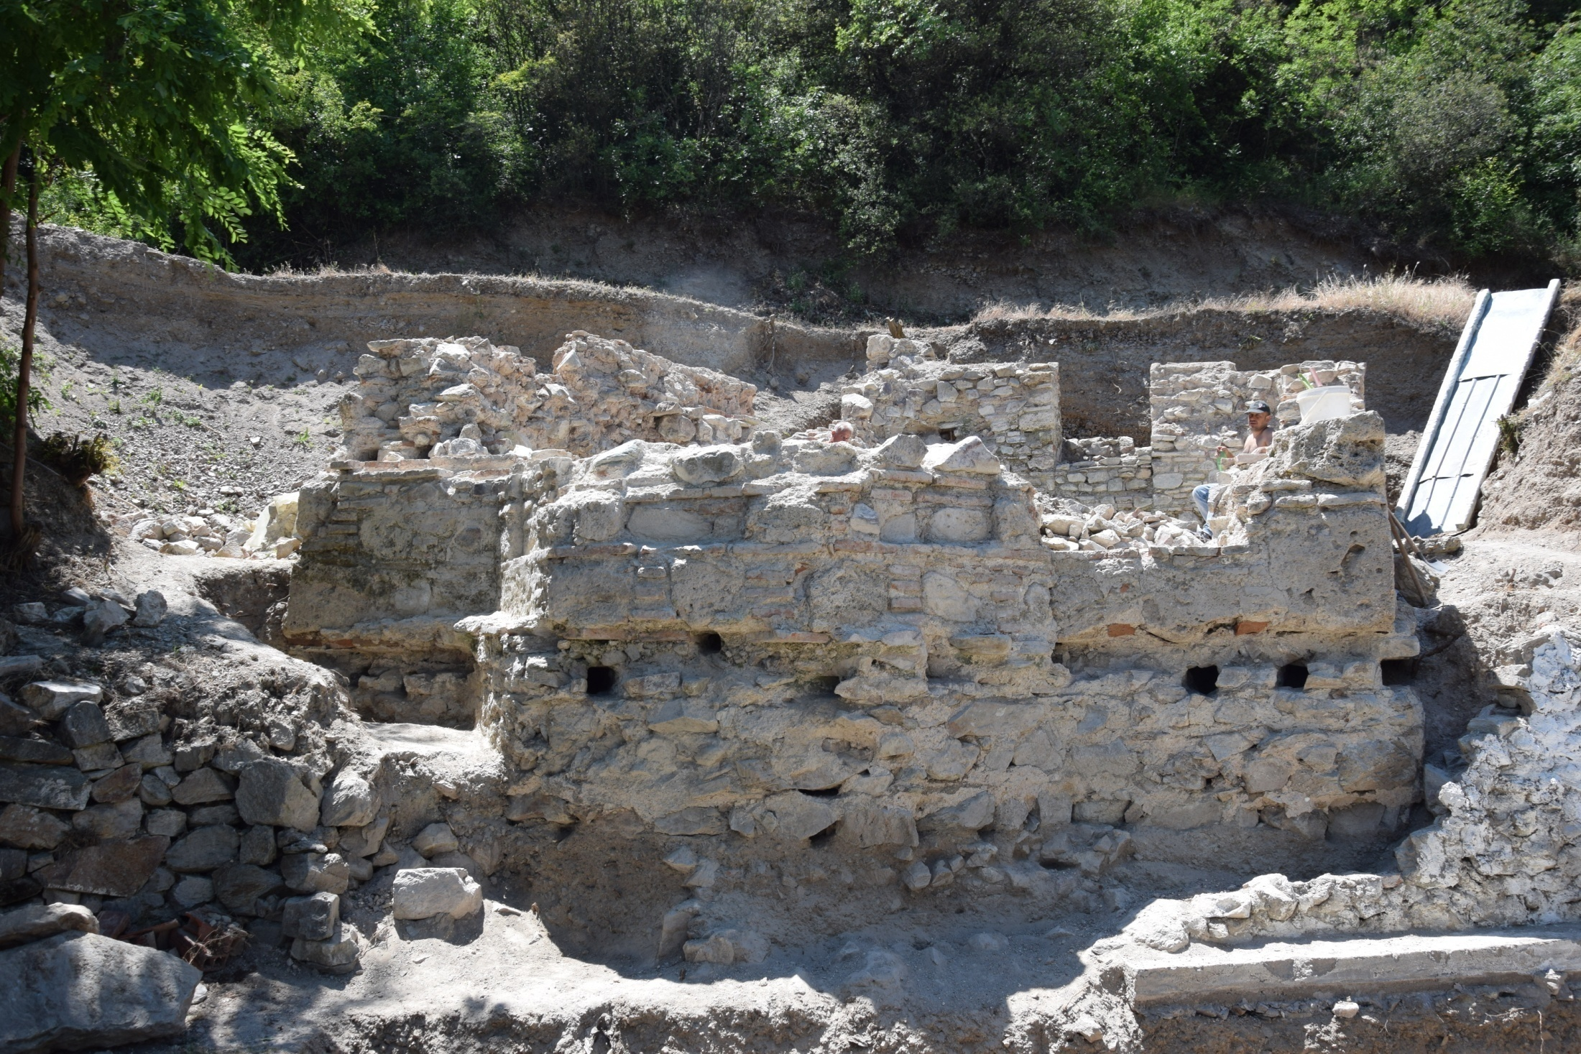

Slide 13
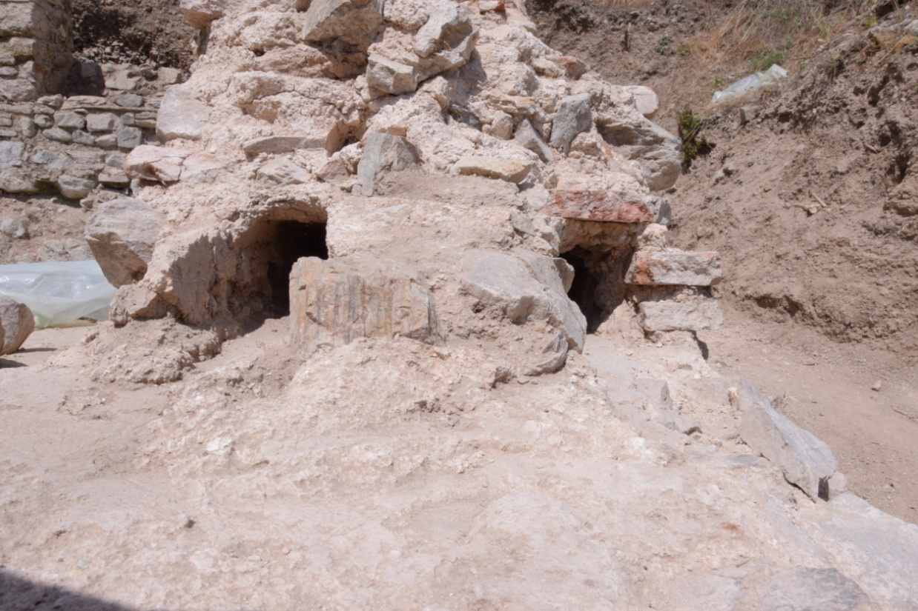
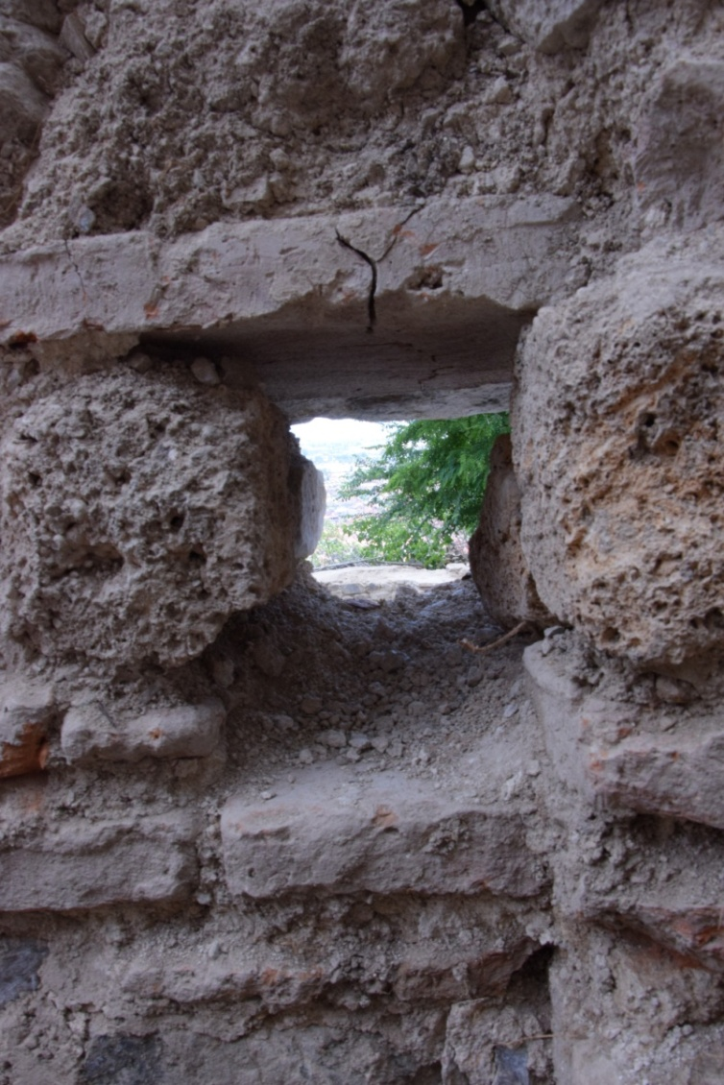
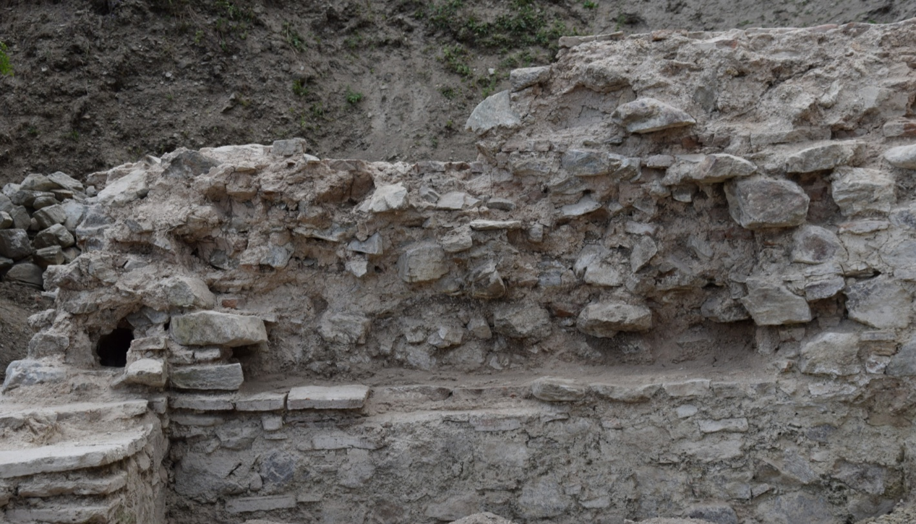

Slide 14
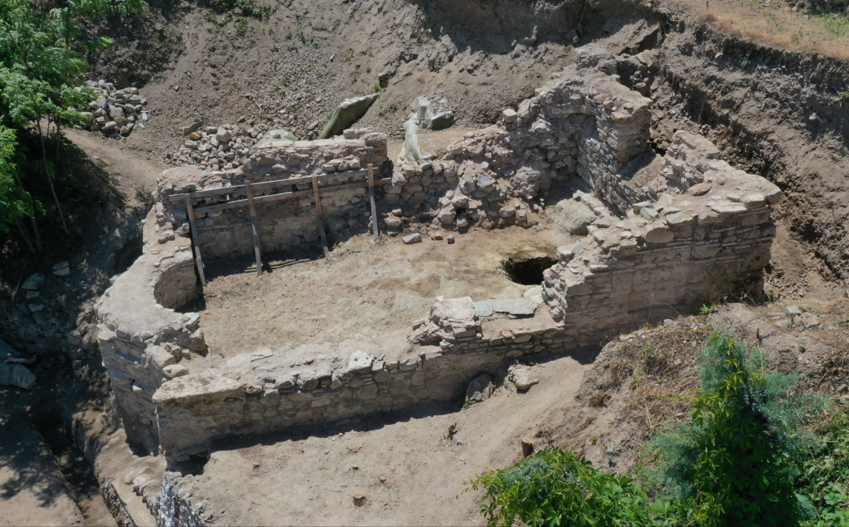

Slide 15
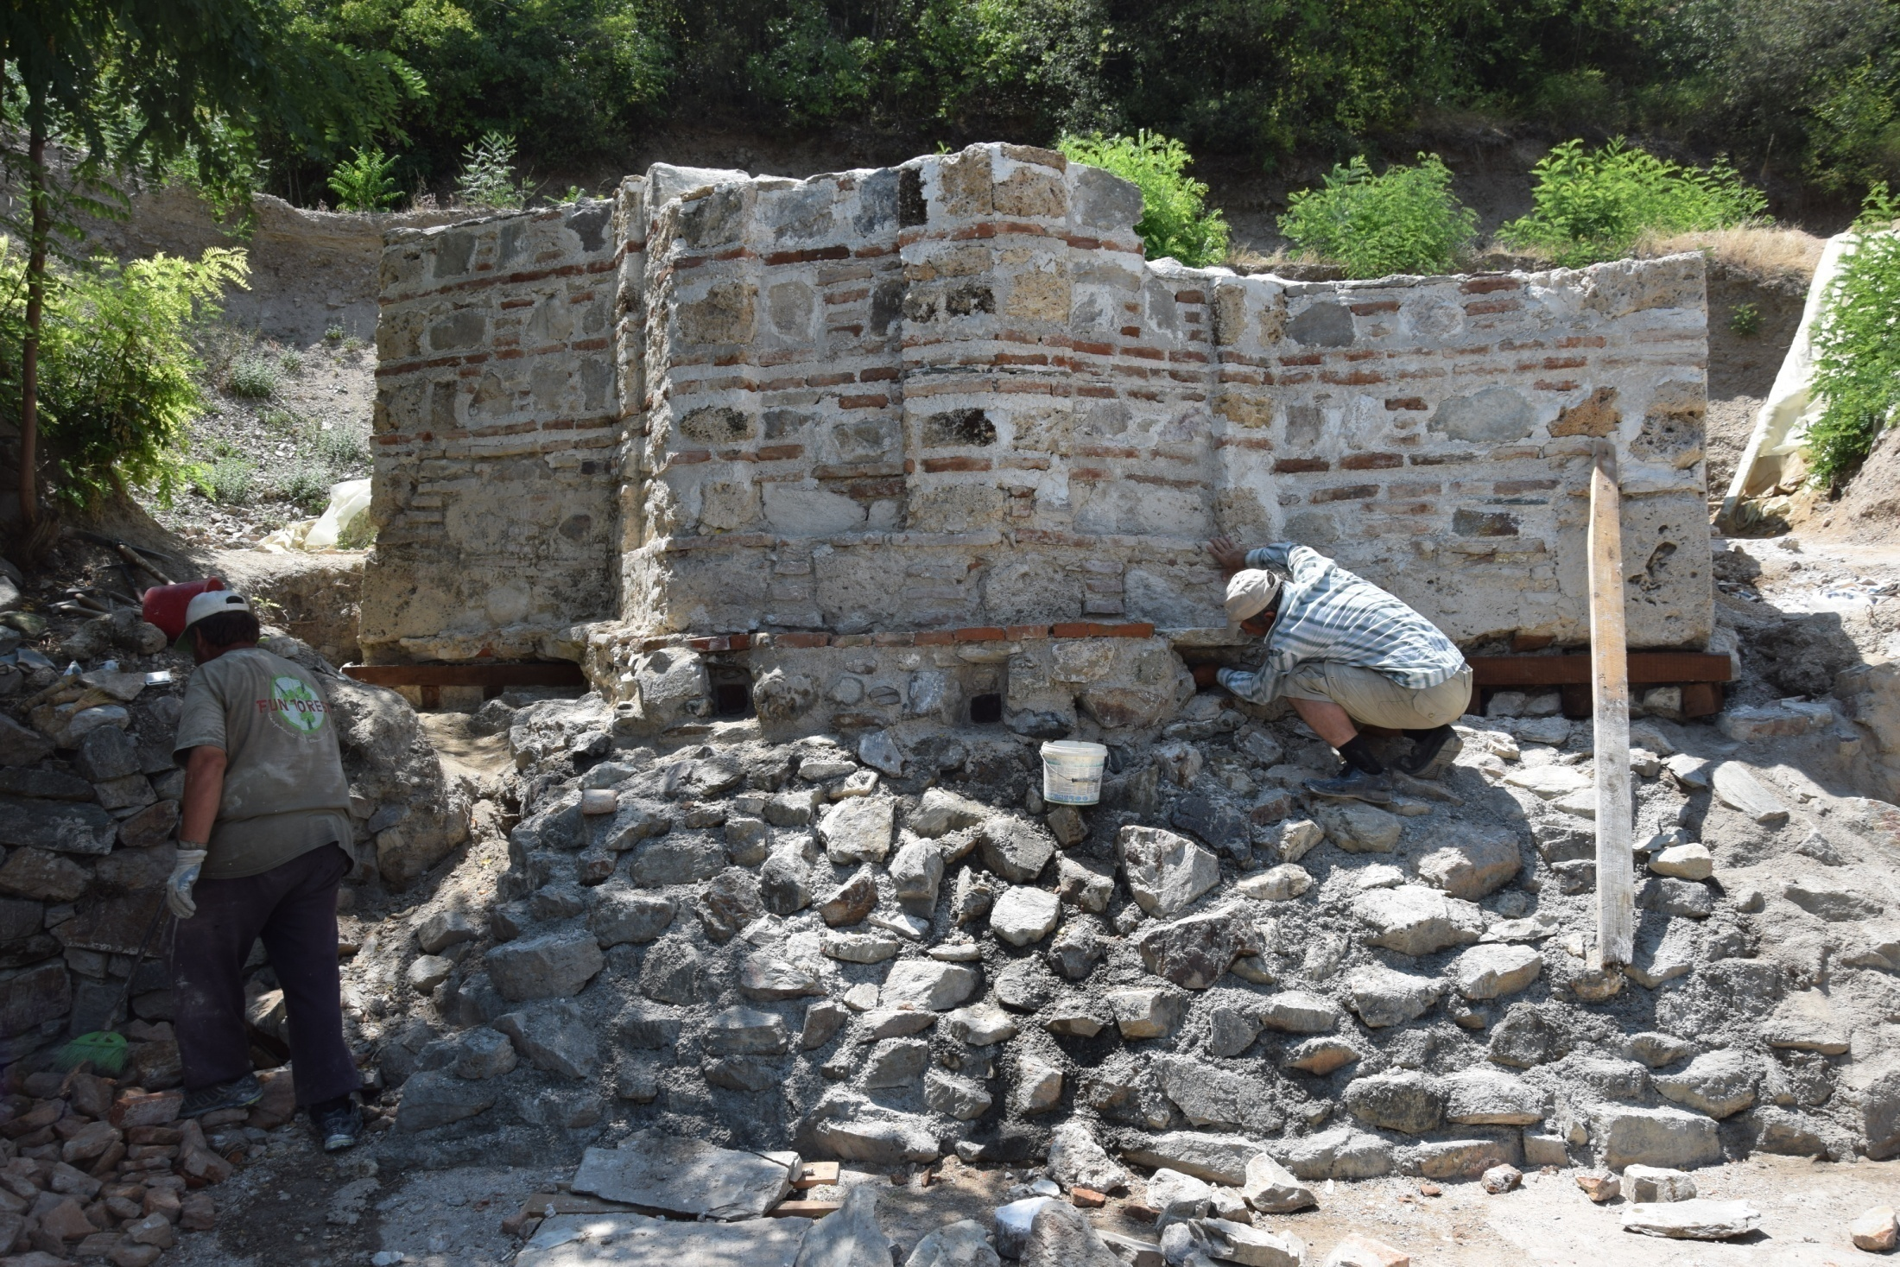

Slide 16
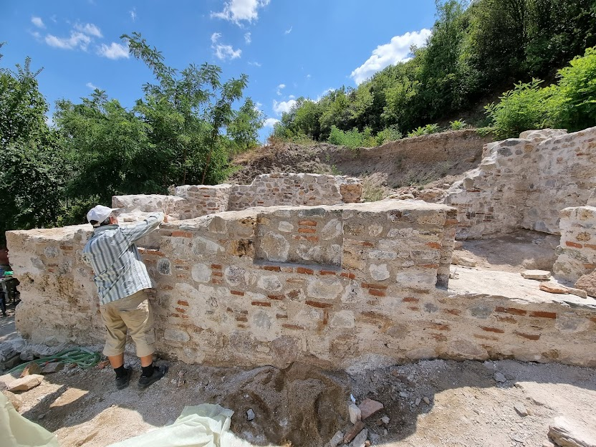

Slide 17
Thank you for your attention
Photo: Duško Cvetanov
Dron: Aleksandar Donchev
Technical documentation: Vaska Maneva

