Slide 1
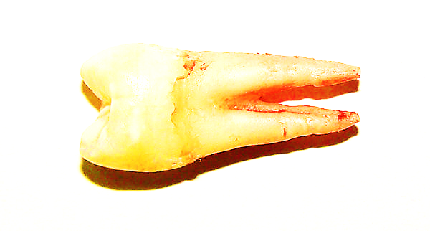
THE NATURE OF SURFACES ROUGHNESS AFTER ER:YAG LASER ASSISTED
ROOT BIO-MODIFICATION
Prof. Dr. Ana Minovska

Slide 2
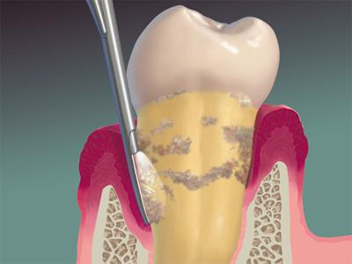
One important contemplation in periodontal therapeutic modalities is the root surface which has become exposed to the oral environment as a result of periodontitis. Changes in pathologically exposed root surface are physical and chemical in nature and also become cytotoxic due to the
release of bacterial toxins that get attached to the root cementum.

Slide 3
Knowing that successful periodontal therapeutic outcomes include clot stability, cell migration towards the root surface, cell attachment, cell proliferation and differentiation,
debridement and preparation of a root surface play an important rule for the above-mentioned events which constitutes the rationale behind root bio-modification.

Slide 4
The most commonly analyzed properties of the cementum are hardness, modulus of elasticity and surface roughness.
Way surface roughness ?
Recent studies have indicated that the stem cell fate decision is strongly correlated to the biomaterial surface topography in tissue engineering and regenerative medicine.
It is reported that topographic features of surface play an important role in adhesion, proliferation, differentiation, and mineralization of stem cells.
\
The most conventional method includes scaling and root planing which are primarily aimed at the gross removal of cement from the root surface.
According to the concepts of functional tissue engineering, the cells can sense and respond to mechanical factors and various other environmental cues of the substrate.

Slide 5
Beside this method, nowadays the laser assisted root debridement become very popular since the laser beam is capable of achieving a delicate removal of tissue.
Whatever method for debridement of root surface in order to detoxify,
decontaminate and demineralize is used, significant change in topography and roughness happens
which has impact on many properties of the environment that they support.

Slide 6
CONCLUSION
THE OBTAINED RESULTS INDICATED THAT THERE ARE STATISTICALLY SIGNIFICANT DIFFERENCES BETWEEN THE MEANS OF ANALYZED AMPLITUDE PARAMETERS
TEXTURE SHOWED NO DIFFERENCES BETWEEN TWO INDEPENDENT GROUPS (CONTROL GROUP VS. CALCULUS REMOVAL GROUP) WHICH MEANS THAT SURFACES CAN BE DESCRIBED AS GRADUALLY VARYING, FREE OF EXTREME PEAKS OR VALLEY FEATURES AND IN SOME WAY SUPPORTS THE PRESUPPOSE SURFACE TOPOGRAPHY AS FAVORABLE MICROMECHANICAL ENVIRONMENT .
G₀
G₁
G₂
FURTHER RESEARCH IS NEEDED TO FOLLOW

