Slide 1
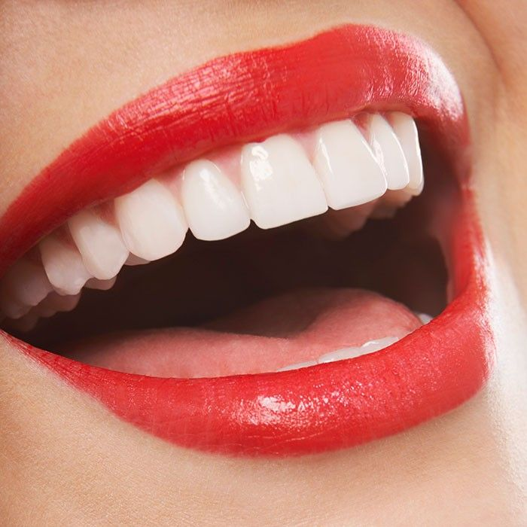
IMPACTED CANINES - TO EXTRACT OR NOT?
RISTE BRZAKOV*, BRUNO NIKOLOVSKI*, BOJAN VELKOSKI*, ANA MINOVSKA**, VERA RADOJKOVA-NIKOLOVSKA***
*ETERNAdent, Skopje;
** UGD, Stip, Faculty of Medical Sciences;
***UKIM, Skopje, Faculty of Dentistry
A canine that is prevented from erupting into a normal position, either by
bone, tooth or fibrous tissue, can be described as impacted. Impacted maxillary canines are seen in about 3% of the population. The majority of impacted canines are palatal (85%), the remaining 15% are usually buccal. One of the biggest dangers is that they can cause resorption of the roots of the lateral or central incisors and this is seen in about 12% of the cases.
Treatment options: Extraction of the impacted canine, transplantation, restoration with a dental implant or orthodontic treatment are the possible treatment plans which can help in restoring into intact dental arches with proper and unhindered movements.
As a conclusion we
can recommend that if there are any doubts about impacted teeth it is better to refer too early than
too late, this latter option may unnecessarily extend the length of treatment as well as the treatment
required.
ЗАКЛУЧОК
Од добиените резултати можеме да заклучиме кои антибиотици најчесто се употребувани кај нашите стоматолози , како и ефикасноста на одреден антибиотик во третман на одредена дијагноза, податоци кои се од големо значење за адекватна употреба на антибиотиците и развиток на фармаколошката стоматологија.

