Slide 1
Convolutional neural networks in object recognition
Mirjana Kocaleva
Семинар по МАТЕМАТИЧЕСКИ ОСНОВИ НА ИНФОРМАТИКАТА - ИМИ – БАН, ВТУ 29.03.2018

Slide 2
Content:
1. Object recognition
2. Deep learning
CNN
3. Image/Video
manual annotation
yolo framework

Slide 3
Object recognition
Object recognition - process or technology for identifying objects (things, entities) in an image or digital video.
We can recognize objects using a variety of models
Deep learning model such as CNN
machine learning models
The Viola-Jones algorithm, which can be used to recognize a variety of objects (faces and upper bodies)
Template matching
Image segmentation and blob analysis

Slide 4
Deep learning
Deep learning can be define as machine learning technique that learns features and tasks of ANNs that contain more than one hidden layers, directly from data. Data can be images, text, or sound. Learning can be supervised, partially supervised or unsupervised.

Slide 5
Deep learning

Slide 6
CNN
combination of biology, math and a little computer science
CNNs are comprised of one or more convolutional layers and then followed by one or more fully connected layers
each region of the input is connected to a neuron in the output.
Each layer applies hundreds or thousands different filters to combines the results.
There’s also pooling layers or downsampling layers.

Slide 7
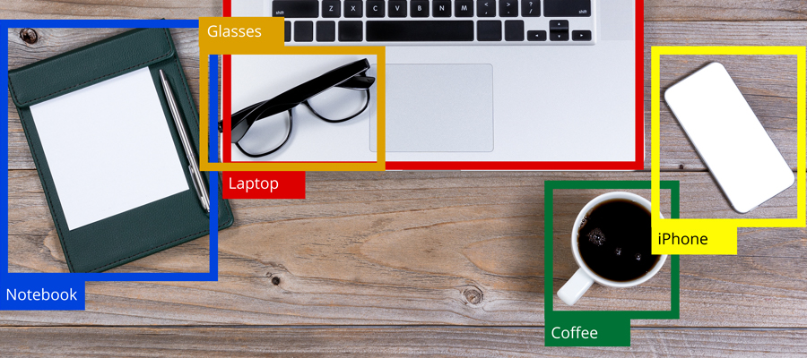
Image/video annotation
The process of manually defining regions in an image and creating a textual description of those regions is known as image annotation.

Slide 8
Labelbox, BBox-label-tool, LabelMe, Pixorize, Simple Image Annotator
We are planning to use BBox label tool for labeling our image database

Slide 9
YOLO framework
YOLO (You only look once) is a neural network for doing object detection in real-time.
YOLO uses a single CNN network to the full image for both classification and localizing the object using bounding boxes. These bounding boxes are weighted by the predicted probabilities.
The base YOLO model processes images in real-time at 45 frames per second.

