Slide 1
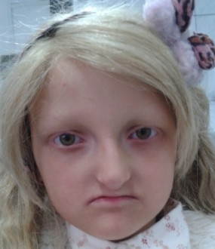
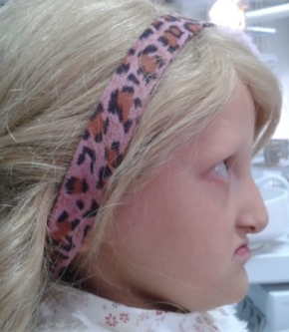
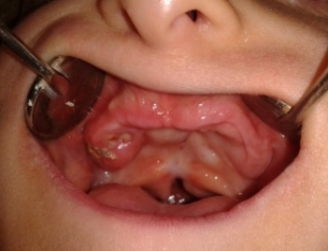
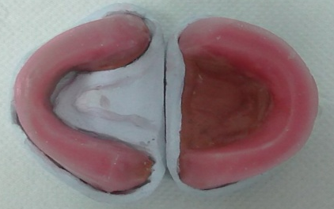
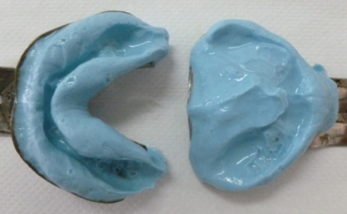
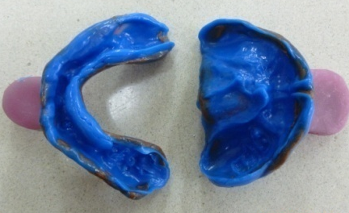
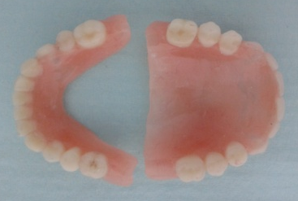
Ectodermal Dysplasia - Case Report: a Challenge for Prosthodontic Solution Bajraktarova Valjakova E¹, Bajevska J¹, Korunoska Stevkovska V¹, Kapuševska B¹, Gigovski N¹, Mijoska A¹, Zlatanovska K², Bajraktarova Miševska C³ ¹Department of Prosthodontics, Faculty of Dentistry, University “Ss. Cyril and Methodius”, Skopje, Macedonia ²Department of Prosthodontics , Faculty of Medical Sciences, University “Goce Delčev”, Štip, Macedonia ³Department of Orthodontics, Faculty of Dentistry, University “Ss. Cyril and Methodius”, Skopje, Macedonia
Introduction: Ectodermal dysplasia (ED) is a hereditary disorder characterized by developmental disturbances of two or more tissues and structures (skin, hair, nails, sweat glands, teeth structures, eye lenses, parts of the inner ear and nerves) of ectodermal embryonic origin. Hypodontia or anodontia of the primary and permanent dentition, poorly developed alveolar ridges and improper мaxillo - mandibular relations are the most common oral manifestations. Disruption during embryonic development of palatal processes in maxilla, may lead to cleft palate with varying degrees of expression.
Management of patients with ED requires a multidisciplinary team approach.
Fig. 3
Fig. 4
Fig. 1
Fig. 2
Fig. 3 / 4. Intraoral photographs of maxilla and mandible:
Complete bilateral cleft palate was partially solved on 1.5 year of age. The oro-nasal comunication was closed with a soft palate only, with an uneven surface. An alveolar ridge in the mandible is rather atrophic. There is severe hypodontia with carious deciduous and permanent molar teeth in the upper jaw and deciduous canines and permanent molar teeth destroyed by caries in mandible. The gingiva is rather swollen and inflamed with dark red color, especially around the teeth.
Fig. 1 / 2. Frontal and profile view of a girl with ED:
Square and bossing forehead, prominent supraorbital ridges, slightly pigmented and wrinkled eyelids, wide nose base with anteverted nostrils, thin lips, and pointed chin. Hypotrichosis is characterized by almost no eyebrows, eyelashes and skin hairs; the sculp is covered with a wig. The skin is dry (hypohidrosis), thin, rough and shiny. Decreased lower facial height, together with deep mentolabial and nasolabial folds contributed to an old-looking facial expression.
Fig. 7
Fig. 5
Fig. 6
Fig. 7. Maxillo-mandibular relations were recorded using temporary bases and wax rims.
Fig. 8
Fig. 5. Preliminary impressions were taken with stock trays and irreversible hydrocolloid material.
Fig. 6. Final impressions were taken with thermoplastic material and light body polyvinyl siloxane impression material using the custom-made trays.
Fig. 8. Artificial teeth, reshaped considering the child’s age, were arranged according to a balanced occlusion.
Fig. 9 / 10. The maxillar and mandibular prosthesis were produced in the heat cure acrylic resin.
Fig. 9
Fig. 10
Conclusion: Correct maxillo - mandibular relations and normal function of the dento-facial system in patients with ED, can be established by the acrylic dentures. Prosthodontic treatment has a major impact not only on the aesthetic and functions, but on the psychological development and emotional condition of the patients as well.

