Slide 1
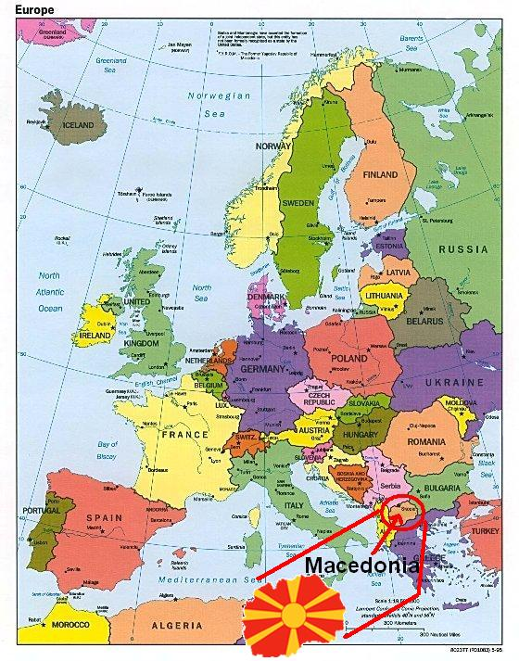

Slide 2
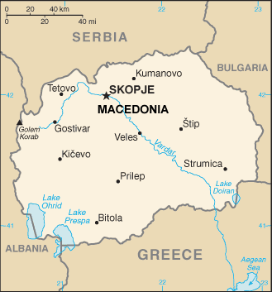
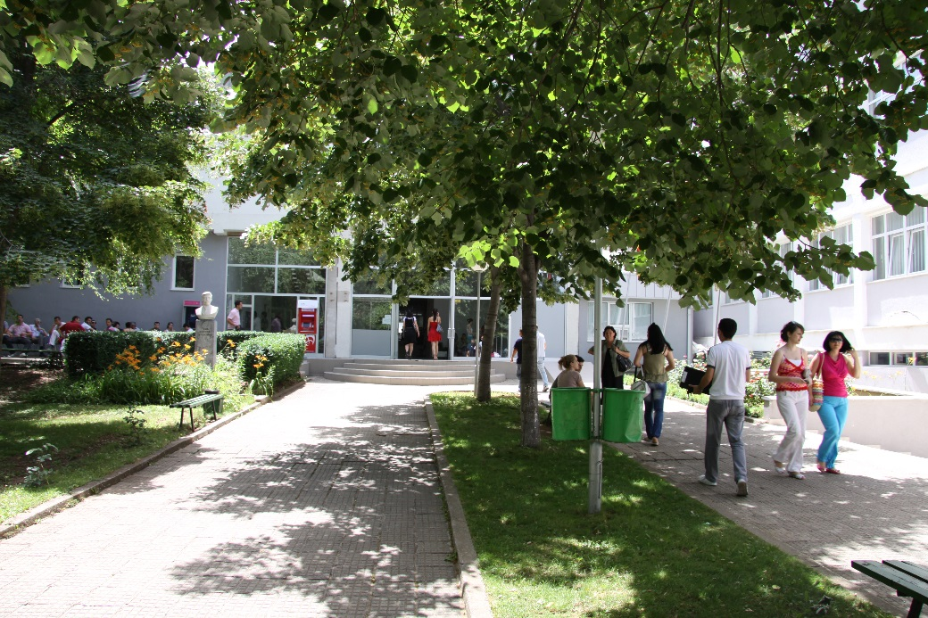
UNIVERSITY CENTERS
FACTS ABOUT US:
THE UNIVERSITY IS FOUNDED ON 27TH OF MARCH 2007
THE SEAT OF THE UNIVERSITY IS IN SHTIP
THE UNIVERSITY HAS TEACHING CENTERS IN 12
CITIES OF THE REPUBLIC OF MACEDONIA
13 FACULTIES
MORE THAN 100 STUDY PROGRAMS

Slide 3
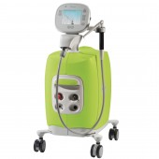
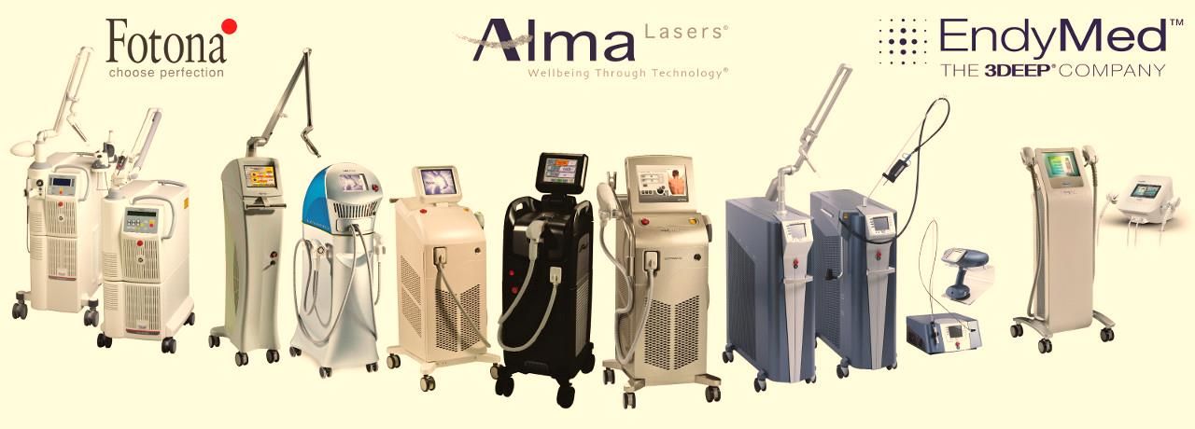
LASERS IN DENTAL SCINCE
AND PRACTICE
MINOVSKA ANA
Professor, Phd, University “Gocedelcev”, Faculty Of Medical Sciences – Stip Macedonia
Notes:
PROPER UNDERSTANDING OF THE SCIENCE OF LASERS IN DENTAL PRACTICE IS IMPERATIVE IN AFFORDING THE CLINICIAN THE KNOWLEDGE AND ABILITY TO DELIVER OPTIMAL TREATMENT TO PATIENTS.
MANY LASER PROCEDURES ARE TECHNIQUE SENSITIVE, AND THUS KNOWLEDGE OF THE SCIENTIFIC BASIS OF THE TREATMENT WILL ENABLE THE PRACTITIONER TO IMPROVE AND REFINE THE TECHNIQUES ASSOCIATED WITH THE CLINICAL PRACTICE AND ARTISTRY OF DENTISTRY.

Slide 4
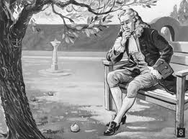
WHAT WE SHOULD BE AWARE OF?
1.
2.
Dentists are generally familiar with how things move, the forces that move them, and the thermodynamic consequences of these forces. These are accurate explanations for everyday clinical experiences in dentistry.
DENTAL EDUCATION RELIES UPON THE CONCEPTS OF CLASSICAL NEWTONIAN MECHANICS.
The foundations of quantum mechanics were established during the first half of the 20th century by
MAX PLANCK, NIELS BOHR,
Werner Heisenberg, Louis de Broglie,
Arthur Compton, ALBERT EINSTEIN,
Erwin Schrödinger, Max Born,
John von Neumann, Paul Dirac,
Enrico Fermi, Wolfgang Pauli, Max von Laue, Freeman Dyson, David Hilbert,
Wilhelm Wien, Satyendra Nath Bose,
Arnold Sommerfeld and others.
3.
IN THE SCIENCE OF LASER-TISSUE INTERACTIONS, HOWEVER, THE CLINICAL CONSEQUENCES ARE THE RESULT OF AN ENTIRELY DIFFERENT SET OF LAWS CALLED QUANTUM MECHANICS.

Slide 5
Lasers in Dentistry: Minimally Invasive Instruments for the Modern Practice
OFFICES WHERE LASERS ARE INCORPORATED INTO TREATMENT OPTIONS ARE CONSIDERED “CUTTING EDGE” AND HAVE A UNIQUE PSYCHOLOGICAL AND PROMOTIONAL ADVANTAGE OVER THOSE THAT DO NOT OFFER SUCH SERVICES.
SELECTIVE AND PRECISE INTERACTION WITH THE TISSUES
BENEFITS
ABILITY TO REDUCE THE BACTERIAL LOAD (AND OTHER PATHOGENS) IN THE SURGICAL FIELD, IN THE CASE OF SOFT/HARD TISSUE PROCEDURES
GOOD HEMOSTASIS WITH THE REDUCED NEED FOR SUTURES.
White JM, Goodis HE, Rose CL. Use of the pulsed Nd:YAG laser for intraoral soft tissue surgery. Lasers Surg Med. 1991;11:455-461.
Notes:
Commercially available dental laser instruments all have emission wavelengths in the range of 488 nm to 10,600 nm (1 nm equals one billionth of a meter), and all are nonionizing radiation. This is to be distinguished from ionizing radiation, which is mutagenic as a result of effects on DNA. Dental lasers emit thermal, or heat, radiation.

Slide 6
Lasers in Dentistry: Minimally Invasive Instruments for the Modern Practice
RELATIVELY HIGH COST
DISADVANTAGES
THE NEED FOR TRAINING
THE END CUTTING NATURE OF THE DESIGN
AND THE FACT THAT NO SINGLE WAVELENGTH IS IDEAL FOR ALL CLINICAL PROBLEMS

Slide 7
PROCEDURES THAT CAN BE PERFORMED MUCH MORE QUICKLY AND EFFICIENTLY WITH LASERS INCLUDE THE FOLLOWING:
Laser tissue retraction for impressions
Implant recovery and impression immediately after uncovering
Gingivectomy to improve access for operative dentistry, especially Class V lesions and root caries
Multiple-quadrant operative dentistry
Soft tissue and hard (osseous) tissue crown lengthening
Apicoectomy
Exposure of unerupted teeth
Frenectomy
Implant placement/sinus lift/periimplantitis treatment
Vestibuloplasty before full-denture fabrication
Notes:
Laser as Profit Center
There are many ways to evaluate the viability of a laser as a profit center in the dental office. Time is money, and all practices must gross a certain hourly income to flourish, so the ability to perform many procedures more quickly and efficiently means extra income.

Slide 8
PROCEDURES NOT PREVIOUSLY DONE THAT ENHANCE THE RESULTS OF ROUTINE PROCEDURES INCLUDE THE FOLLOWING:
Ovate pontic site preparations
Periodontal pocket disinfection
Graft donor site palliation
Graft bed site preparation
Esthetic remodeling of bulky graft sites
Esthetic crown lengthening/gingivoplasty
Melanin depigmentation
Laser tooth whitening
Tooth desensitization

Slide 9
CERTAIN REFERRED PROCEDURES NOW STAY IN THE PRACTICE, AS FOLLOWS:
Tuberosity/torus reduction
Biopsy
Orthodontic and drug-induced tissue hypertrophy
Osseous periodontal surgery/de-epithelialization
Lingual frenum removal
Oral medicine procedures, such as treatment of :
aphthous ulcers,
herpetic gingivostomatitis, and lichen planus

Slide 10
BENEFITS
CHOOSING A LASER FOR DENTAL PRACTICE
/ / due to wavelengths interaction with various chromophores such as hemoglobin, melanin, and water i.e. laser-tissue interaction. /
1.
LASER USE IS MINIMALLY INVASIVE
Laser Wavelengths & Associated Targets
514 | Argon or Dye | Melanin, Blood
532 | Doubled Nd:YAG | Melanin, Blood
578 | Copper Vapor | Blood
555-600 | Pulsed Dye | Blood
694 | Ruby | Melanin
755 | Alexandrite | Melanin, Blood
810 | Diode | Melanin, Blood
1064 | Nd:YAG | Melanin, Blood
1319 | Nd:YAG | Water
2940 | Erbium YAG | Water
10600 | CO2 | Water
A chromophore is the part of a molecule responsible for its color.
The color arises when a molecule absorbs certain wavelengths of visible light and transmits or reflects others.
en.wikipedia.org/wiki/Chromophore
Notes:
/Understanding how photonic energy is minimally invasive requires a basic knowledge of laser physics and how different wavelengths interact with various chromophores such as hemoglobin, melanin, and water./

Slide 11
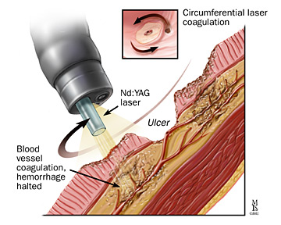
2.
LASER USE OFFERS IMPROVED HEMOSTASIS COMPARED TO SCALPEL
The warming of tissue to more than 60°C will result in protein denaturation and coagulation, which are properties useful in controlling bleeding.¹
Consideration should be given to the use of a hot-tip technique, which converts light energy into thermal energy at the end of the fiber, thus limiting the ability of photonic energy to penetrate into the tissue.²
1.Knappe V, Frank F, Rohde E. Principles of lasers and biophotonic effects. Photomed Laser Surg 2004;22(5):411-417.
2. Bornstein E. Near-infrared dental diode lasers. Scientific and photobiologic principles and applications. Today 2004;23(3):102-104, 106-108.

Slide 12
3.
LASER ENERGY CAN AID HEALING THROUGH PHOTOBIOMODULATION
- laser treatment at low energy levels can be useful and beneficial for healing and regeneration.
1.Tuner J, Hode L. Laser therapy: Clinical practice and scientific back-ground. Grängesberg, Sweden: Prima Books AB, 2002:40-44.
2.Ohshiro T, Calderhead RG. Development of low reactivelevel laser therapy and its present status. J Clin Laser Med Surg 1991;9(4):267-275
4.
LASER IRRADIATION CAN REDUCE BACTERIA
- bacterial reduction has been found to occur at temperatures as low as 50°C.
1.Harris DM, Yessik M. Therapeutic ratio quantifies laser antisepsis:Ablation of Porphyromonas gingivalis with dental lasers. Lasers Surg Med 2004;35(3):206-213.
2.Whitters CJ, MacFarlane TW, Mackenzie D, Moseley H, Strang R. The bactericidal activity of pulsed Nd-YAG laser radiation in vitro. Lasers Med Sci 1994;9(4):297-303.
3. Ando Y, Aoki A, Watanabe H, Ishikawa I. Bactericidal effect of erbium YAG laser on periodontopathic bacteria. Lasers Surg Med 1996;19(2):190-200.
LASER ENERGY CAN REDUCE PAIN /Associated reported laser benefits are reduced pain and discomfort after surgery.80 Reports of pain relief mechanisms appear to
originate in stimulating oxidative phosphorylation in mitochondria and through modulating inflammatory responses.81
5.

Slide 13
WHEN A CLINICIAN DECIDES TO USE A LASER AS PART OF TREATMENT, IT IS ESSENTIAL THAT THE USER HAS A CLEAR UNDERSTANDING OF PHOTOBIOLOGY.
INTERACTIONS OF NONIONIZING ELECTROMAGNETIC RADIATION WITH TISSUES AND THE MOLECULAR COMPONENTS THAT COMPRISE TISSUES.

Slide 14
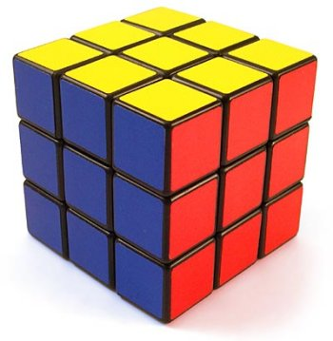
THE LASER-TISSUE INTERACTION CUBE
Biologic level of interaction
Biologic response
Tissue
Cell
Z
Organelle
Y
Long-term healing
X
Delayed response
Photochemical
Photobiomodulation
Immediate physical effect
Photo thermal
Photodisruptive
When laser energy irradiates tissue the resulting event will map somewhere in this cube.
Mechanism of action-consequences
Notes:
The laser-tissue interaction cube comprises three axes: (x) the mechanisms of interaction, (y) the time course of the tissue response, and (z) the level of biologic structures. When laser energy irradiates tissue and something happens, the resulting event will map somewhere in this cube.

Slide 15
PHOTOBIOLOGY OF NEAR-INFRARED LASER ENERGY
NIEMZ HAS DETERMINED THAT ALL EFFECTS WITH INFRARED LASER WAVELENGTHS AT PULSE DURATIONS OF 1 MICROSECOND OR GREATER
ARE THERMAL IN NATURE.
There are 5 factors to consider regarding heat generation :
wavelength and optical penetration depth of the laser;
(2) absorption characteristics
of exposed tissue;
(3) temporal mode (pulsed or
continuous);
(4) power density of the laser
beam and
(5) exposure time;
Niemz H.M. Laser-Tissue Interactions. Fundamentals and Applications, Berlin, Springer, pp45-80, 2002

Slide 17
TO BE THERAPEUTICALLY EFFECTIVE AND EFFICIENT,
IT IS NECESSARY TO DELIVER LIGHT OF SUFFICIENT ENERGY OVER TIME
TO EFFECT TISSUE CHANGE,
WITHOUT CAUSING UNWANTED COLLATERAL THERMAL DAMAGE BY CONDUCTION OF EXCESS HEAT INTO THE SURROUNDING TISSUES.

Slide 18
THESE EFFECTS DEPEND ON DIFFERENT LASER PARAMETERS :
WAVELENGTH, AVERAGE POWER, PULSE ENERGY,
PULSE DURATION, PULSE PAUSE, REPETITION RATE,
DUTY CYCLE, DIFFERENT FIBER DIAMETERS,
DIFFERENT HAND PIECES (FOCUSSING AND NON-FOCUSSING), DOSE, TOTAL ENERGIES, PEAK OR PULSE POWER,
IRRADIANCE, FLUENCE, BEAM DIAMETER ETC.
Notes:
AND THIS OVERWHELMING MAGNITUDE OF DIFFERENT LASER PARAMETERS IS ONE THING THAT MAKES LASER MEDICINE AND LASER DENTISTRY SO COMPLICATED AT FIRST. SOME CAN BE CHANGED DIRECTLY ON THE DISPLAY OF THE LASER SYSTEM, OTHERS CANNOT.

Slide 19
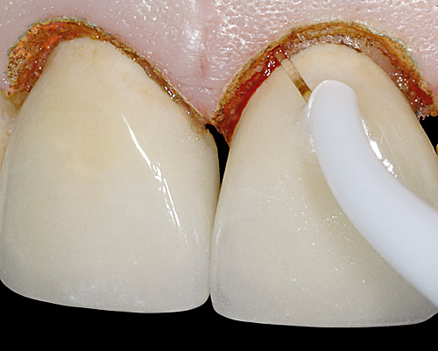
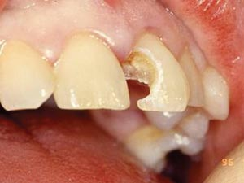
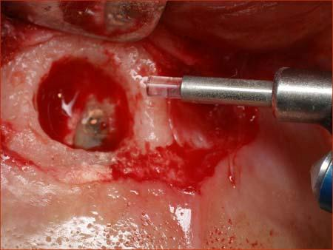
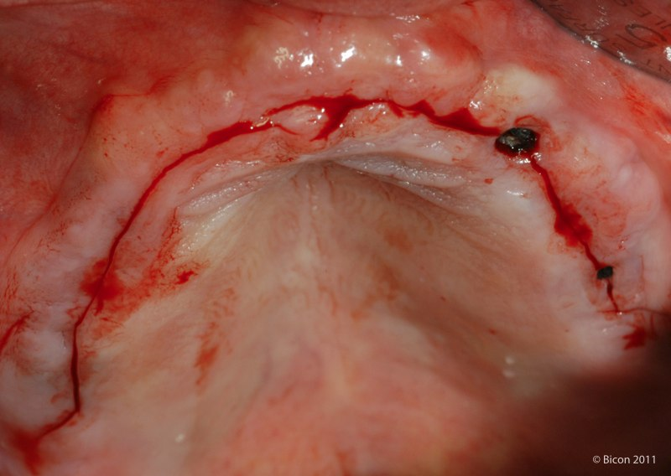
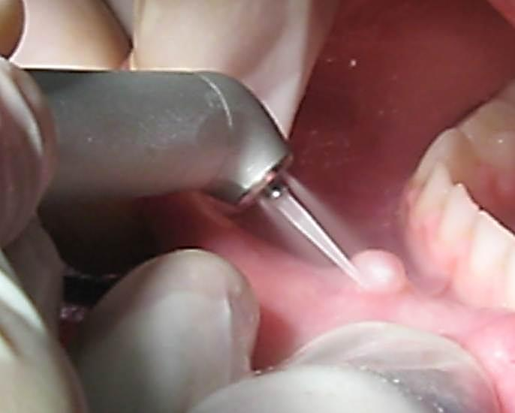
WHEN THE WAVELENGTH OF INCIDENT LASER LIGHT IS MATCHED TO THE ABSORPTION BAND(S) OF A TARGET TISSUE COMPONENT, LIGHT ENERGY IS CONVERTED PRIMARILY TO HEAT WHICH CAUSES TISSUE CHANGE AND/ OR ABLATION.
TOOTH/ENAMEL
SOFT TISSUE
BONE
INCISION
EXCISION

Slide 20
ABLATION OF HARD DENTAL TISSUES BY MID-INFRARED LASERS
Araki, Ângela Toshie, Ibraki, Yuji, Kawakami, Tomofumi, & Lage-Marques, José Luiz. (2006). Er:Yag laser irradiation of the microbiological apical biofilm. Brazilian Dental Journal, 17(4), 296-299.
Mechanism of interaction When incident laser energy directed onto hard dental tissue is absorbed by the prime chromophores, either water or carbonated hydroxyapatite, one of two effects occur. For both Er:YAG and Er,Cr:YSGG wavelengths this energy is absorbed primarily by the water and is rapidly converted to heat, which causes superheating and a phase transfer in the subsurface water, resulting in a disruptive expansion in the tissue. Through this mechanism, whole tissue fragments are ejected and a hole is cut in the tooth, with little or no alteration to the mineral itself.
If laser light is effectively absorbed by the mineral, the crystals themselves may be heated above their melting point and some disruption of the crystal structure occurs with subsequent resolidification in a different form, or direct ablation of the mineral, but there is also conductive heat transfer to interstitial free water.33-37 Relatively high fluences are needed at these wavelengths for this to occur.

Slide 21
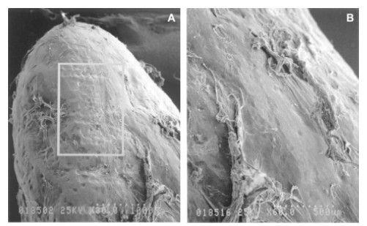
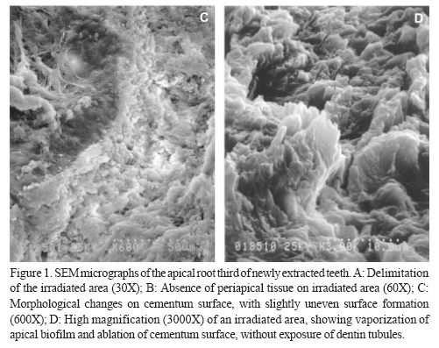
The results were based on a morphological analysis of SEM micrographs. Figure 1 shows an Er:YAG laser irradiated area on the apical root third (A) and irradiated and non-irradiated areas with periodontal tissue (B). Morphological changes can be observed on the apical surface with slightly uneven superficial formations (C). The irradiated area at high magnification (3000X) shows vaporization of microbio logical apical biofilm, periodontal tissue and part of the cementum surface without dentin exposure (D).
Advantages of using erbium laser for operative dentistry include:
• Precise ablation allows for minimally invasive preparations
• Smear layer removal
• Disinfection of preparations
• Eliminates the noise, heat, and vibration of high speed rotary instrumentation
• Reduced need for local anesthesia
• Selective caries removal due to carious dentin’s higher water content and softer consistency

Slide 22
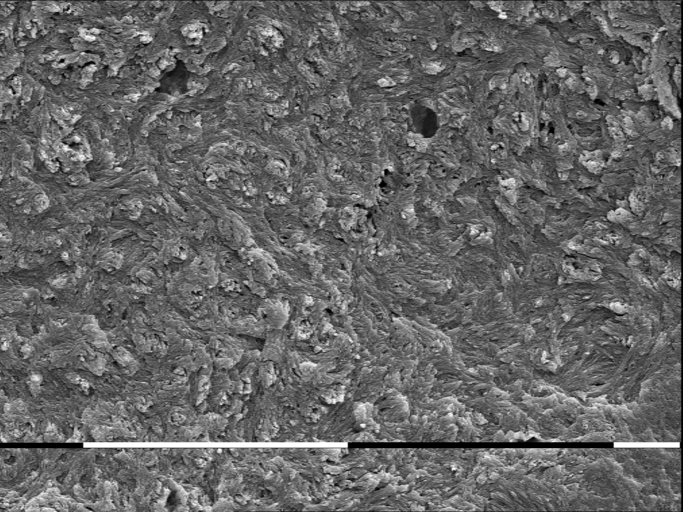
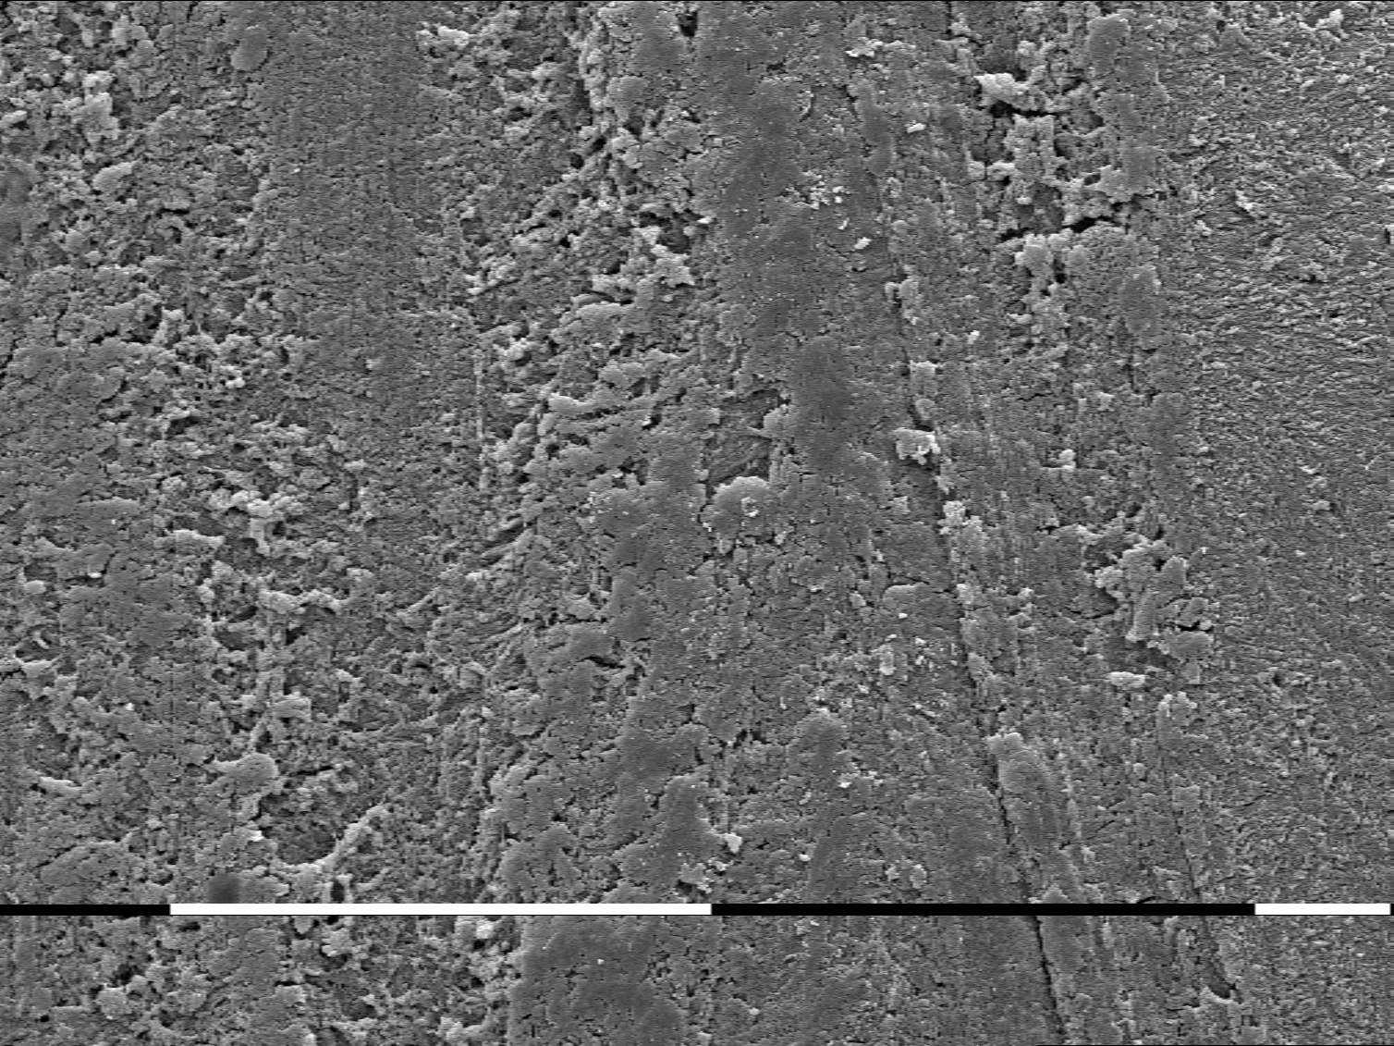
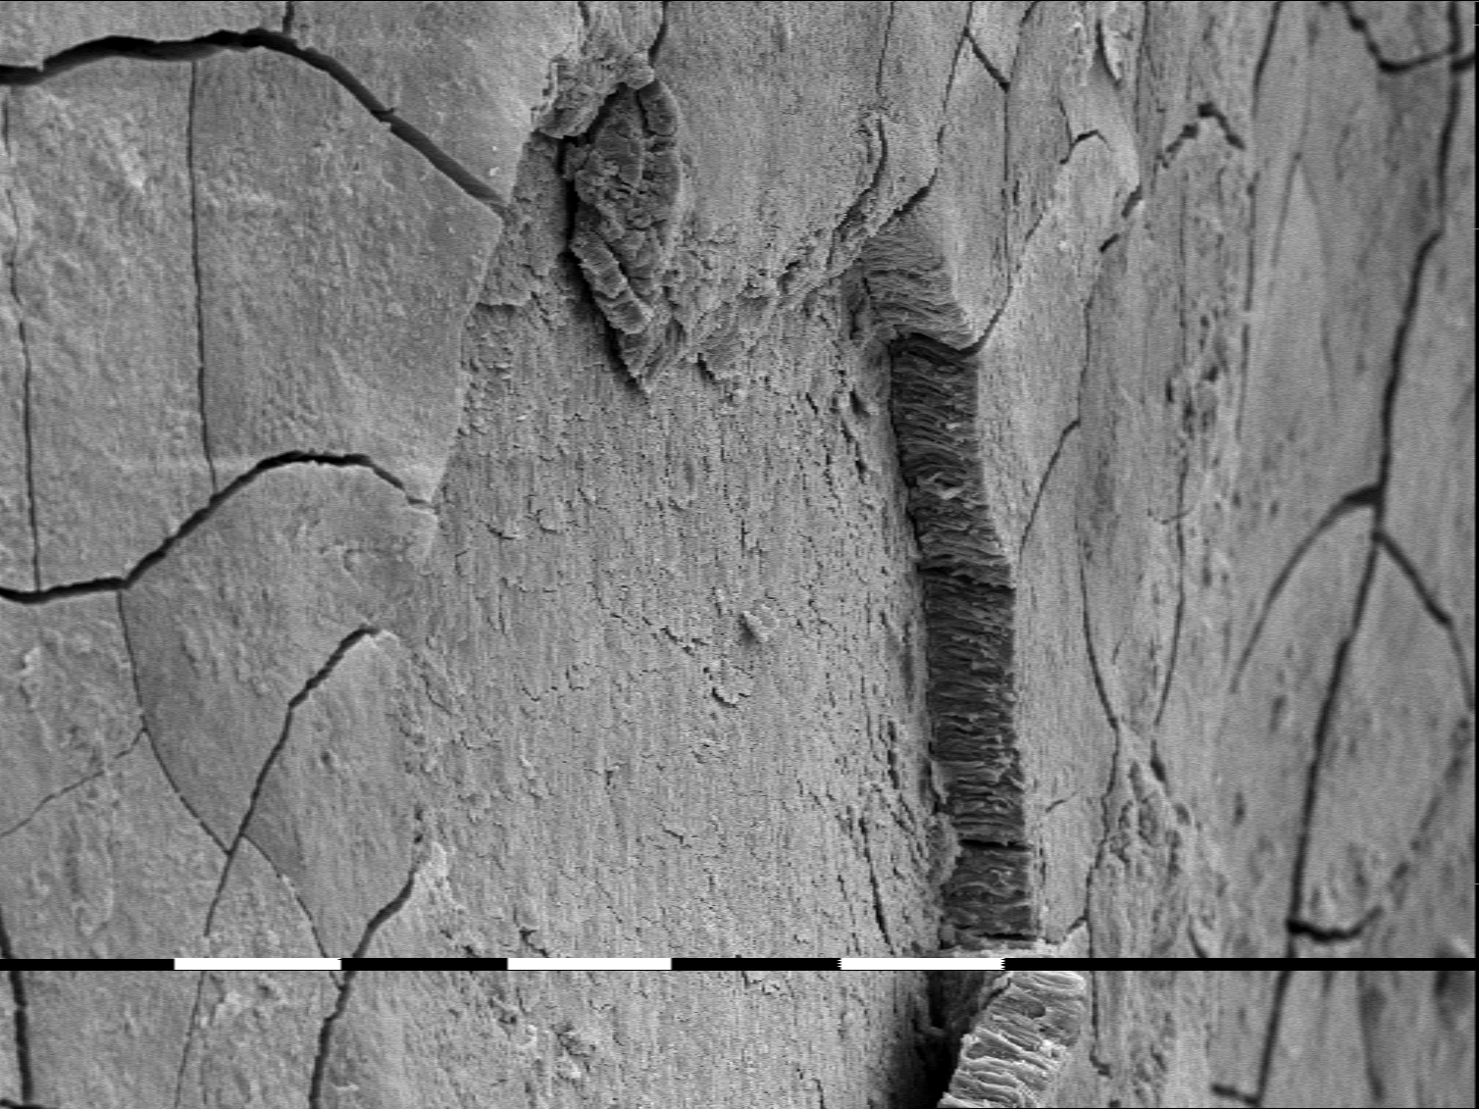
Before treatment
Treated with laser “chisel tip”
Treated with “curette”
hand instrument have produced a plane surface, but removed more tooth structure. The laser treated specimens showed rough surfaces without much residual deposit or any other sign of morphological change.

Slide 23
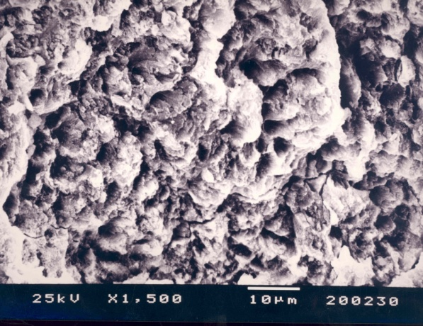
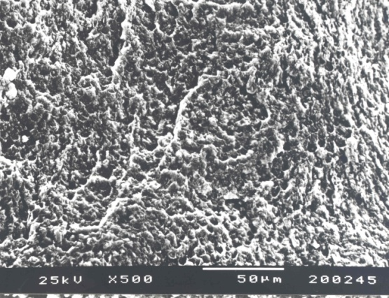
Enamel. 100 mj. 10 Hz. With water cooling. Honey-comb appearance can be seen but not throughout the surface which is due to non-homogenous application of the laser.
Enamel. 250 mj. 10 Hz. With water cooling. Serrated surface with honey-comb appearance.

Slide 24
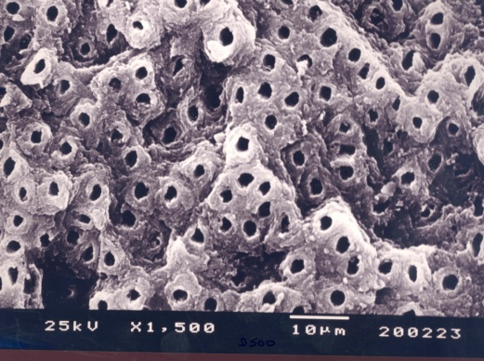
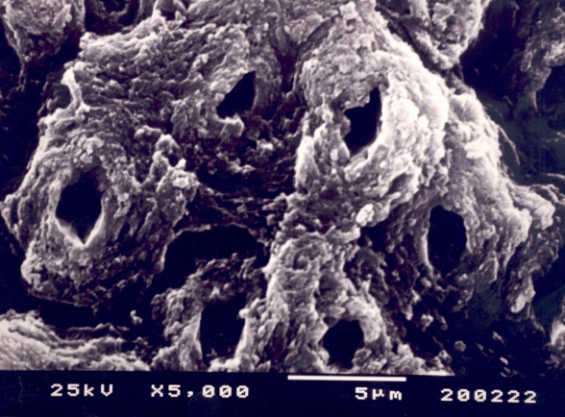
Dentin. 250 mj. 5 Hz. With water cooling. Higher magnification of the surface in Fig. 16. No signs of thermal damage. No melted and swollen dentin. All dentinal tubules are open. Adequate surface for bonding procedures.
Dentin. 250 mj. 5 Hz. With water cooling. Higher magnification of the surface in Fig. 17. No signs of thermal damage.

Slide 25
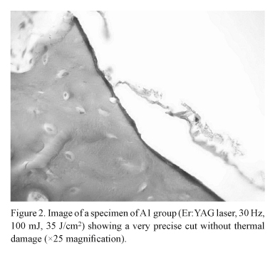
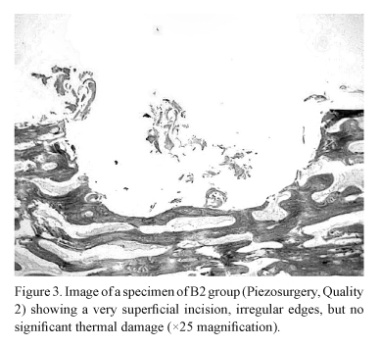
Romeo Umberto, Del Vecchio Alessandro, Palata Gaspare, Tenore Gianluca, Visca Paolo, Maggiore Claudia. Bone damage induced by different cutting instruments: an in vitro study. Braz. Dent. J. [Internet]. 2009 [cited 2015 May 09

Slide 26
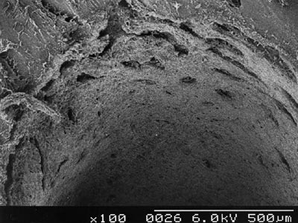
Scanning electron micrograph showing the cutting effect of Er:YAG laser light on bone
S. Parker. Verifiable CPD paper: Laser-tissue interaction. British Dental Journal 202, 73 - 81 (2007)

Slide 27
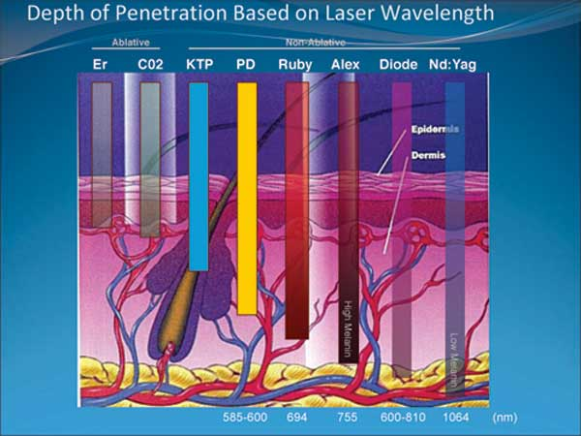
SURGICAL APPLICATIONS OF DENTAL LASERS - SOFT TISSUE SURGICAL DEVICES
ALL FOUR MAJOR WAVELENGTHS OF DENTAL LASERS ARE

Slide 28
Photo thermal effects
Tissue temperature ° (C) Observed effect
37–50 Hyperthermia
60–70 Coagulation,
protein denaturation
70–80 Welding
100–150 Vaporization, ablation
>200 Carbonization

Slide 29
Histological examination of erbium incised tissue exhibits almost no tissue damage or inflammatory response.
Diode and Nd:YAG lasers exhibit much deeper tissue penetration and thermal effects than the erbium lasers and the potential for tissue damage is greater.
thermal effects of diodes, Nd:YAG and CO2 lasers must be understood to avoid collateral damage, but in properly trained hands these devices are quite effective. Erbium lasers pulsed technology, shallow penetration, and water absorption produces a minimal thermal effect and minor procedures can sometimes be achieved with no anesthetic at all. The nearly “cold cutting” effect of erbium tissue interaction creates a remarkable post-operative course.

Slide 30
CHOOSING A LASER FOR DENTAL PRACTICE
FIRST: determine which laser is able to perform the treatments you want the laser to do.
Treba da sledi opis na dvete grupi ili kategorii na laseri
Cold laser: that use photobiostimulation to produce an effect without generating heat
Hot laser: that use photothermal reaction, which generate heat in target tissue to produce an effect.
Considering all the effects we want our laser to be able to produce, we should realize that laser closest to doing everything is ERBIUM: YAG “ the laser for all purpose.”

Slide 31
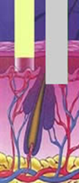
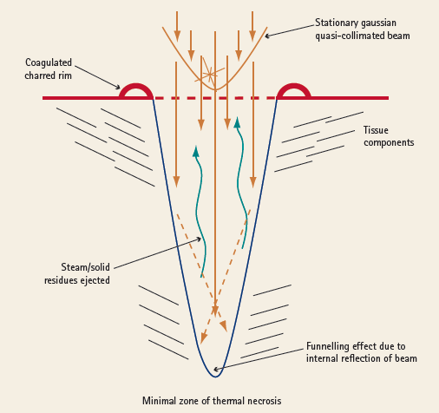
WHY ER:YAG LASER?
HAVE THE ABILITY TO EFFECTIVELY ABLATE, INCISE AND EXCISE BIOLOGICAL TISSUE: SOFT and HARD
The” ALL TISSUE LASER” IS PRACTICAL.
Longer wavelengths 2940 nm, being maximally absorbed by WATER-BASED CHROMOPHORES
- little sub-surface disruption.
Depth 0,1 mm
Tissue ablation – 10 µm.
Thermal damage- 5 µm
Tissue ablation (also called vaporization) is used to remove only the surface - the epithelium or to the epithelium and underlying superficial submucosa.

Slide 32
Studies have shown additional benefits with laser use, such as minimal wound contraction91 and minimal scarring when compared to scalpel surgery.92 Researchers comparing CO2 laser vs. scalpel and electrosurgery demonstrated less tissue damage
with the laser compared to electrosurgery or conventional instruments93 and a higher production and release of growth factors in laser sites compared to scalpel sites.94

Slide 33
IN SCIENCE
The energy used is indicated in Joule (J), which is the number of milliwatts x the number of seconds of irradiation.
Thus, 50 mW x 60 seconds produces an energy of 3000 millijoules, equals 3 J. Suitable therapeutic energies range from 1-10 J per point.
The dose is expressed in J/cm2. To calculate the dose, the irradiated area must be known.
1 J over an area of 1 cm2 = 1 J/cm2. 1 J over an area of 0.1 cm2 = 10 J/cm2. There is generally no heat sensation or tissue heating involved in this therapy.
There are more than 2500 scientific studies in the field of laser therapy(LLLT), among them more than 100 positive double blind studies [3]. In dentistry alone, the number of studies are some 325, from 82 institutions in 37 countries [4]. The quality of these studies vary but it is interesting to note that more than 90% of the studies report on positive effects of laser therapy. [3] Tunér J, Hode L. 100 positive double blind studies - enough or too little? Proc. SPIE, Vol 4166, 1999: 226-232. [4] Tunér J, Hode L. Low level laser therapy - clinical practice and scientific background. 1999. Prima Books. ISBN 91-630-7616-0.
In total, 30 different dental indications have been reported in the literature. The very variety of indications has been used as an argument against the probability of laser therapy. However, it rather shows the input on general biological systems, such as the immune system, SOD activity, ATP production, cell membrane permeability, release of transmitter substances etc.

Slide 34
IN SCIENCE
Laser therapy science is a complicated matter where a combined knowledge about laser physics, medicine, clinical procedures and scientific rules is essential [5]. Many studies, positive and negative, lack relevant reporting parameters and make a proper evaluation difficult. The existing literature is a sufficient foundation for successful clinical therapy but more research is still needed to find out the optimal parameters. [5] Tunér J, Hode L. It´s all in the parameters: a critical analysis of some well-known negative studies on low-level laser therapy. Journal of Clinical Laser Medicine & Surgery. 1998; 16 (5): 245-248.
Non-biomodulating LLLT
A large number of in vitro studies have reported on the enhanced killing of bacteria using various dyes in combination with low level lasers. The most frequently used dye has been toluidine blue (TBO) and some of the microorganisms studied are streptococcus mutans (20) and staphylococcus aureus (21). The bactericidal effect of TBO is enhanced by low level laser light and the clinical implications of this combination in cariology and periodontology are indeed promising. Low level laser has also been shown to enhance the release of fluoride from lacquers (22) and resin cements (23).
[21] Wilson M, Yianni C. Killing of methicillin-resistant staphylococcus aureus by low-power laser light. J Med Microbiol. 1995; 42: 62-66.
[22] Kazmina S et al. Laser prophylaxis and treatment of primary caries. SPIE Proc. 1984; 1994: 231-233.
[23] van Rensburg S D, Wiltshire W A. The effect of soft laser irradiation on fluoride release of two fluoride-containing orthodontic bonding materials. J Dent Assoc S Afr. 1994; 49 (3): 127-31

Slide 35
while the peak power is

Slide 36
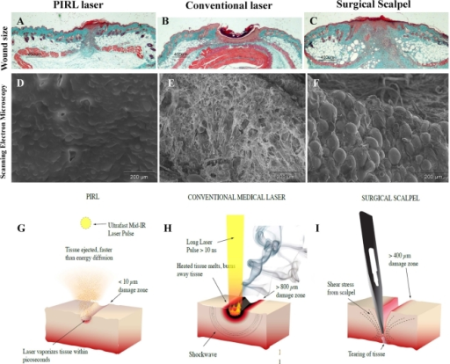
Ultrafast Mid-IR Laser Scalpel; Approaching to Scar-less Surgery
Nik SA - Int J Prev Med (2010)
Figure 0001: Minimal tissue ablation with less damage of surrounding tissues by using the PIRL laser. Scanning electron microscopy (SEM) of skin at the cut borders. (A) The PIRL laser kept the collagen layer intact. (B) The conventional laser damaged (burned) skin and deformed the collagen fibres resulting in a damaged, irregular extracellular matrix surface. (C) The scalpel damaged the skin by shearing between the collagen fibres and exposing individual cells (Arrow shows an adiopocytes which is exposed in this image). (D-F) Representative histologic sections of healed skin of excisional 4mm circular full thickness wounds using the three methods at 9 days post wounding. (D) PIRL Laser (E) Conventional Laser (F) Skin Biopsy Punch. (G-I) Schematic of cutting modalities. (G) The well absorbed PIRL pulses cause superheating of water inside the tissue on the picosecond timescale, ejecting the tissue faster than energy can diffuse to the surroundings area. The remaining adjacent tissue shows minimal damage compared to the other two modalities. (H) Conventional surgical lasers cut by depositing heat until the tissue melts or burns away. The damage zone in this case, can reach up to 800 µm away from the ablated edge. (I) The mechanical scalpel cuts skin by producing shear forces which exceed the elastic limit of the tissue. This causes a border of damage around the incision which reaches as far as 400 µm from the borders of the incision.
Mentions: To determine how the various modalities ablate tissue differently, the skin of the mouse subject was cut to a linear full thickness cut using the PIRL system, a commercial Er:YAG surgical laser (long pulse) at the exact same wavelength, or a conventional surgical scalpel. Transmission electron microscopy and scanning electron microscopy of the incised border revealed that the conventional laser damaged the skin border up to 800 μm away from the visible edge and the surgical scalpel caused dissociation of extracellular matrix fibres up to 400 μm further from the edge (Figure 1A–C). By comparison, cuts done with the PIRL system had sharp edges and minimal damage to adjacent tissue. The PIRL system generated a cutting gap of 8 μm, smaller than the diameter of a single skin fibroblast which was observed in the same skin sections. In contrast, the measured gap for scalpel incisions ranged from 40 to 120 micrometers and 650 μm for the conventional laser (data not shown). Wounds that were formed using the PIRL system had a higher number of viable skin cells immediately adjacent to the cut as compared to the other modalities (data not shown). Taken together, these results show that PIRL produces substantially less damage to the extracellular matrix and cells surrounding the wound, and ablates a much lower volume of tissue to execute the same function in comparison to a conventional laser and surgical scalpel.

Slide 37
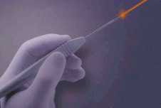
Schwarz et al. 2003, 120 mJ/pulse (14.5 J/cm²) 10 Hz, water spray 15–20_ contact (chisel tip). In vivo selective subgingival calculus removal to a level equivalent to that provided by scaling and root planning.
Frentzen et al. 2002 , 100 or 120 mJ/pulse (18.8 or 14.5 J/cm2 per pulse 10 Hz, water spray 20_ contact (chisel tip) Clinically adequate debridement without carbonization or other side-effects of clinical relevance.
Keller & Hibst 1997 , 120 or 150 mJ/pulse (15.0 or 18.8 J/cm2 per pulse 10 or 15 Hz, water spray 20 or 40_ contact (chisel tip) Effective calculus removal with a chisel-type tip without thermal alteration of the root surface.
Laser irradiation exhibit bactericidal and detoxification effects without producing a smear layer, and the laser treated root surface may therefore provide favorable conditions for the attachment of periodontal tissue.

Slide 38
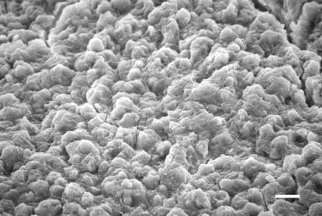
Schoop et al.2002 reported that the surface structure of periodontally diseased root after Er:YAG laser irradiation at 100 mJ/ pulse (energy density 5.98 J/cm2) and 15 Hz with water spray offered better conditions for the adherence of fibroblasts in vitro than a root surface after mechanical scaling only.
Researches conducted so far has indicated the safety and effectiveness of clinical application of the Er:YAG laser for periodontal pocket treatment, including root surface debridement.
Er:YAG laser irradiation may be a promising, useful adjunctive or alternative method to the conventional technique for root preparation and pocket curettage.
The micro structurally and thermally changed root surface produced by Er:YAG laser irradiation may influence the attachment of soft periodontal tissues.
Photograph from Aoki A et al. In vitro evaluation of Er:YAG laser scaling of subgingival calculus in comparison with ultrasonic scaling. J Periodontal Res 2000: 35: 5: 266-277;

Slide 39
Lasers in Dentistry: Usually Asked Question
What are specific procedures that the laser would perform in my practice?
Can one device perform all indicated clinical procedures?
Is the technology reliable?
Is it difficult to learn and operate a dental laser device?
Is the substantial investment, in terms of equipment and training, justified?

Slide 40
ER:YAG THERAPY
REASONS THAT SEEMS TO BE AN EFFICIENT ALTERNATIVE FOR NON-SURGICAL PERIODONTAL TREATMENT:
GOOD BACTERICIDAL EFFECT EVEN AT LOW ENERGY DENSITY OUTPUT LEVELS, STARTING AT 0.3 J/CM2, WITHOUT EXCESSIVE TEMPERATURE ELEVATION.¹
IN COMPARISON TO ULTRASONIC SCALING, A SIMILAR REMOVAL OF CALCULUS CAN BE OBTAINED BUT SUPERFICIAL STRUCTURAL AND THERMAL MICRO-CHANGES IN THE FORM OF MICROROUGHNESS WERE FOUND ON ROOT CEMENTUM ²
MOST PROBABLY AS A RESULT OF THE ELIMINATION OF BACTERIA AND ENDOTOXINS ON ROOT SURFACES, HUMAN GINGIVAL FIBROBLASTS ADHERE AND GROW SIGNIFICANTLY FASTER ON A 60 MJ ER:YAG PRETREATED SURFACE THAN AFTER SRP.³
USING LOW RADIATION ENERGIES, CALCULUS REMOVAL CAN BE DONE WITH A CERTAIN SELECTIVITY, COMPARABLE TO THAT OF CONVENTIONAL ROOT SURFACE INSTRUMENTATION. IT IS POSSIBLE TO REMOVE CALCULUS WITH A SIGNIFICANT SELECTIVITY OF MORE THAN 4.5 TIMES THAN FOR ROOT SURFACE MATERIAL ⁴
Ando Y, Aoki A, Watanabe H, Ishikawa I. Bactericidal effect of erbium YAG laser on periodontopathic bacteria. Lasers Surg Med 1996; 19:190-200.
Aoki A, Miura M, Akiyama F, Nakagawa N, Tanaka J, Oda S, Watanabe H, Ishikawa I. In vitro evaluation of Er:YAG laser scaling of subgingivalcalculus in comparison with ultrasonic scaling. J Periodont Res 2000; 35:266-277.
Feist IS, De Micheli G, Carneiro SR, Eduardo CP, Miyagi S, Marques MM. Adhesion and growth of cultured human gingival fibroblasts on periodontally involved root surfaces treated by Er:YAG laser. J Periodontol 2003; 74:1368-1375.
Folwaczny M, Mehl A, Haffner C, Benz C, Hickel R. Root substance removal with Er:YAG laser radiation at different parameters using a new delivery system. J Periodontol 2000; 71:147-155.

Slide 41
ER:YAG THERAPY
WHAT DO WE EXPECT AFTER “WOUNDING” – LASER VS. CLASICAL TREATMENT ? Clinical studies and research indicates that
Erbium lasers
GOOD BACTERICIDAL EFFECT EVEN AT LOW ENERGY DENSITY OUTPUT LEVELS, STARTING AT 0.3 J/CM2, WITHOUT EXCESSIVE TEMPERATURE ELEVATION.¹
IN COMPARISON TO ULTRASONIC SCALING, A SIMILAR REMOVAL OF CALCULUS CAN BE OBTAINED BUT SUPERFICIAL STRUCTURAL AND THERMAL MICRO-CHANGES IN THE FORM OF MICROROUGHNESS WERE FOUND ON ROOT CEMENTUM ²
MOST PROBABLY AS A RESULT OF THE ELIMINATION OF BACTERIA AND ENDOTOXINS ON ROOT SURFACES, HUMAN GINGIVAL FIBROBLASTS ADHERE AND GROW SIGNIFICANTLY FASTER ON A 60 MJ ER:YAG PRETREATED SURFACE THAN AFTER SRP.³
USING LOW RADIATION ENERGIES, CALCULUS REMOVAL CAN BE DONE WITH A CERTAIN SELECTIVITY, COMPARABLE TO THAT OF CONVENTIONAL ROOT SURFACE INSTRUMENTATION. IT IS POSSIBLE TO REMOVE CALCULUS WITH A SIGNIFICANT SELECTIVITY OF MORE THAN 4.5 TIMES THAN FOR ROOT SURFACE MATERIAL ⁴
Ando Y, Aoki A, Watanabe H, Ishikawa I. Bactericidal effect of erbium YAG laser on periodontopathic bacteria. Lasers Surg Med 1996; 19:190-200.
Aoki A, Miura M, Akiyama F, Nakagawa N, Tanaka J, Oda S, Watanabe H, Ishikawa I. In vitro evaluation of Er:YAG laser scaling of subgingivalcalculus in comparison with ultrasonic scaling. J Periodont Res 2000; 35:266-277.
Feist IS, De Micheli G, Carneiro SR, Eduardo CP, Miyagi S, Marques MM. Adhesion and growth of cultured human gingival fibroblasts on periodontally involved root surfaces treated by Er:YAG laser. J Periodontol 2003; 74:1368-1375.
Folwaczny M, Mehl A, Haffner C, Benz C, Hickel R. Root substance removal with Er:YAG laser radiation at different parameters using a new delivery system. J Periodontol 2000; 71:147-155.

Slide 42
ТHIS MINIMAL INVASIVE METHOD MAY ALLOW INSTRUMENTATION OF VERY DEEP POCKET WITHOUT LEADING TO MAJOR TRAUMA OF THE HARD AND SOFT TISSUES; I.E., REMOVAL OF TOOTH SUBSTANCE AND INCREASE IN GINGIVAL RECESSION.⁵
CLINICAL PARAMETERS AS PLAQUE INDEX (PI), GINGIVAL INDEX (GI), PROBING DEPTH (PD), BLEEDING ON PROBING (BOP) AND CLINICAL ATTACHMENT LEVEL (CAL) IMPROVE MORE AFTER ER:YAG LASER TREATMENT THAN AFTER SRP.⁶
CLINICAL ATTACHMENT LEVEL (CAL) IMPROVEMENT AFTER ER:YAG LASER TREATMENT WAS TWICE THE ONE OF THE CLASSICAL APPROACH.⁷
IMPROVED POCKET HEALING WITH SOFT AND BONE TISSUES REGENERATION BY REDUCTION OF INFLAMMATORY CONDITION AND PROMOTION OF CELL PROLIFERATION AND DIFFERENTIATION.⁸
Schwarz F, Sculean A, Georg T, Reich E. Periodontal treatment with an Er:YAG laser compared to scaling and root planning. A controlled clinical study. J Periodontol 2001;72:361-367.
Schwarz F, Sculean A, Berakdar M, Georg T, Reich E, Becker J. Clinicalevaluation of an Er:YAG laser combined with scaling and root planing for non-surgical periodontal treatment. A controlled, prospective clinical study. J Clin Periodontol 2003; 30:26-34.
Schwarz F, Sculean A, Berakdar M, Georg T, Reich E, Becker J. Periodontal treatment with an Er:YAG laser or scaling and root planing. A 2-year follow-up split-mouth study. J Periodontol 2003;74:590-596.
Aoki A, Sasaki K, Watanabe H, Ishikawa I (2004) Lasers in non-surgical periodontal therapy.Periodontology 2000 36: 59–97

Slide 43
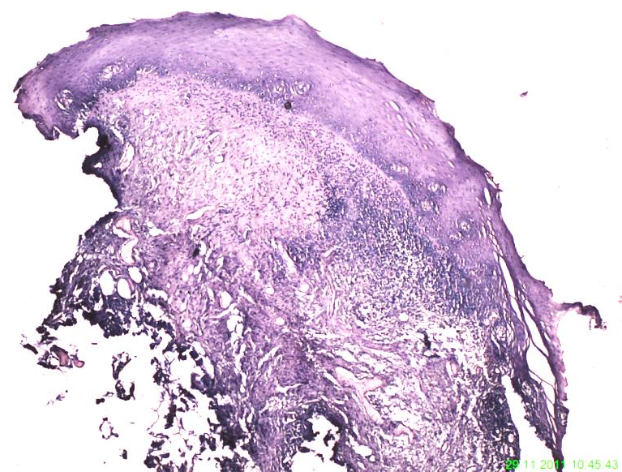
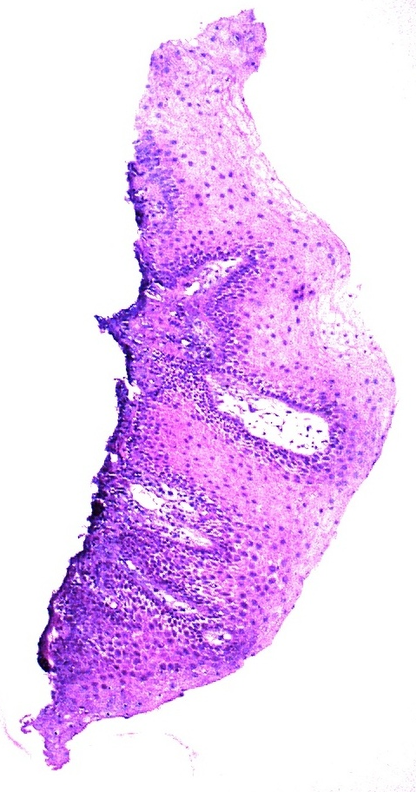
“WOUNDING” – LASER VS. CLASICAL TREATMENT
SOFT TISSUE
Fig. 1 (Magnification x40) Inner periodontal pocket area treated with LASER.
Fig. 1 (Magnification x40) Inner periodontal pocket area treated with curette.
Neev et al. observed that less thermal damage means less collagen remodeling is necessary. With less collagen damage and remodeling, faster healing with minimal scarring of soft tissue is seen.
Neev J, Links JLS, Calderon N, et al. Thermo-optical skin conditioning: a new method for thermally modifying skin
conditions. SPIE Proc. 2002;4609:94-106.

Slide 44
“WOUNDING” – LASER VS. CLASICAL TREATMENT
SOFT TISSUE
Fig. 1 (Magnification x40) Inner periodontal pocket area treated with LASER.
Fig. 1 (Magnification x40) Inner periodontal pocket area treated with curette.
Neev et al. observed that less thermal damage means less collagen remodeling is necessary. With less collagen damage and remodeling, faster healing with minimal scarring of soft tissue is seen.
Neev J, Links JLS, Calderon N, et al. Thermo-optical skin conditioning: a new method for thermally modifying skin
conditions. SPIE Proc. 2002;4609:94-106.

Slide 45
Classifications of Lasers According to Modes of Emission • Fractioned: which means there are periodic alternations of the laser energy being on and off, similar to a blinking light. This mode is achieved by the opening and closing of a mechanical shutter in front of the beam path of a continuous-wave emission.12 • Continued: Continuous wave emission means that laser energy is emitted continuously as long as the laser is activated—and produces constant tissue interaction.
Pulsed: The second mode is termed free-running pulsed mode, sometimes referred to as ‘true pulsed.’ Freerunning pulse emission occurs with very short bursts of laser energy due to a flash lamp pumping mechanism.
According to Power • High power: These lasers increase tissue kinetic energy and produce heat. As a result, they leave their therapeutic effects through thermal interactions. • Medium power: These lasers leave their therapeutic effects without producing significant heat. • Low power: These lasers have no thermal effect on tissues and produce a reaction in cells through light, called photobiostimulation or photobiochemical reaction. Output power of these lasers is less than 250 mW, e.g. diode laser. Based on the Emitting Material • Gas lasers—Argon, carbon dioxide lasers • Solid state lasers—Nd:YAG, Er:YAG, Ho: YAG • Semiconductors—Diode lasers.

Slide 46
According to the Type of Tissue being Acted Upon • Soft lasers: Soft tissue lasers penetrate soft tissue while sealing blood vessels and nerve endings. This is the primary reason why many people experience virtually no postoperative pain following the use of a laser. Also, soft tissue lasers allow tissues to heal faster.12 • Hard lasers: The hard tissue lasers are used to cut precisely into bone and teeth, to prepare teeth surfaces for bonding, to remove small amounts of tooth structure, and to repair certain worn down dental restorations.12

Slide 47
Four dental lasers emit light that is visible: the Argon laser, which has a 488-nm blue color and a 514-nm blue-green color; the frequency doubled Nd:YAG, which has mostly green color of 532 nm; a low-level (nonsurgical power) therapeutic device with a 635-nm red light; and another low-level caries detector with a similar red color at 655 nm.
All other laser devices (with one exception) that are employed for soft- and hard- tissue surgery emit laser light in the near, middle, and far infrared portion of the electromagnetic spectrum. The exception is one low-level laser in the range of 810 nm. The other surgical instruments are, in ascending wavelength order: 800- to 830-nm diode, in which the usual active medium consists of aluminum, gallium, and arsenate; 980-nm diode with a similar active medium; 1,064-nm Nd:YAG, where YAG is a crystal of yttrium aluminum garnet, doped (ie, coated) with neodymium; 2,790-nm Er,Cr:YSGG, which is a crystal of yttrium scandium, gallium, and garnet doped with erbium and chromium; 2,940 nm Er:YAG, where the doping agent is erbium; and 10,600-nm carbon dioxide.³

Slide 48
The different wavelengths have different absorption coefficients, and this property accounts for their variable effect on human tissue (Figure 5). Water, a molecule that is universally present, is most interactive with the 2 erbium wavelengths, and somewhat less so for carbon dioxide. Conversely, the shorter wavelength lasers, including argon, diode, and Nd:YAG, have a high degree of transmission through water. Carbon dioxide, followed closely by the erbium family, is highly absorbed by the hydroxyapatite crystals of teeth and bone.
There is very little interaction of the wavelengths of less than 1,000 nm with hydroxyapatite and water. However, argon, diode, and Nd:YAG do have a high affinity for hemoglobin and tissue pigments, as well as melanin. Longer wavelength laser light has little interaction with tissue pigments.
In addition to unique absorptive optical properties, all wavelengths have different depths of penetration through tissue. The erbium family of lasers is essentially absorbed on the surface of the target material, whereas the diode family can reach deeper into the tissue on the order of several thousand layers.³Manni JG. Dental Applications of Advanced Lasers — 2003. Burlington, Mass: JGM Associates; 2003.
It is important to emphasize that human dental hard- and soft-tissue is a combination of all of the above substances. In the treatment of dental soft tissues, the practitioner has a wide choice of devices, since all of those

Slide 49
With this background and understanding, the clinician will be able treat a variety of dental problems using different lasers. An underlying principle is the use of the least amount of energy to accomplish the treatment objective.⁶ The primary interaction of dental lasers with oral tissues is photothermal, ie, laser light is absorbed and transformed into heat (Figure 6). At 100C, the inter- and intra-cellular water boils, causing either soft-tissue ablation or explosive expansion and disruption of hard tissue. If the laser energy continues to be absorbed by the tissue, carbonization occurs and with it the possibility of significant tissue damage. Clearly, both target and nontarget tissues are subjected to these harmful effects. Successful treatment depends upon proper monitoring of the energy delivered, beam diameter, and duration of exposure.
There are numerous benefits of using dental lasers, but chief among them is the selective and precise interaction with the tissues. Other advantages include the ability to reduce the bacterial load (and other pathogens) in the surgical field, and, in the case of soft-tissue procedures, good hemostasis with the reduced need for sutures.⁷White JM, Goodis HE, Rose CL. Use of the pulsed Nd:YAG laser for intraoral soft tissue surgery. Lasers Surg Med. 1991;11:455-461.
The disadvantages of the currently available dental lasers are the relatively high cost, the need for training, the end cutting nature of the design, and the fact that no single wavelength is ideal for all clinical problems. One additional drawback of the erbium family of lasers is their inability to remove existing metallic and cast porcelain restorations.

Slide 50
When a clinician decides to use a laser as part of treatment, it is essential that the user has a clear understanding of the discipline and applications of photobiology. Laser photobiology is the science describing the unique interactions of nonionizing electromagnetic radiation (laser generated photons) with tissues and the molecular components that comprise tissues (ie, hemoglobin, water, collagen). As an example, the Er:YAG laser is one of the more commonly used lasers in dentistry today, and produces a beam at 2.94 um in the mid infrared portion of the electromagnetic spectrum. At this wavelength, the Er:YAG has the highest coefficient of absorption for water in the mid-infrared range, and correspondingly, the lowest depth of tissue penetration.¹ To cut or ablate hard or soft tissue effectively, the Er:YAG laser targets the chromophore of water selectively instead of the extracellular matrix of collagen or hydroxyapatite, and produces an instantaneous vaporization of the water to a depth of about 4 um/pulse (4/1000ths of a millimeter) in front of the beam.² The result of this interaction is a thermally driven, instantaneous, controlled tissue degradation or ablation, with an explosive ejection of the degraded cellular components and heated vaporous material, with poor hemostasis in soft tissue.²

Slide 51
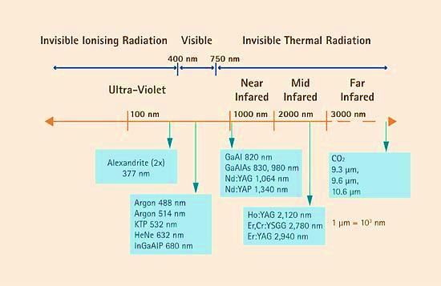
Introduction, history of lasers and laser light production S. Parker. BDJ 202, 21 - 31 (2007) Published online: 13 January 2007

Slide 52
What are specific procedures that the laser would perform in my practice?
• Can one device perform all indicated clinical procedures?
• Is the technology reliable?
• Is it difficult to learn and operate a dental laser device?
• Is the substantial investment, in terms of equipment and training, justified?
Light is a form of energy that travels in a wave and exists as a particle.¹ This particle is called a photon. A wave of photons has 3 basic properties:
(1) A constant velocity (the speed of light).
(2) Amplitude (the vertical measurement of the height of the wave, from top to bottom). This is a measurement of energy of that wave, expressed as a joule, or 1 unit of energy. In dental applications, a useful quantity is a millijoule, one thousandth of a joule.
(3) Wavelength (the horizontal distance between any 2 corresponding points of the wave).

Slide 53
A second example is the superpulsed CO₂ laser, which is a gas laser that produces a beam at 10.6 um in the far infrared portion of the electromagnetic spectrum. At this wavelength, the super-pulsed CO₂ has the highest coefficient of absorption for water in the far-infrared range, and correspondingly has a penetration depth of about 50 um with a greater thermal interaction and diffusion than the Er:YAG.1 The super-pulsed CO₂ is an excellent laser for hemostasis and coagulation as opposed to the Er:YAG, which is used for cutting and thermal mechanical ablation without significant tissue thermal diffusion to surrounding tissues.³

Slide 54
Diode lasers, the focus of this paper, have a wide variety of medical and dental applications. Current diode technology can emit photons over a wide range of the electromagnetic spectrum, ranging from the red visible (600 to 700 nm) to the near infrared (800 to 1000 nm). The wavelength generated by the diode laser is related to the diode formed from different concentrations and layers of materials, such as gallium-arsenide and gallium-aluminum-arsenide.¹ Currently available, FDA-approved diode lasers for dental applications have a photobiology that is always based on thermal tissue interactions, but is fundamentally different from other dental hard- and soft-tissue lasers by the degree of thermal interaction based on energy penetration in the tissues.⁴

Slide 55
WE HAVE THE PRIVILEGE TO BE ABLE TO USE THE LASER AS AN ASSISTIVE OR COMPLETELY INDEPENDENT EVIDENCE-BASED TOOL IN ALMOST EVERY FIELD OF DENTISTRY, IN TERMS OF A MULTI-WAVE CONCEPT.
DO WE NEED A “MULTI-WAVE” CONCEPT?
WE CAN CLASSIFY LASER-ASSISTED DENTISTRY INTO CATEGORIES, BASED ON THE FOCUSED MAIN EFFECT

Slide 56
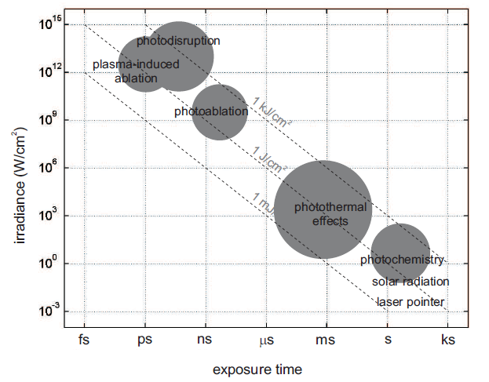
For soft tissue treatments any available wavelength can be use, because all dental lasers absorb one or more of the soft tissue components.
For hard tissue, however, the Erbium lasers with very short pulse durations easily ablate layers of calcified tissue with minimal thermal effects.

Slide 57
Almost no anesthesia
No post-operative numbness & sensitivity
Multiple quadrant
No drilling noise & vibrations
Bactericidal effect
Coagulation: fast healing, not bloody
No micro-fracturing / no smear layer
No etch or bond enhanced
Faster recovery
Esthetic procedure
Fast procedures, less chair time, more patients per day
More procedures, aesthetic, surgery, herpes, frenectomy less referrals etc
More patients, including new segments such as gender , age groups, and long distance patients,
Less Anesthesia costs
Patient satisfaction, better clinic reputation
Increase in clinic's annual revenue

Slide 58
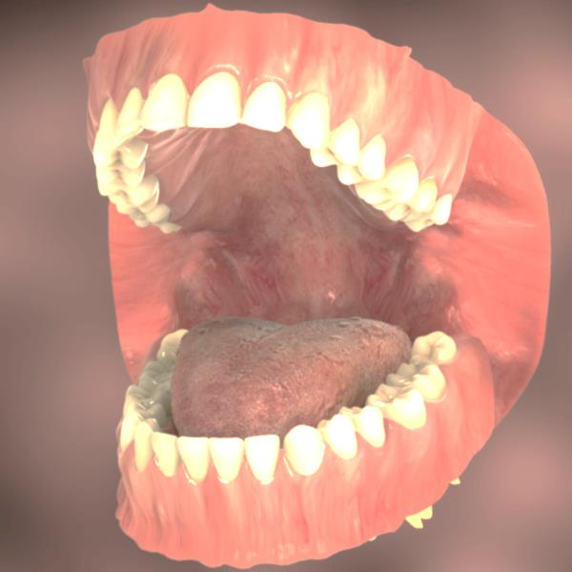

Slide 59
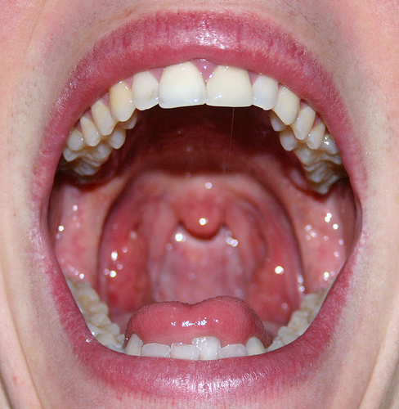
DENTISTRY IS THE BRANCH OF MEDICINE THAT IS INVOLVED IN THE STUDY, DIAGNOSIS, PREVENTION, AND TREATMENT OF DISEASES, DISORDERS AND CONDITIONS OF THE ORAL CAVITY, COMMONLY IN THE DENTITION BUT ALSO THE ORAL MUCOSA, AND OF ADJACENT AND RELATED STRUCTURES AND TISSUES, PARTICULARLY IN THE MAXILLOFACIAL (JAW AND FACIAL) AREA.
"Glossary of Dental Clinical and Administrative Terms". American Dental Association Retrieved 1 February 2014

Slide 60
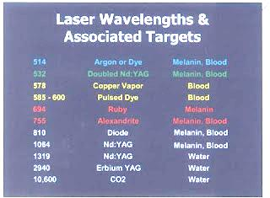
Laser Wavelengths & Associated Targets
514 | Argon or Dye | Melanin, Blood
532 | Doubled Nd:YAG | Melanin, Blood
578 | Copper Vapor | Blood
555-600 | Pulsed Dye | Blood
694 | Ruby | Melanin
755 | Alexandrite | Melanin, Blood
810 | Diode | Melanin, Blood
1064 | Nd:YAG | Melanin, Blood
1319 | Nd:YAG | Water
2940 | Erbium YAG | Water
10600 | CO2 | Water

Slide 61
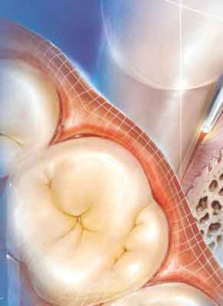
LASERS IN DENTAL SCINCE
AND PRACTICE
ANA MINOVSKA

Slide 62
30. Pick RM, Pecaro BC. Use of the CO2 laser in soft tissue dental surgery. Lasers Surg Med 1987;7(2):207-213.
31. White JM, Goodis HE, Rose CL. Use of the pulsed Nd:YAG laser for intraoral soft tissue surgery. Lasers Surg Med 1991;11(5):455-461.
32. Pedron IG, Ramalho KM, Moreira LA, de Freitas PM. Association of two lasers in the treatment of traumatic fibroma: Excision with Nd:YAP laser and photobiomodulation using InGaAlP: A case report. J Oral Laser Appl 2009;9(1):49-53.
33. Miyazaki H, Kato J, Watanabe H, Harada H, Kakizaki H, Tetsumura A, Sato A, Omura K. Intralesional laser treatment of voluminous vascular lesions in the oral cavity. Oral Surg Oral Med Oral Pathol Oral Radiol Endod 2009;107(2):164-172.
34. Genovese WJ, dos Santos MT, Faloppa F, de Souza Merli LA. The use of surgical diode laser in oral hemangioma: A case report. Photomed Laser Surg 2010;28(1):147-151.
35. Romanos G, Nentwig GH. Diode laser (980 nm) in oral and maxillofacial surgical procedures: Clinical observations based on clinical applications. J Clin Laser Med Surg 1999;17(5):193-197.
36. Ishikawa I, Aoki A, Takasaki AA. Potential applications of erbium:YAG laser in periodontics. J Periodontal Res 2004;39(4):275-285.
37. Coluzzi DJ. Fundamentals of lasers in dentistry: Basic science, tissue interaction, and instrumentation. J Laser Dent 2008;16(Spec. Issue):4-10.
38. Black JF, Wade N, Barton JK. Mechanistic comparison of blood undergoing laser photocoagulation at 532 and 1,064 nm. Lasers Surg Med 2005;36(2):155-165.

Slide 63
LASER IRRADIATION CAN REDUCE BACTERIA /However, bacterial reduction has been found to occur at temperatures as low as 50°C.20 Furthermore, bacterial reduction has been demonstrated in both in vitro45-47 and in vivo48-52 clinical studies
LASER ENERGY CAN REDUCE PAIN /Associated reported laser benefits are reduced pain and discomfort after surgery.80 Reports of pain relief mechanisms appear to
originate in stimulating oxidative phosphorylation in mitochondria and through modulating inflammatory responses.81
LASER ENERGY CAN AID HEALING THROUGH PHOTOBIOMODULATION /Providing laser treatment at low energy levels can be useful and beneficial for healing and regeneration. When desired, reducing the energy density can also be accomplished by using the laser in a defocused mode. At energy levels (measured in mW) incapable of tissue removal, the stimulation of cellular metabolism known as low-level laser therapy (LLLT)66-68 or photobiomodulation (PBM) can be observed. The PBM effect has been shown to stimulate mitochondria, enhancing ATP production.69-72
This effect can lead to increased wound healing through increased fibroblast proliferation73 and collagen formation; thus, low-level biostimulation can promote gingival healing or reduction of gingival inflammation,74-75 increased release of
growth factors,70 and pain relief.76-77 Healing times have been reported to be reduced.78
The predominance of literature suggests that PBM occurs with visible and near-infrared wavelengths from 633 to 904 nm, though defocused modes of higher wavelengths have also been investigated.79 Thus, most of the lasers listed in Table 1 do not apply to this discussion. PBM is not a thermal effect, which is the primary focus of this paper.

Slide 64
LASER PHOTOBIOLOGY
Biologic
level of interaction
Tissue z 3
Cell z 2
Organelle z 1
Photochemical X 1
Y 3 Long-term healing
Photothermal X 2
Y 2 Delayed response
Photomechanical X 3
Y 1 Immediate physical effect
Mechanism of action
Biologic response

Slide 65
LASERS IN DENTAL SCINCE AND PRACTICE
DENTISTRY IS THE BRANCH OF MEDICINE THAT IS INVOLVED IN THE STUDY, DIAGNOSIS, PREVENTION, AND TREATMENT OF DISEASES, DISORDERS AND CONDITIONS OF THE ORAL CAVITY, COMMONLY IN THE DENTITION BUT ALSO THE ORAL MUCOSA, AND OF ADJACENT AND RELATED STRUCTURES AND TISSUES, PARTICULARLY IN THE MAXILLOFACIAL (JAW AND FACIAL) AREA.
"Glossary of Dental Clinical and Administrative Terms". American Dental Association Retrieved 1 February 2014

Slide 66
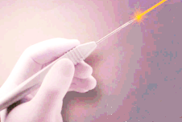
❶
GENERAL OVERVIEW
LASERS IN DENTAL SCINCE
AND PRACTICE
❷
IN CLINICAL DENTISTRY
❸
HOW SCIENCE EXPLAINS

Slide 67
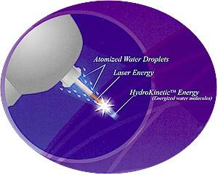
❶
GENERAL OVERVIEW
THERE ARE CURRENTLY FIVE PREDOMINANT TYPES OF LASERS AVAILABLE FOR DENTAL PROFESSIONALS:
DIODE, ND:YAG, ER:YAG, ER:YSGG, AND CO2.

Slide 68
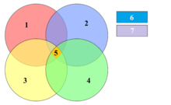
Diagrammatic representation of acidogenic theory of etiology of dental caries. Four factors, namely, a suitable carbohydrate substrate (1), micro-organisms in dental plaque (2), a susceptible tooth surface (3) and time(4); must be present together for dental caries to occur (5). Saliva (6) and fluoride (7) are modifying factors

Slide 69
Advantages of using erbium laser for operative dentistry include:
• Precise ablation allows for minimally invasive preparations
• Smear layer removal
• Disinfection of preparations
• Eliminates the noise, heat, and vibration of high speed rotary instrumentation
• Reduced need for local anesthesia
• Selective caries removal due to carious dentin’s higher water content and softer consistency

Slide 70
Laser Procedures Laser Assisted Caries Diagnosis and Management Restorative Dentistry  Surgical Applications of Dental Lasers  Periodontal Pocket Therapy  Laser Biopsy  Gingivectomy  Frenectomy  Flapless Crown Lengthening  Crown Lengthening with Minimally Invasive Flap Design • Oral Surgery • Lasers in Pediatric Dentistry • Endodontic Applications • Photobiomodulation (Biostimulation) • Conclusion • Course Test • References • About the Author
CLINICAL APLICATIOTS
LASERS FOR SOFT TISSUE
Diode (810 nm, 940 nm, 980 nm, 1,064 nm), Nd:YAG (1,064 nm), CO2 (10,600 nm), Er:YAG (2,940 nm), Er,Cr:YSGG (2,780 nm), and potassium-titanyl-phosphate (KTP) (532 nm) lasers are the wavelengths used most commonly for soft tissue procedures.2 2. Miserendino LJ, Pick RM. Lasers in dentistry. Chicago: Quintessence Publishing Co.;1995.
LASER FOR HARD TISSUES
At present, erbium lasers are the only hard tissue laser wavelengths available commercially.
Diagnostic/curing lasers These types of devices can be used for caries and calculus detection.
Photodynamic therapy Research is ongoing for the treatment of oral cancer using photodynamic therapy (PDT).18
photobiomodulation – The process whereby laser energy is used to stimulate positive clinical outcomes such as pain relief and improved healing.

Slide 71
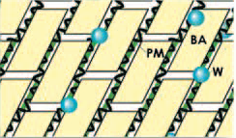
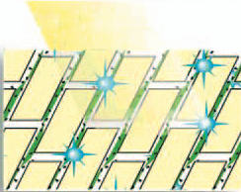
Scaling and Concrement Removal / Er:YAG wavelength
Before irradiation
Laser irradiation
BA: biological apatites.
PM: protein matrix.
W: water molecules.
Deep layer Intermediate layer Superficial layer
(Schema from Sasaki KM et al. Ultrastructural analysis of bone tissue irradiated by Er:YAG laser. Lasers Surg Med 2002: 31: 322-332; with permission. Lasers in Surgery and Medicine copyright (2002) Wiley-Liss, Inc.).
71
Notes:
Dental calculus contains water in its structural micro pores as well as in its intrinsic components. Since the Er:YAG laser has the ability to ablate dental hard tissues such as enamel and dentin, the laser was expected to be capable of removing dental calculus at much lower energy levels. Several researchers have already reported the promising ability of the Er:YAG laser to remove subgingival calculus in vitro Erbium lasers are unique in that they are the only lasers that can cut both hard and soft tissues with minimal heat-related side effects.
During Er:YAG laser irradiation, the laser energy is absorbed selectively by water molecules and hydrous organic components of biological tissues, causing evaporation of water and organic components and resulting in thermal effects due to the heat generated by this process (‘photo thermal evaporation’). The water vapour production induces an increase of internal pressure within the tissue, resulting in explosive expansion called ‘micro explosion’ .
These dynamic effects cause mechanical tissue collapse, resulting in a ‘thermo mechanical’ or ‘photomechanical’ ablation .This phenomenon has also been referred to as ‘water mediated explosive ablation’

Slide 72
LASER – THE FUTURE OF DENTISTRY
1. Topic
Working with light energy in dentistry is still our choice. In future it will be a must – the patients demand rises.
Dental laser applicable in so many dental procedures is a new level of GP dentistry;
Are we “better” general practitioners???
Do the cases look differently done with laser???
Can we start being selective in the procedures WE LIKE, specifying in certain dental issues - making Influence over the praxis development?
To know how to work with the Er:YAG laser is important to get informed about:
Physics of laser light
Laser – tissue interaction
Laser device
Clinical application of Er:YAG laser in dentistry/periodontics

Slide 73
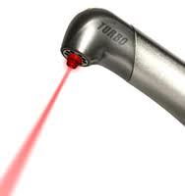
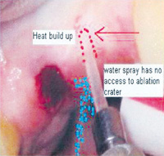
LASER PRIMARILY INTERACT WITH TISSUE STRUCTURES PHOTOTHERMALY
WAVELENGTH
POWER DENSITY
TISSUE CHARACTERISTICS
EXPOSURE TIME
IRRADIATED VOLUME
The extent of the area of vaporization, char, and coagulation is defined by the temperature gradient
Notes:
Thermal animation of continually firing contact tip embedded in tissue resulting in a quantum heat trap.

Slide 74
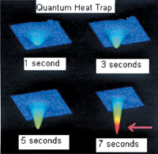
Increasing depth –
(1) increasing power (good),
moving slower to increase time (bad, owing to time for thermal conduction), or
decreasing spot size (acceptable, but less ideal because of increased number of strokes needed to cover area).
To decrease depth –
(1) move faster (best, if control is still maintained),
(2) widen the spot size ( good choice),
(3) decrease power (acceptable, but not ideal),
Thermal animation of "heat trap". in tissue
Notes:
. This is an explanation of some aspects of quantum physics involved when lasers are used to cut teeth and bone and provides a practical approach for avoiding what this author describes as the “quantum heat trap” effect (a thermodynamic event that produces a decrease in ablation efficiency). This can occur from excessive heat generation in a growing ablation crater due to incorrect use of Er:YAG irradiation and contact sapphire tips.

Slide 75
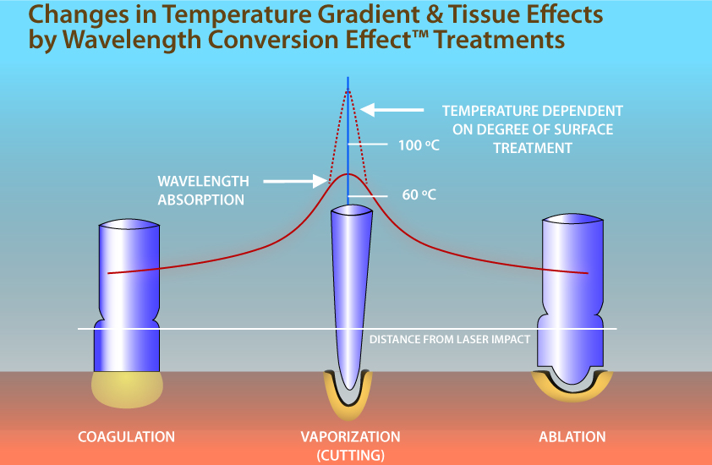
Lasers in maxillofacial surgery and dentistry .By Lewis Clayman, Paul Kuo
Notes:
Thus, as can be seen in Figure 1-9, by use of this absorbing material the tissue temperature gradient induced by the laser emission has been altered. Depending upon the quantity and distribution of the absorbing material the contact tip can mimic the effect of other laser wavelengths.
This event is referred to as the Wavelength Conversion Effect. The wavelength conversion effect does not result in changing the wavelength of the laser; rather, it changes the effect the wavelength has in the surgical situation. By adjusting the Wavelength Conversion Effect material
on the probe tip, one can titrate the amount of laser light exiting the tip in comparison to the amount of heat generated by absorption at the tip. This means, in essence, that a single laser in combination with different interchangeable tips, can mimic the tissue temperature profile and effect of various lasers.

Slide 76
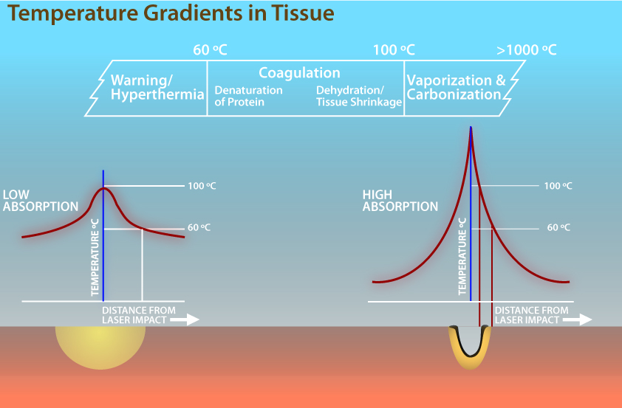
Thermal penetration depth
Notice this is not a linear relationship between penetration depth and time. In tissue, the diffusivity D ≈ 114 × 10−9 m2 s −1 so heat diffuses to about
0.7 µm in 1 µs,
to 2.1 µm in 10 µs,
to 7 µm in 100 µs,
to 21 µm in 1 ms, and so on.
Capillars= These microvessels, measuring around 5 to 10 micrometres (µm) in diameter,

Slide 77
How it happened?
LASER-LIGHT-TISSUE INTERACTION:
WHAT WILL HAPPEN IF YOU IRRADIATE BIOLOGICAL MATERIAL?
WHAT KIND OF EFFECTS ARE THERE?
WHAT PROCESSES ARE YOU STARTING IN THE TISSUE?
On what do these effects depend?
THERE ARE SO MANY DIFFERENT PARAMETERS YOU CAN SET ON YOUR MACHINE... AND THEY ARE EVEN INFLUENCING EACH OTHER! FOR EXAMPLE, THERE ARE:

Slide 78
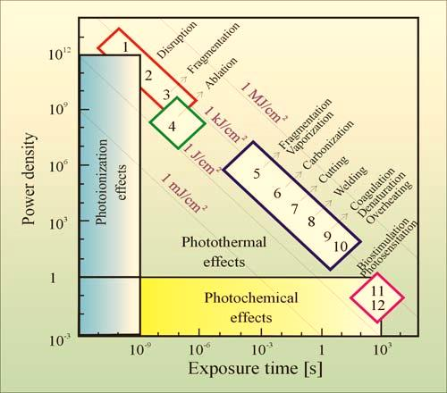
energy density
Er:YAG
2940
Diode
800-830
Nd:YAG
1064
KTP
CO2
9600,
10600
Argon
488,514
Diode
980
Er,Cr:YSGG
2790
U V
Infrared
(IR)
Invisible
Ionizing
Invisible
Thermal
Radiation
V I S I B L E
INFRARED
400
750
Dental Laser Wavelengths on Electromagnetic Spectrum
(in nanometers)
CATEGORIES OF INTERACTION TYPES
Notes:
mainly five categories of interaction types are classified today.
These are 1. photochemical interactions, 2.thermal interactions, 3. photoablation, 4. plasma-induced ablation, and 5.photodisruption. All these Seemingly(po izgled) different interaction types share a single common datum: the characteristic energy density ranges from approximately 1 J/cm2 to 1000 J/cm2.
When elastically bound charged particles are exposed to electromagnetic waves, the particles are set into motion by the electric field. If the frequency of the wave equals the natural frequency of free vibrations of a particle, resonance occurs being accompanied by a considerable amount of absorption.
mainly five categories of interaction types are classified today.
These are 1. photochemical interactions, 2.thermal interactions, 3. photoablation, 4. plasma-induced ablation, and 5.photodisruption. All these
Seemingly(po izgled) different interaction types share a single common datum: the characteristic energy density ranges from approximately 1 J/cm2 to 1000 J/cm2.
When elastically bound charged particles are exposed to electromagnetic waves, the particles are set into motion by the electric field. If the frequency of the wave equals the natural frequency of free vibrations of a particle, resonance occurs being accompanied by a considerable amount of absorption.

Slide 79
Scaling and Concrement Removal / Er:YAG wavelength
Before irradiation
Laser irradiation
BA: biological apatites.
PM: protein matrix.
W: water molecules.
Deep layer Intermediate layer Superficial layer
(Schema from Sasaki KM et al. Ultrastructural analysis of bone tissue irradiated by Er:YAG laser. Lasers Surg Med 2002: 31: 322-332; with permission. Lasers in Surgery and Medicine copyright (2002) Wiley-Liss, Inc..
Notes:
Dental calculus contains water in its structural micro pores as well as in its intrinsic components. Since the Er:YAG laser has the ability to ablate dental hard tissues such as enamel and dentin, the laser was expected to be capable of removing dental calculus at much lower energy levels. Several researchers have already reported the promising ability of the Er:YAG laser to remove subgingival calculus in vitro Erbium lasers are unique in that they are the only lasers that can cut both hard and soft tissues with minimal heat-related side effects.
During Er:YAG laser irradiation, the laser energy is absorbed selectively by water molecules and hydrous organic components of biological tissues, causing evaporation of water and organic components and resulting in thermal effects due to the heat generated by this process (‘photo thermal evaporation’). The water vapour production induces an increase of internal pressure within the tissue, resulting in explosive expansion called ‘micro explosion’ .
These dynamic effects cause mechanical tissue collapse, resulting in a ‘thermo mechanical’ or ‘photomechanical’ ablation .This phenomenon has also been referred to as ‘water mediated explosive ablation’

Slide 80
History has shown that the evolution of worthy new dental technologies from tech-push to market-pull tends to be slow-paced at best.
‘‘Tech-push’’ is a term that describes products that are developed, tested, and marketed before the widespread perception of need in the user community.¹
1. Martin MJ. Managing Innovation and Entrepreneurship in Technology-based Firms. Hoboken, NJ: WileyIEEE; 1994:43-44.

Slide 81
Immediately postoperatively the laser can offer protection to the surgical site through a coagulum surface91 and bacterial reduction.
91. Fisher SE, Frame JW, Browne RM, Tranter RMD. A comparative histological study of wound healing following CO2 laser and conventional surgical excision of canine buccal mucosa. Arch Oral Biol 1983;28(4):287-291.
94. Cecere W, Liebow C. Laser causes greater growth factor release than scalpel. Lasers Surg Med 1990;10(Suppl 2):22, Abstract 79.
Studies have shown additional benefits with laser use, such as minimal wound contraction91 and minimal scarring when compared to scalpel surgery.92
less tissue damage with the laser compared to electrosurgery or conventional
instruments93 and a higher production and release of growth factors in laser sites compared to scalpel sites.94
Aphthous and herpetic lesions – Defocusing techniques and using subablative power values can reduce pain, stimulate cellular repair, and reduce any inflammatory reaction. Care should be taken during laser treatment of herpetic lesions; surface coagulum may inhibit laser energy absorption during treatment. Any claims of the laser’s ability to reduce viruses
remain speculative.
• Postoperative Appearance – The optimal appearance of a postoperative laser surgical site will be pink in the zone of ablation that may be accompanied with a superficial layer of coagulum, which may serve to protect the surface. Depending on different laser parameters and the type of wavelength, coagulum layers can range from 0.01-1.0 mm thick, which aids in hemostasis.100-101 As healing occurs, regardless of device, physiologically a zone of reversible edema surrounds the surgical site.97
100. Aoki A, Sasaki KM, Watanabe H, Ishikawa I. Lasers in
nonsurgical periodontal therapy.
Periodontol 2000. 2004;36:59-97.
97. Parker S. Laser-tissue interaction. Br Dent J 2007;202(2):73-81.

Slide 82
a science-based perspective on several increasingly popular uses for dental lasers. These topics include: Sulcular Debridement (sometimes termed Laser Curettage), Laser-Assisted New Attachment Procedure (LANAP), Reduction of Bacteria Levels in periodontal pockets (sometimes termed Pocket Sterilization), Laser-facilitated Wound Healing, Laser Root Planing, Aid in the Diagnosis of Caries (Laser Fluorescence), and other Hard Tissue Applications including endodontics.
Blood-containing targets- wavelength between
500 and 600 nm.
Melanin-containing targets- The peak absorption of human melanin pigment occurs around 335nm, and absorption is almost completely attenuated for wavelengths longer than 700nm. “blue /450-495/ or green(495-570)/yellow” (570-590) portion of the spectrum; wavelengths of 630-1100 nm may provide selective melanosome absorption
The spectroscopy of human melanin pigmentation," by N. Kollias. In: Melanin: Its Role in Human Photoprotection, pp. 31 - 38. Valdenmar Publishing Co. (1995).

Slide 83
CONCLUSION
In total, 30 different dental indications have been reported in the literature.
However, it rather shows the input on general biological systems, such as the immune system, superoxide dismutases (SOD) activity, ATP production, cell membrane permeability, release of transmitter substances etc.

