Slide 1
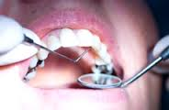
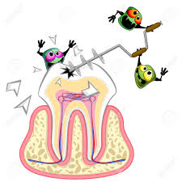
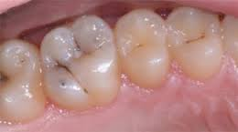
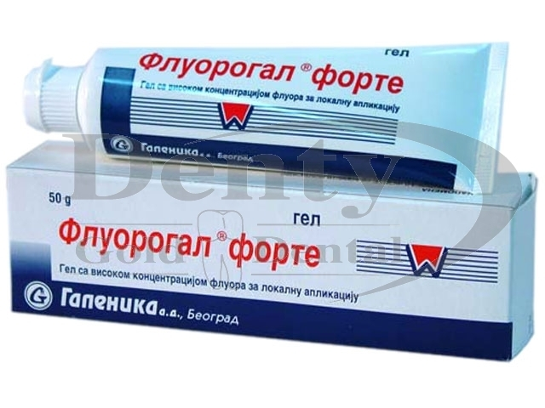
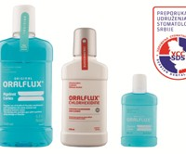
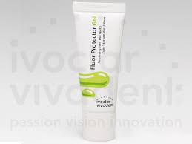
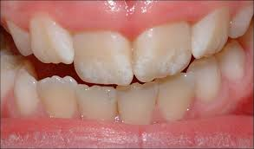
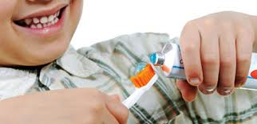
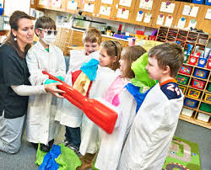
University “ Goce Delcev” Shtip,
Faculty of Medical Sciences Department of Stomatology*
University „ Sv. Kiril i Metodij’ -Skopje Facuty of stomatology **
Correlation between the application of fluoride prophylaxis and the state of oral health
Natasha Denkova*, Snezana Iljovska**, Mihajlo Petrovski*
Caries most often is result of sufficiently knowledgeable and not responsible behavior of the population in relation to the mouth and teeth.
Head goal of this study is to determinate the correlation between the condition of oral health and application of any prophylaxis with fluor.
Materials and Methods: The study included selected groups of students 15 years of age (120 from urban and 120 from RURAL areas) and their parents who completed questionnaires for the parents' education level (elementary, middle, high, Ph.D.), habits to visit the dentist and information on prophylaxis with fluoride.
Results: The results of the X2- test indicates constatation that there is statistically significant difference (p <0.05)from the values obtained when and how refer to prophylaxis with fluorine between respondents from the experimental groups А and B.
The results of the X2- test indicates constatation that there is statistically significant difference (p <0.05) from the values obtained when and how is maintening oral hygiene between respondents from the experimental groups А and B.
This shows the need for changes the behavior of the individual, groups or communities as a whole, in terms of establishing correct mode in nutrition, on establishing habits for maintaining oral hygiene and use of fluoride. Health educationas as one of the most important aspects of preventive dental activities, have a particularly important role in the achievement of health oral administration.

