Slide 1
PREPARATION AND CHARACTERIZATION OF CURCUMIN LOADED HYBRID pH-SENSITIVE LIPOSOMES
Elena Drakalska, Denitsa Momekova, Budurova D.,Stanislav Rangelov, Nikolay Lambov

Slide 2
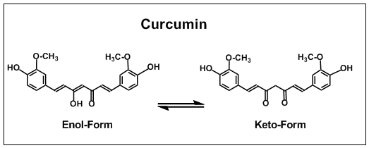
Introduction
Pleiotropic antineoplastic activity
Without toxicity to normal cells

Slide 3
Disadvantages
Poor aqueous solubility (11ng/ml)
Instability in physiological pH
Low bioavailability

Slide 4
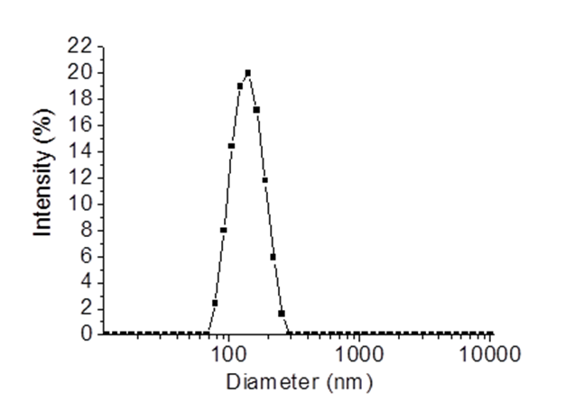
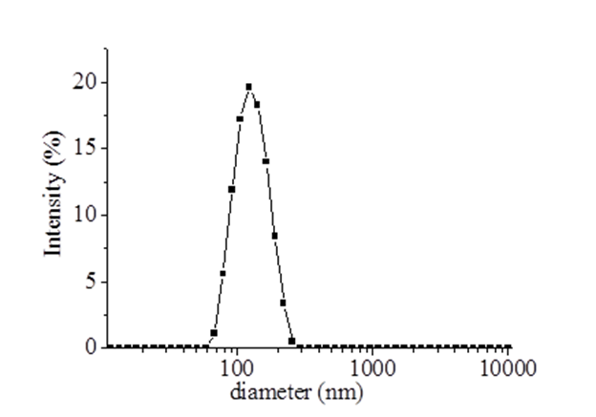
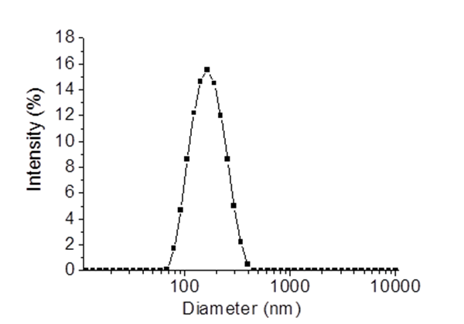
- Monomodal distribution - Size app.180 nm - Zeta potential -20mV
Results

Slide 5
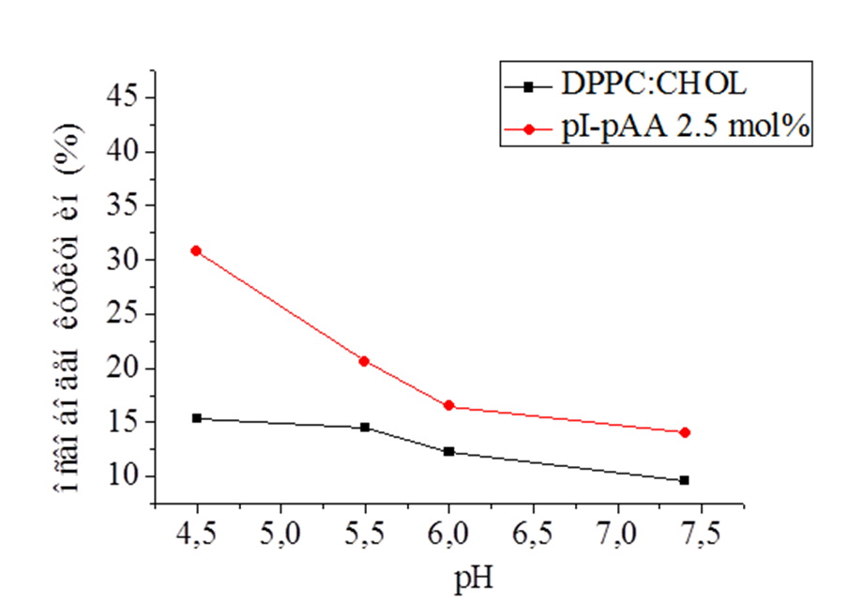
In vitro drug release profile
Figure 2. In vitro curcumin release from hybrid non pH sensitive (black) and hybrid pH-sensitive liposomes

Slide 6
Cytotoxicity
MTT- dye reduction assay
Panel of human cancer cell lines

Slide 7
Conclusion
These findings give us a reason to conclude that the hybrid pH-sensitive liposomal nanoparticles are promising platforms for curcumin.

