Slide 1
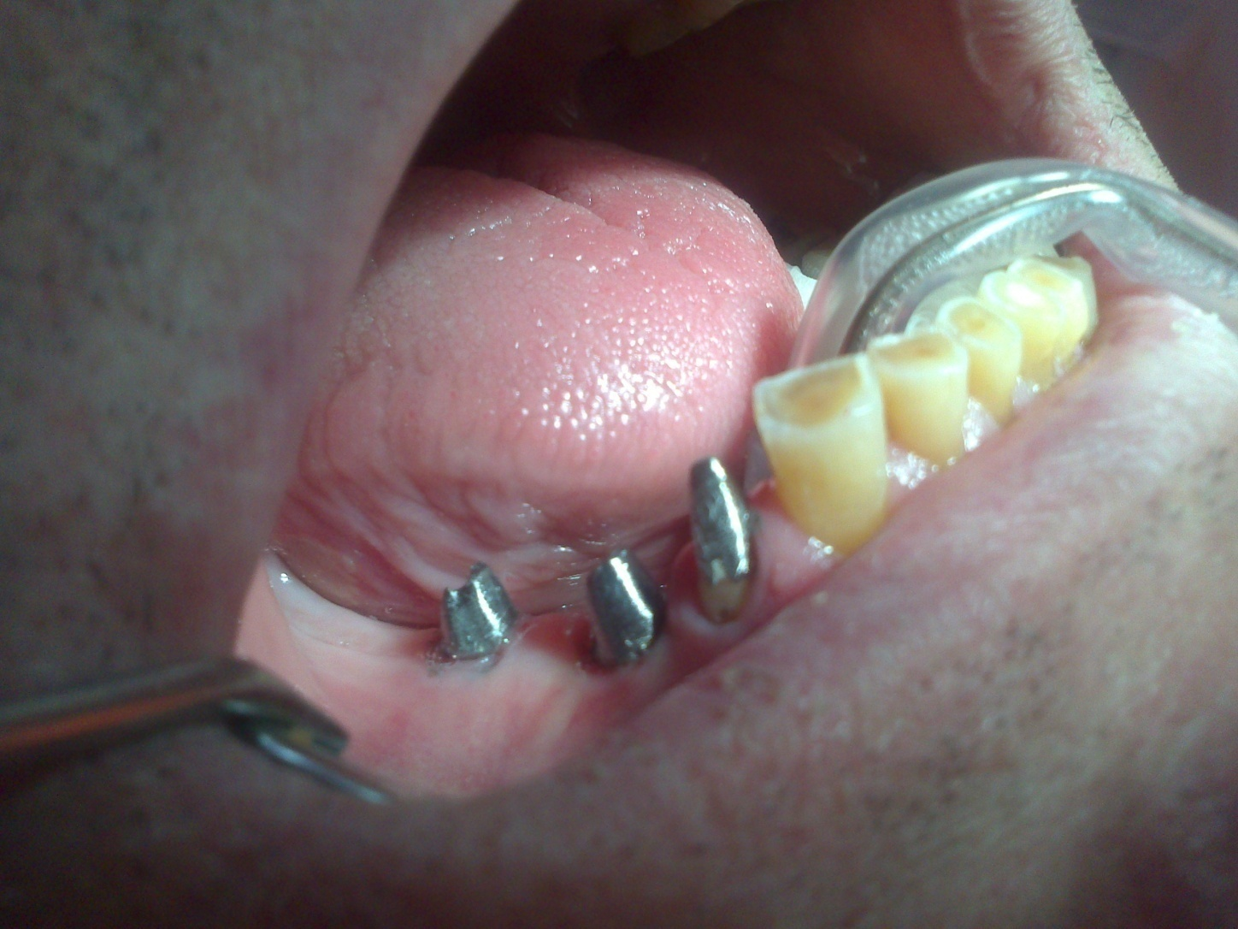
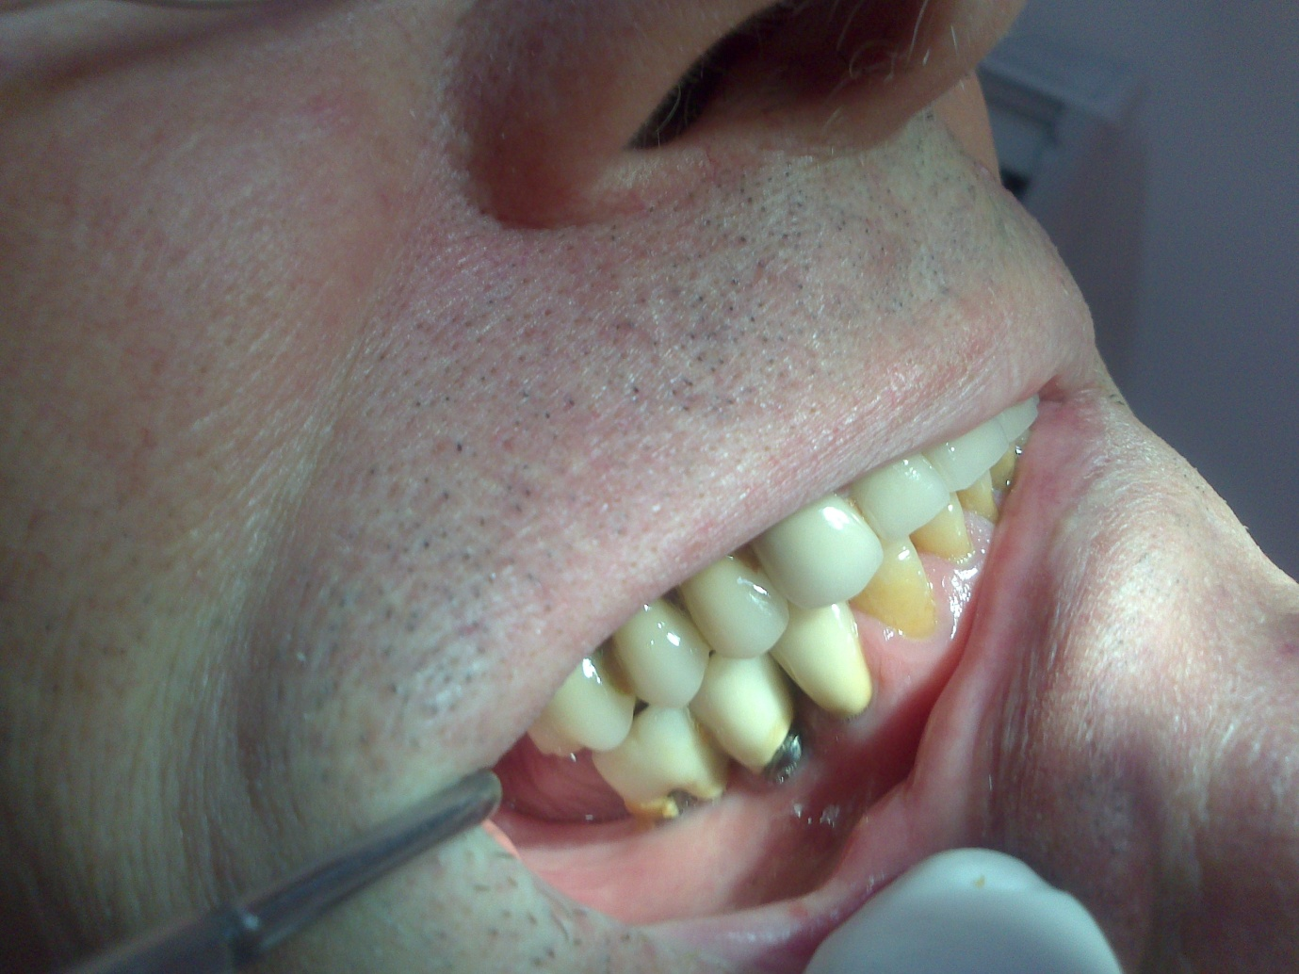
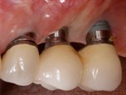
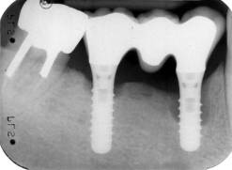
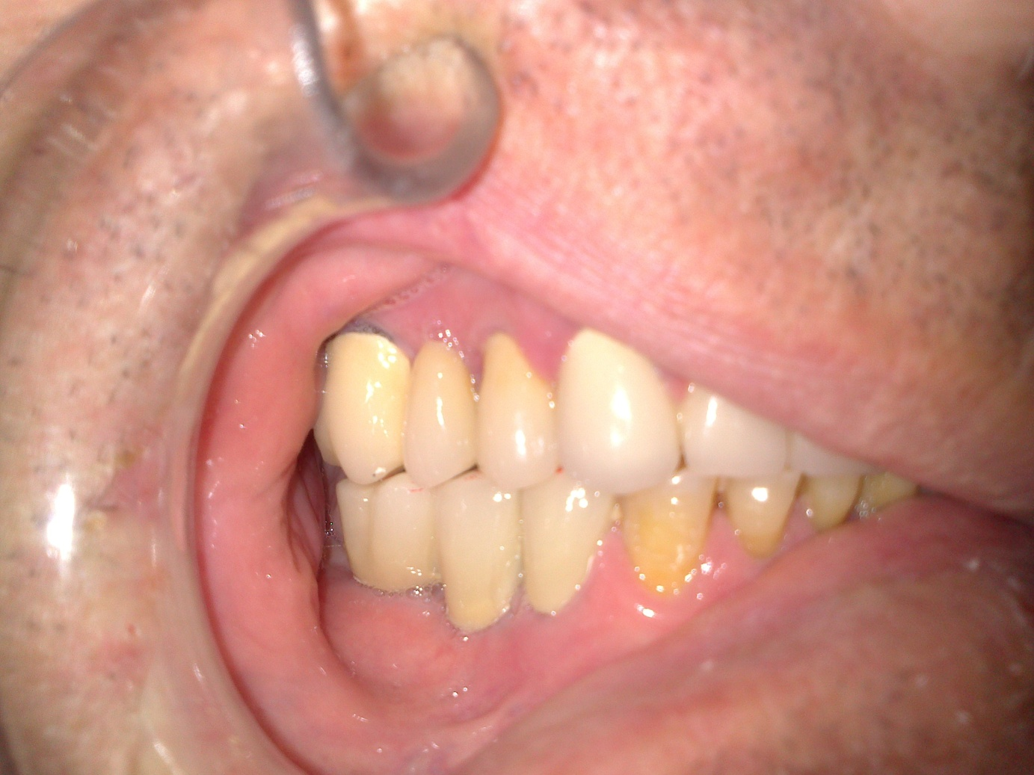
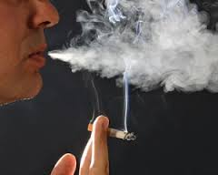
Implant-prosthetic therapy failure
Mijoska A, Popovska M, Gigovski N, Stevkoska-Korunovska V, Bajraktarova E, Zlatanovska K
Faculty of Dentistry, Skopje UKIM
Introduction
Results
Fixed dental crowns and bridges on implants in partially edentulous patients have predictable success, yet in some cases different complications arise. Complications of implant prosthetics therapy are associated with a range of factors, and smoking is one of them.
Smoking increased the risk of implants loss twice more in smokers than in nonsmokers. Smoking, poor oral health and lack of oral hygiene have significant influence in bone loss around implants, while occlussal load and construction shape and type are with minor influence.
During first year 0,5mm of bone was lost around implant, and 0,05 mm later next years.
Results showed that early complications are results of smoking, while quality and quantity of surrounding bone for late complications.
Smoking cigarettes is linked to number of oral diseases, bone loss, loss of soft tissue and teeth, appearance of periimplantitis and finally implants and prosthesis loss. The objective of this paper is to examine the relationship of smoking and implant-prosthetic therapy, whether it has an impact on the process of osseointegration, retention and long-term success of implant-prosthetics devices.
GROUP | NUMBER OF PATIENTS | NUMBER OF IMPLANTS | FAILURED IMPLANTS | SUCCES RATE %
SMOKER | 16 | 19 | 5 | 73
NO SMOKER | 34 | 42 | 2 | 95
TOTAL | 50 | 61 | 7 | 84
GROUP | NO COMPLICATIONS | LOST IMPLANTS | PERI IMPLANTITIS | POSTOPERATI INFECTION
SMOKER | 14 | 5 | 9 | 9
NO SMOKER | 40 | 2 | 2 | 4
TOTAL | 54 | 7 | 11 | 13
Methods and materials
Conclusion
Patients had FDP made on different types of implants in frontal and molar region. They were divided in two groups: smokers and nonsmokers. Criteria data for the success of the therapy were mobility of the implant, pain, peri-implant bone loss higher than 1.5 mm, absence of technical complications and function and aesthetics for the period. Control checkups were made after six months, one and two years. Patients had questionnaires, clinical examination and X-ray.
Overload and occlussal forces were measured with T scan III .
- Smoking alone as a risk factor does not increase the risk of implant loss, but the placement of implants in patients who smoke and have other risk factors should be considered contraindicated.
Former smokers have lower percentage of failure than present.
It is necessary to quit smoking at least one week before treatment and after, because smoking is responsible for early complications.

