Slide 1
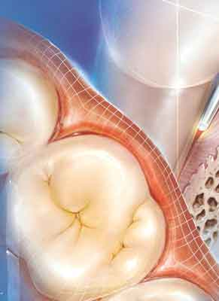
WOUND HEALING AFTER ER: YAG LASER ASSISTED POCKET DEBRIDEMENT
Ana Minovska

Slide 2
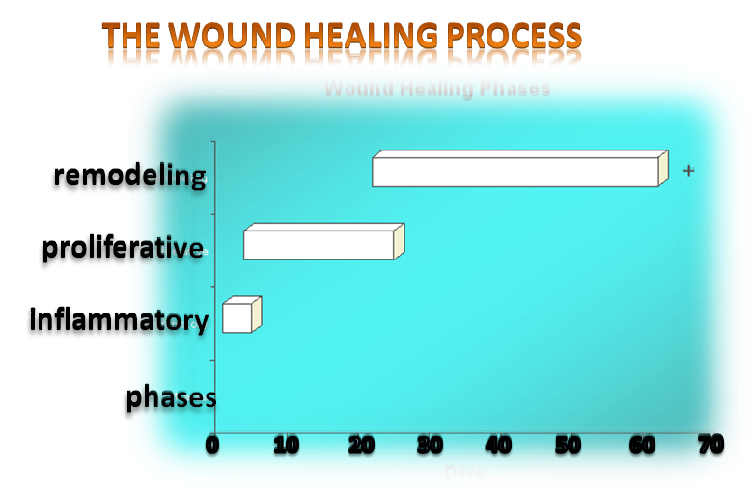
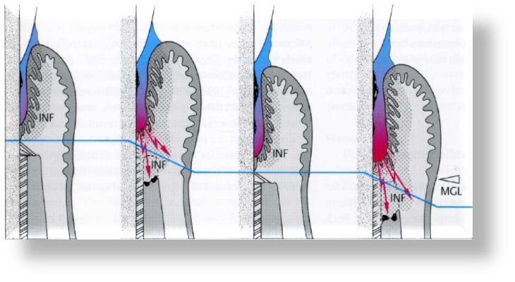
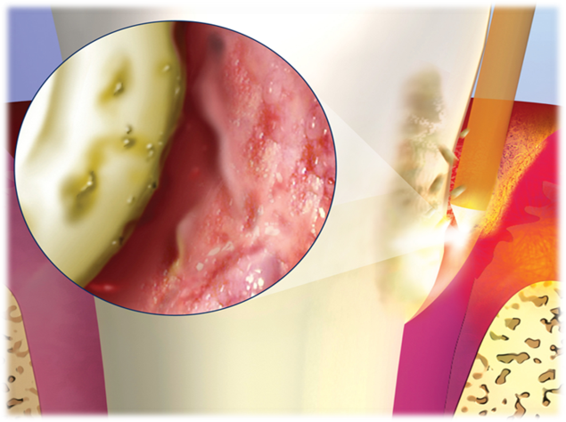
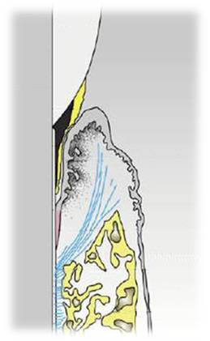
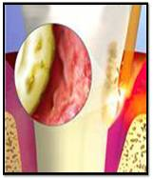
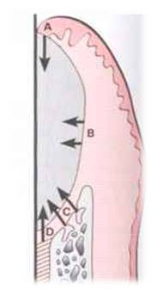
WOUND HEALING AFTER ER: YAG LASER ASSISTED POCKET DEBRIDEMENT
1
2
3
Periodontal pocket
ER:YAG laser in periodontal treatment
Periodontal healing

Slide 3
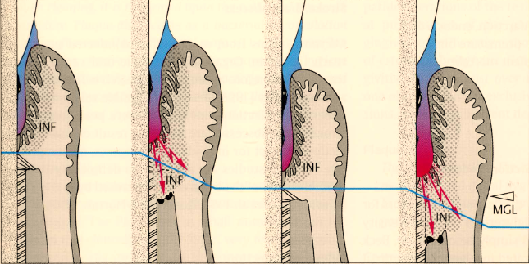
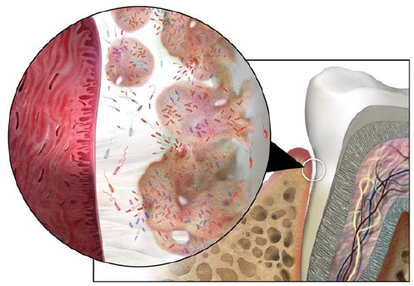
Clinical Symptoms Of Disease
1. Periodontal pocket ”wounding of periodontium”
1
PLAQUE
Pathogenic
microorganisms
Antigens
LPS
Virulencefactors
PMN
Antibodies
Inflammatory
Immune
response
Connective
tissue
and bone
metabolism
2
Cytokines
Prostanoids
MMPs
3
Non-genetic risk factor
4
5
Genetic factors
Modified from R. Page, K Kornman, 1997

Slide 4
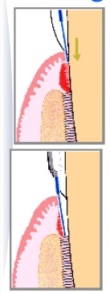
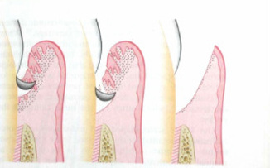
LASER-ASSISTED
- MECHANICALLY USING CONVENTIONAL HAND INSTRUMENTS

Slide 5
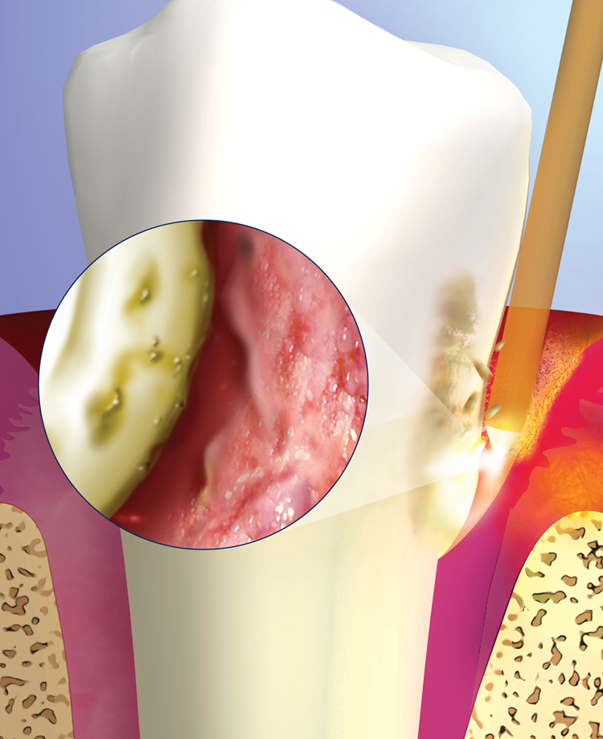
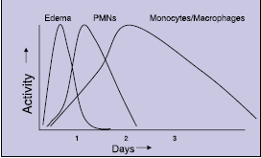
3. Periodontal healing
RESOLUTION OF ACUTE INFLAMMATION

Slide 6
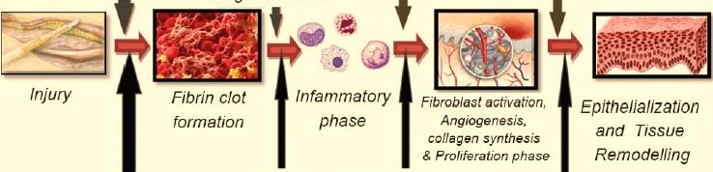
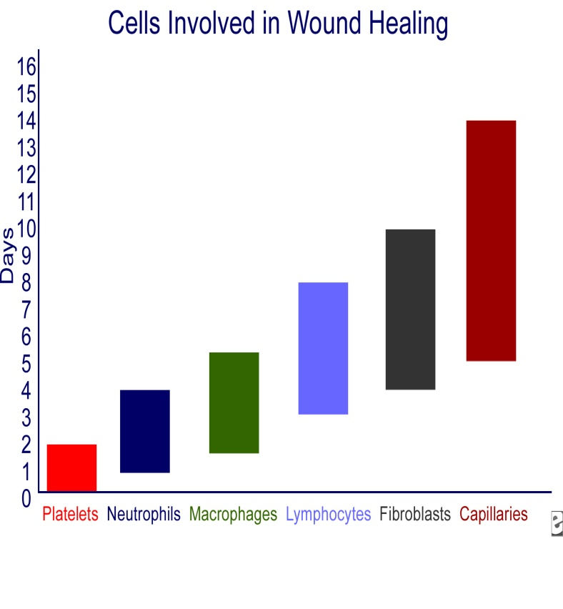
Cellular response
MYELOPEROXIDAZA CD68
VIMENTIN
CD34
Giuseppe Polimeni, Andreas V. Xiropaidis & Ulf M. E. Wikesjo. Biology And Principles of Periodontal Wound Healing/Regeneration. Periodontology 2000, Vol. 41, 2006, 30–47

Slide 7
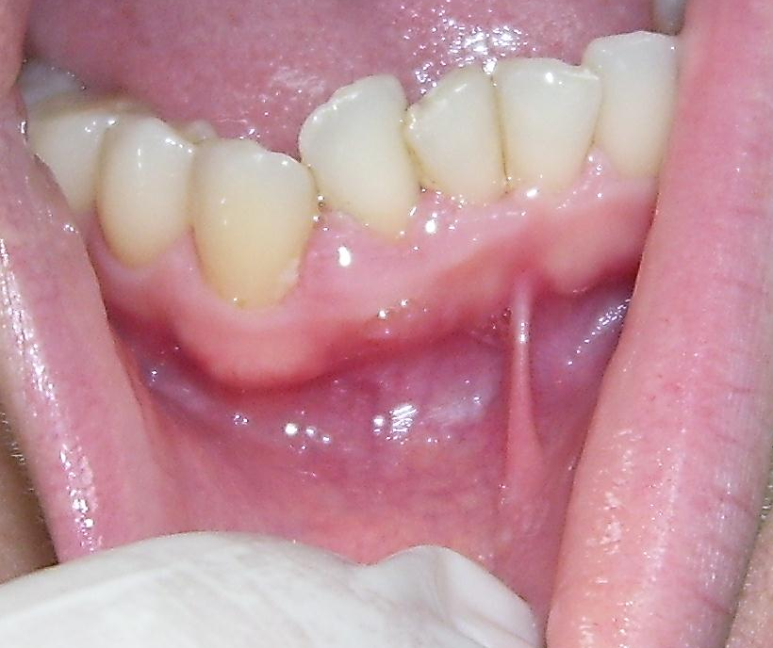
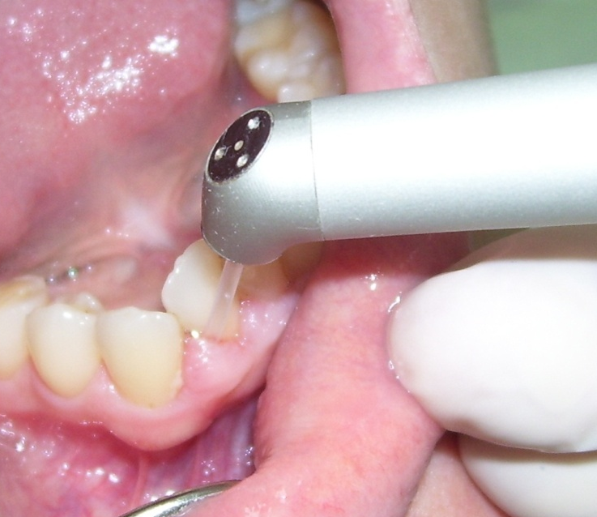
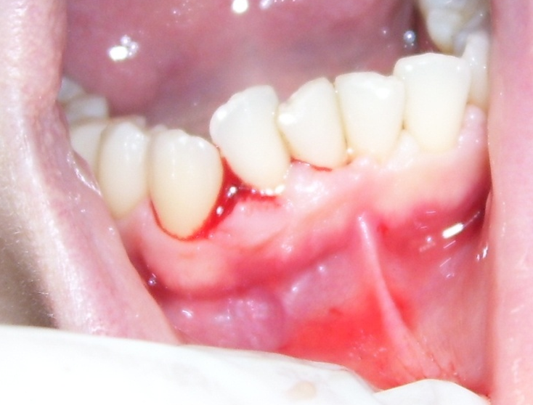
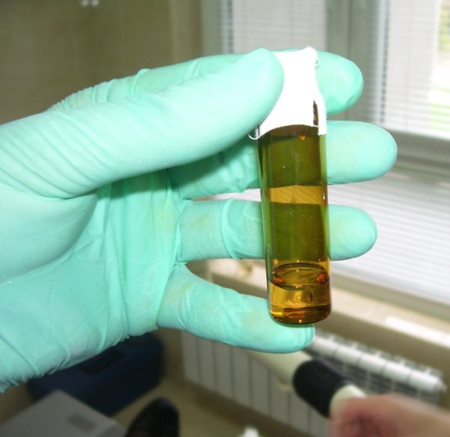
THE AIM OF THE PRESENT STUDY WAS TO PROVIDE IMMUNOHISTOCHEMICAL AND HISTOMORPHOMETRIC ANALYSIS OF EARLY PHASE OF WOUND HEALING FOLLOWING LASER ASSISTED POCKED DEBRIDEMENT COMPARED TO CONVENTIONAL HAND INSTRUMENTATION
Material and Method
For the purpose of the study a split-mouth design was performed. A total of 15 pairs of contralateral single- and multirooted teeth were included. Each tooth of each contra lateral pair had to exhibit
attachment lost ≥5 mm on one aspect of the tooth.
Determination of : Myeloperoxidaza, CD68 , Vimentin, CD34.
The tissue biopsy was taken from the soft tissue wall of the periodontal pocket 24 and 72 hour after preformed periodontal treatment.
Notes:
To evaluate the earlier signs of resolution in molecular terms, which at present do not appear to be effectively captured in clinical endpoints.

Slide 8
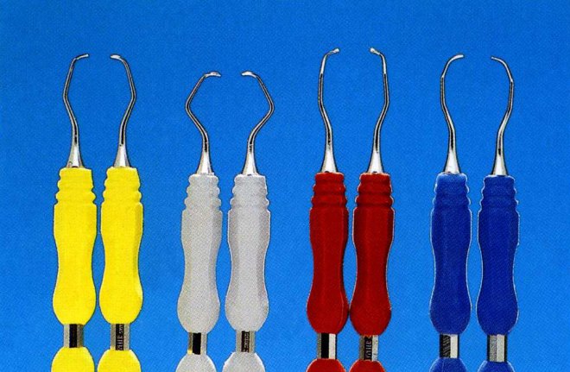
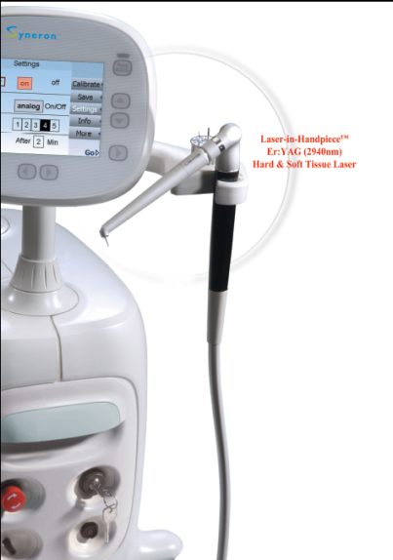
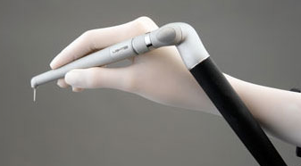
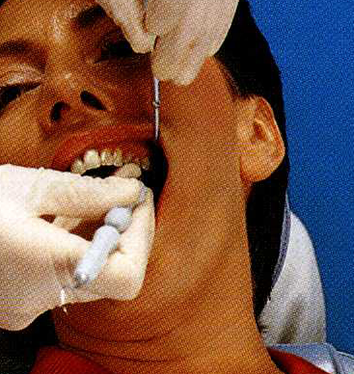
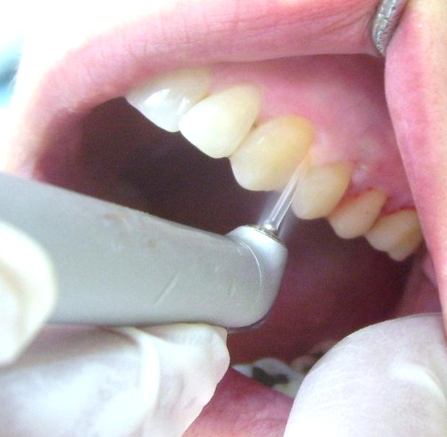
Scaling / Root Planing (SRP)/Gingival Curetage - Using Hand Instruments and Laser Assisted Pocked Debridement
In the study we used LiteTouch Er:YAG laser with direct delivery system
CLINICAL APPLICATIONS FOR LOW-ENERGY SETUPS (50MJ- 100MJ).
Chisel tip length 17 mm - H/T, 100 mJ , 15 Hz
Energy density about 256 mJ/mm²
Power density about 3.85 watt/mm²
Pulse width about 170 micro sec
Conical tip 0.4 x 17 mm - S/T , 50 mJ, 30 Hz
Energy density about 178 mJ/ mm²
Power density 5.35 watt/ mm²
Pulse width about 290 micro sec
Notes:
Relaxation time is more than 99% of the pulse. The Er:YAG laser has been shown to have similar root debridement results to an ultrasonic scaler (7,42,43 кои се ги имам ви тема Тирана).

Slide 9
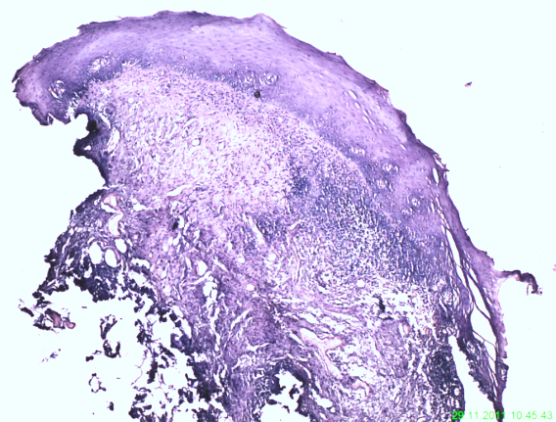
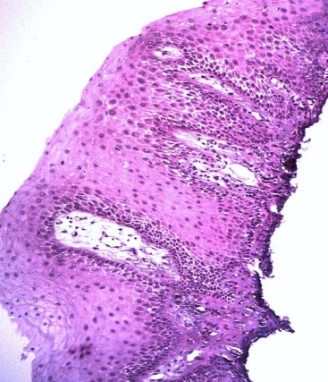
Tab.3
3. HAND INSTRUMENTS TREATED GROUP VERSUS LASER TREATED GROUP AFTER 24h / T-tests;
Grouping: Contr. vs. Examin.
Group 1: Contr.
Group 2: Examine.
Tab. | Mean Contr. | Mean Examin. | t-value | df | p | Std.Dev. Contr. | Std.Dev. Examin. | F-ratio | p
Myelo/24. | 108.1333 | 56.62500 | 10.84048 | 21 | 0.000000 | 10.48037 | 11.56272 | 1.21721 | 0.711734
CD68/24 | 29.6000 | 22.25000 | 3.46462 | 21 | 0.002318 | 4.22239 | 5.89794 | 1.95112 | 0.272022
CD34/24 | 13.5333 | 7.62500 | 6.84596 | 21 | 0.000001 | 2.35635 | 0.74402 | 10.03011 | 0.005043
Vimen/24 | 76.9333 | 53.37500 | 5.10335 | 21 | 0.000047 | 10.76016 | 10.09862 | 1.13531 | 0.909237
Marked in red are significant differences ;
Group 1: Contr.
Group 2: Examine/Laser

Slide 10
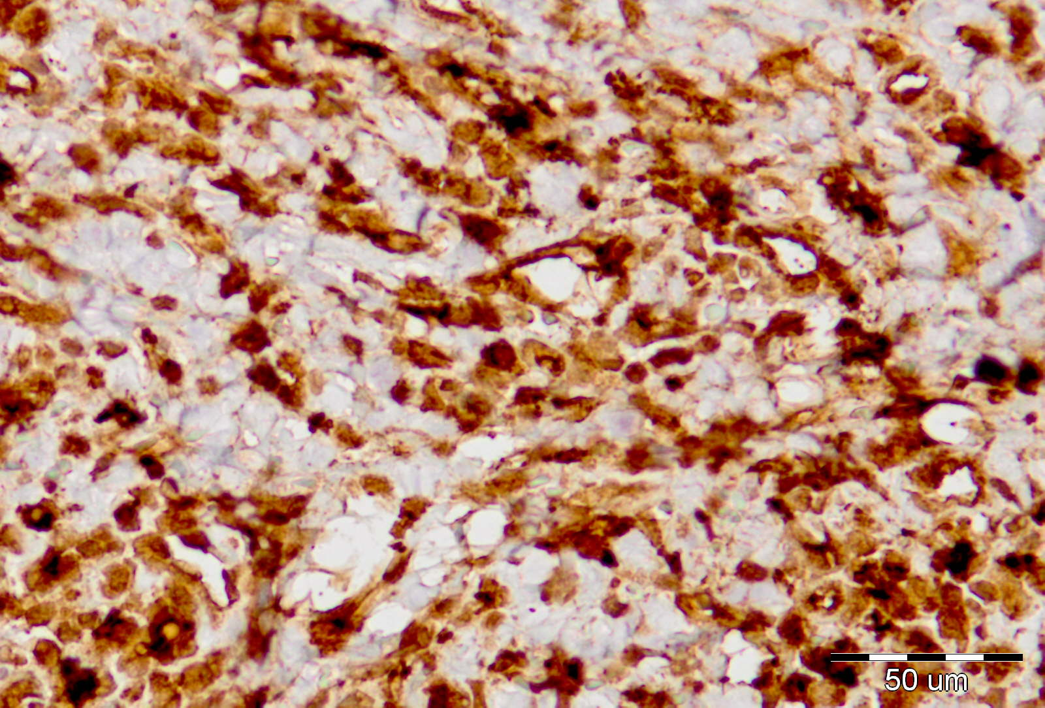
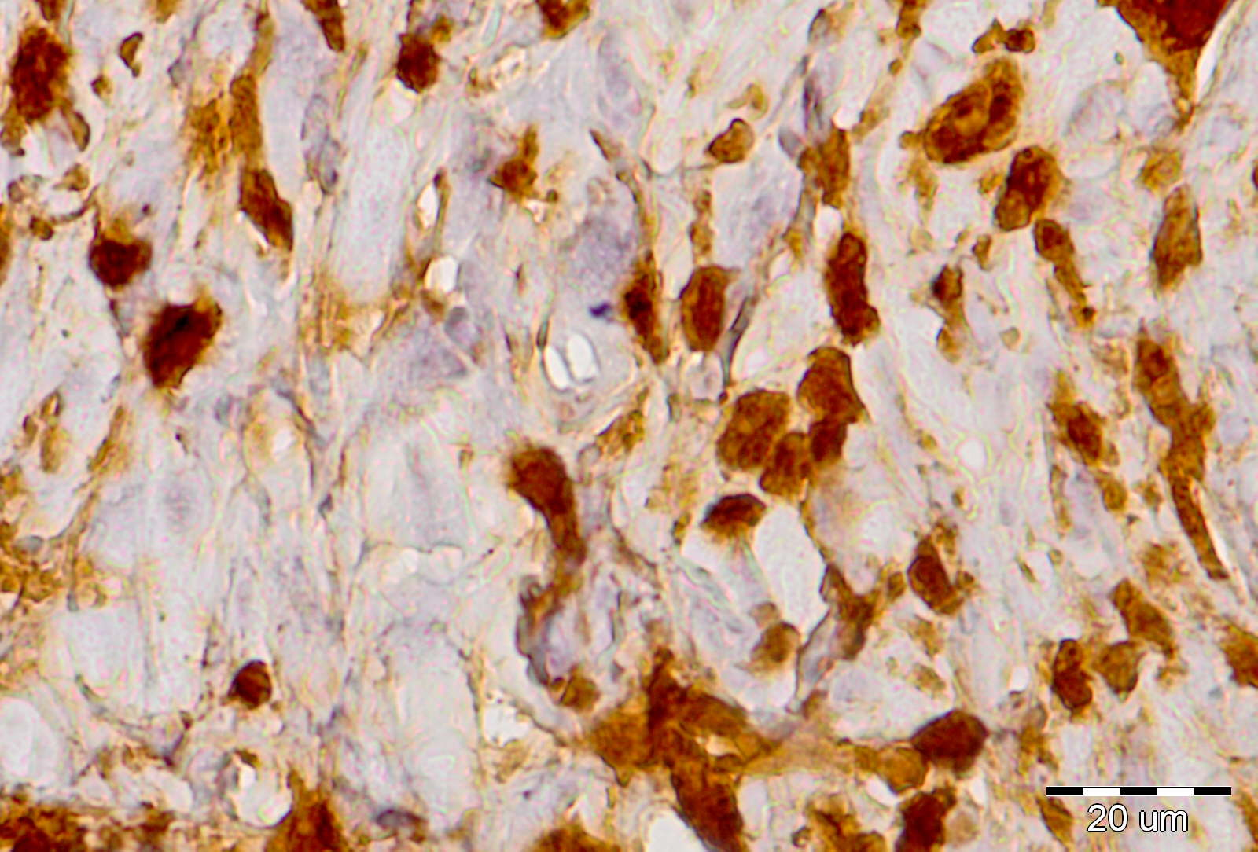
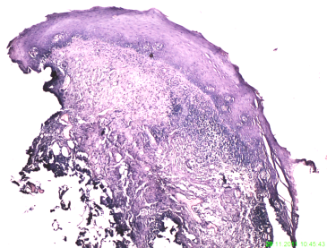

Tab.4a
 | Mean Conntr. | Mean Examin. | t-value | df | p | Std.Dev. Contr. | Std.Dev. Examin | F-ratio | p
Myelo/72 Ne | 140.9333 | 93.8750 | 6.07525 | 21 | 0.000005 | 13.55658 | 23.90719 | 3.10997 | 0.067294
Contr.
Examine/Laser

Slide 11
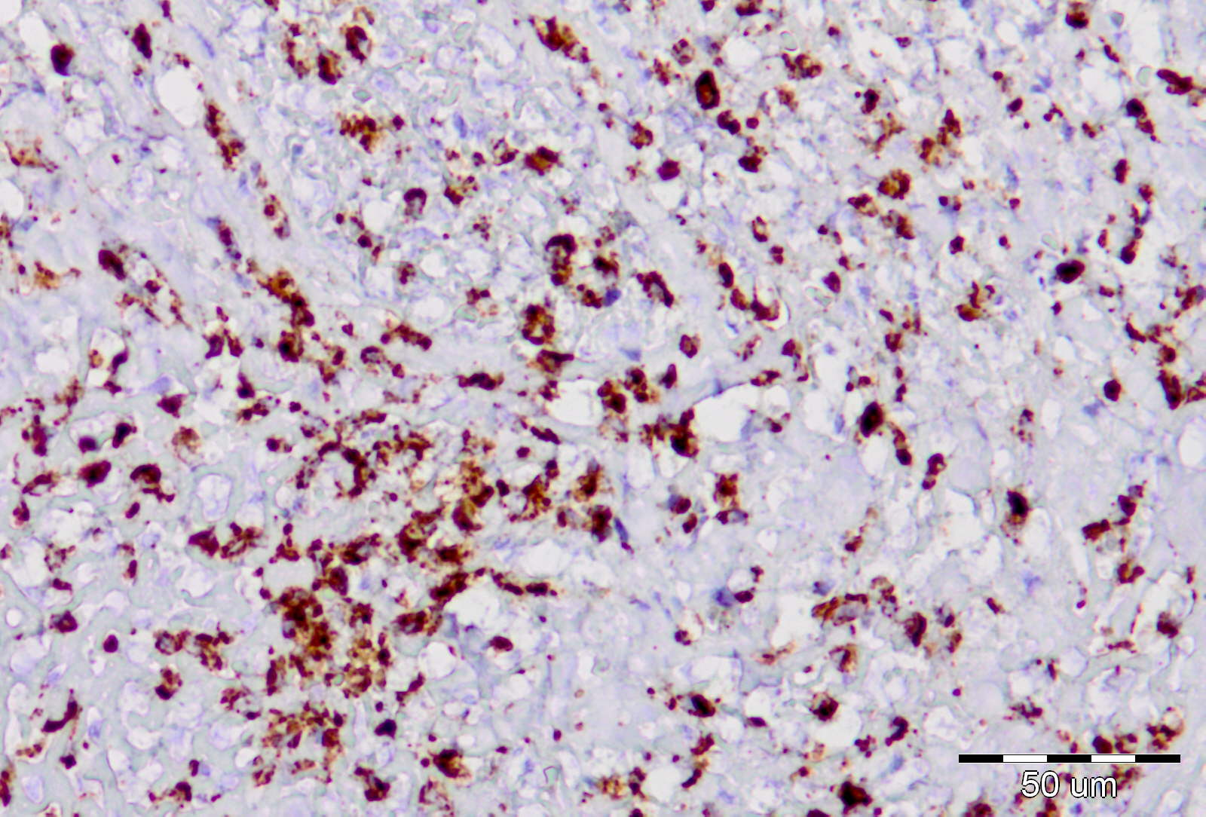
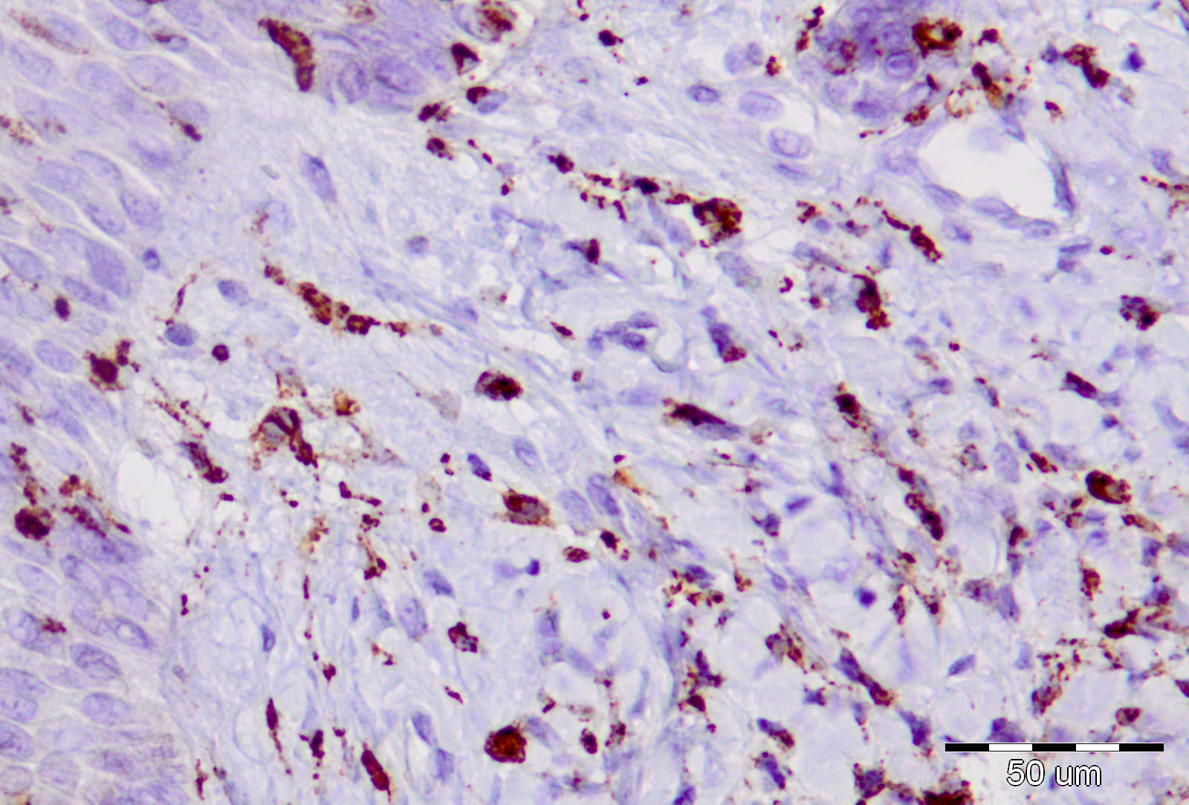
Tab.4b
 | Mean Conntr. | Mean Examin. | t-value | df | p | Std.Dev. Contr. | Std.Dev. Examin | F-ratio | p
CD68/72 Macrof. | 123.8667 | 65.7500 | 8.84964 | 21 | 0.000000 | 17.27453 | 8.84388 | 3.81528 | 0.081954
t-test = 8,84
df=21
p<0,001
Contr.
Examine/Laser

Slide 12
CONCLUSIONS
WITHIN THE LIMITS OF THIS STUDY THE DATA REPORTED HERE SHOWN THAT EARLY PHASE OF WOUND HEALING FOLLOWING LOW ENERGY ER: YAG LASER ASSISTED POCKED DEBRIDEMENT IS CHARACTERIZED WITH
RELATIVELY LOW POSTOPERATIVE CELLULAR INFLAMMATORY RESPONSE ATTRIBUTED TO THE MINIMALLY INVASIVE INSTRUMENTATION OF POCKET WITHOUT LEADING TO MAJOR TRAUMA OF THE SOFT TISSUES, ON ONE HAND,
AND THE VERY NARROW ZONE OF THERMAL DISRUPTION, ON THE OTHER, FOLLOWED BY INCREASE VALUES OF VASCULAR-ASSOCIATED CD4 POSITIVE TISSUE CELLS.
FURTHER RESEARCH IS STILL REQUIRED BEFORE OUR UNDERSTANDING OF THE MECHANISM OF WOUND HEALING, AFTER LOW–ENERGY ER:YAG LASER IRRADIATION IS COMPLETE.

